Slide 1
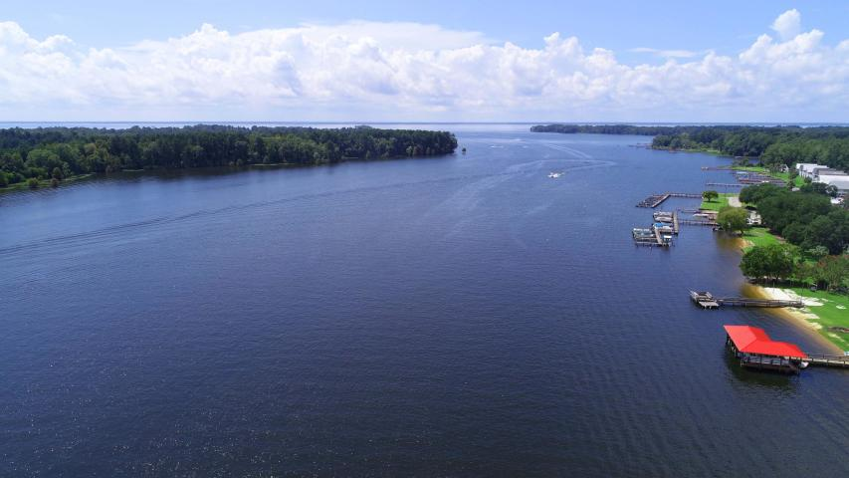
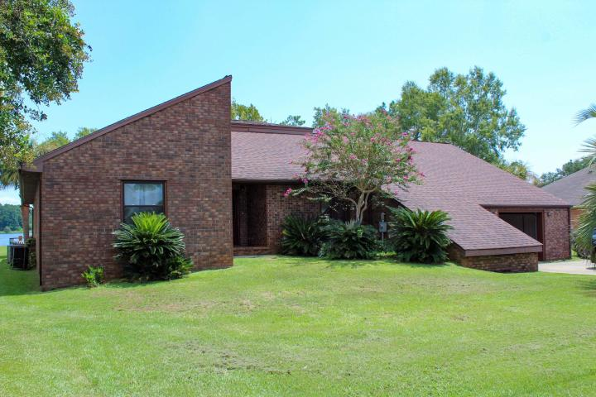
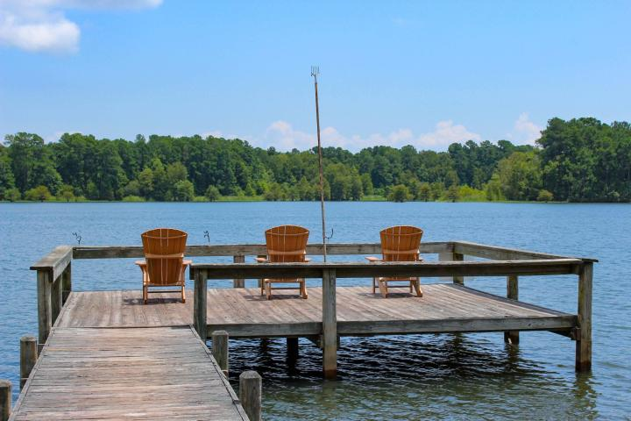
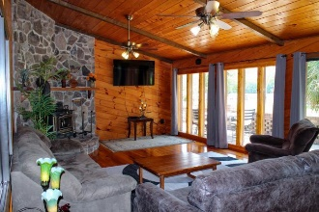
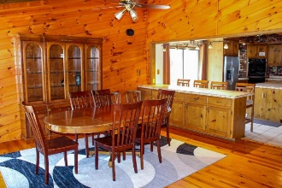
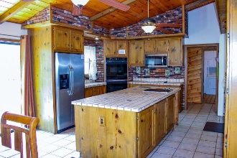
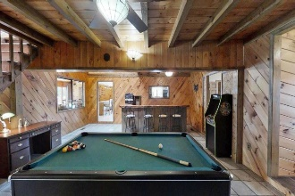
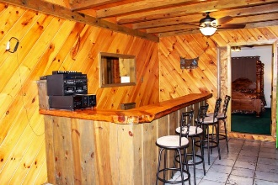
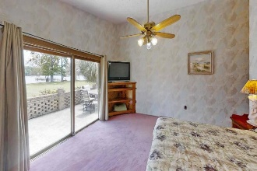
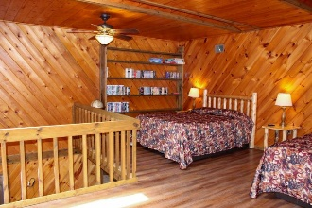
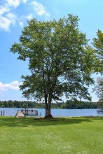
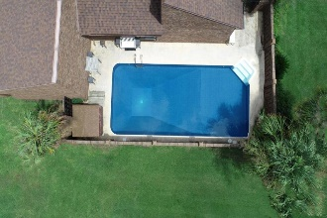


Enjoy The Lake Life With This
Deeded Waterfront Home On Lake Marion
1174 Ralph Bell Road
Summerton, SC 29148 ~ MLS# 20022018 ~ $540,000
Sitting just off i95 on exit 108 allowing short drives to Charleston, Florence and Columbia. Only 2.5 hours from Charlotte and the foot hills of SC. Jump on the boat and float to Charleston for the weekend. Have your own private oasis here with the pool, large green space, sandy beach and dock. Inside has beautiful woodwork on floors, walls and ceilings. This 4 bedroom with a 296 sqft loft home will easily have enough room for your large family. Bring the lake Toys and Boat! Home is currently a vacation rental with proven rental history. Home only be seen during turn over days.
Take a virtual tour: https://my.matterport.com/show/?m=qZuvV7XULZK
Lake Homes Realty, LLC
Elloree, SC 29047
www.SCLakeLife.com
Kristie Anderson
(803) 387-9459
kristie@sclakelife.com

