Slide 1
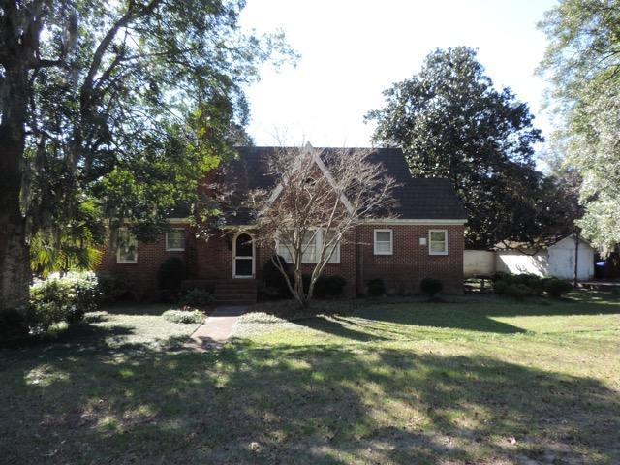
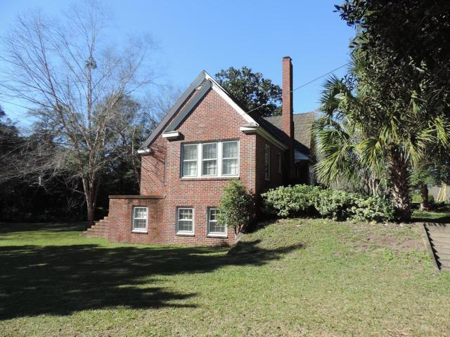
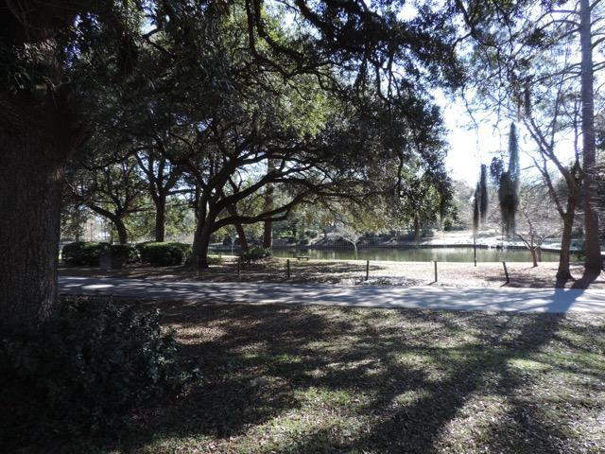
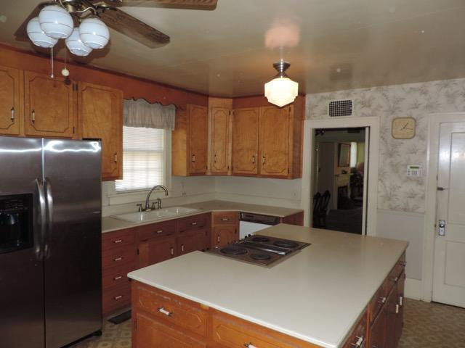
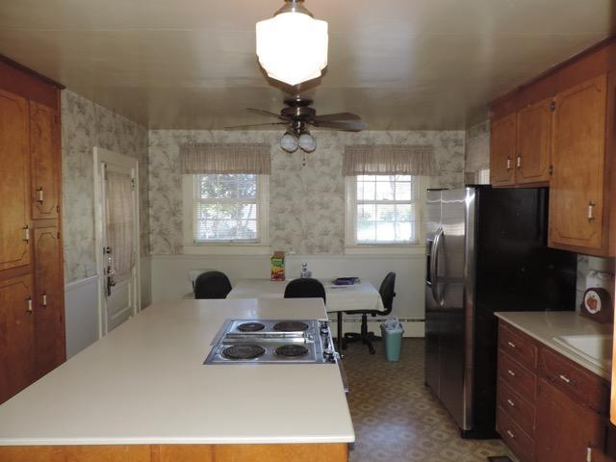


Amazing Location in Park Circle
1175 Buist Avenue
Park Circle · North Charleston MLS# 17001481 · $415,000
Michael Dew
O (843) 870-7000
M (843) 870-7000
michaeledew@gmail.com
www.michaeldewrealestate.com
Fabulous property in highly sought after Park Circle.
Stately 3 bedroom brick home on over sized, corner lot with mature landscaping. Eat in kitchen has an island. Great formal dining room, living room and study. Walk out basement to back yard with view of the lake. Great curb appeal on a large lot in a great location! Inside needs remodeling.
AgentOwned Charleston Group
902 Savannah Hwy
Charleston, SC 29407
Real Estate ● Mortgage Insurance ● Business Brokerage

