Slide 1

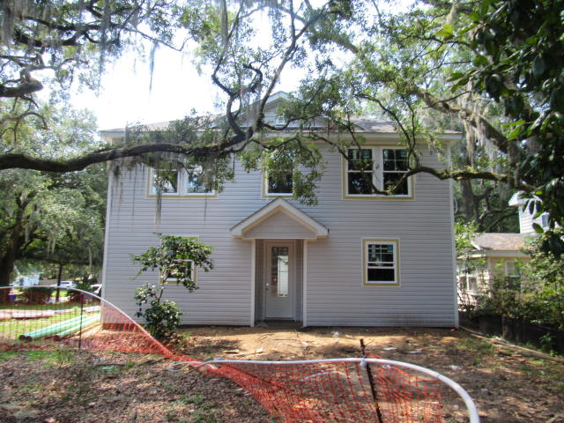
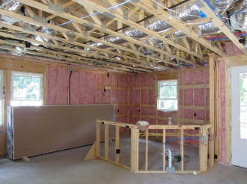
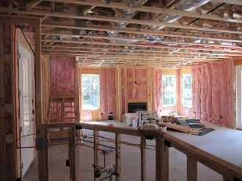
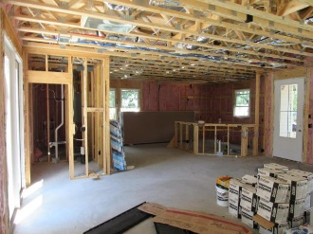
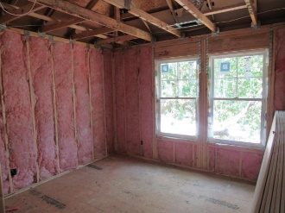
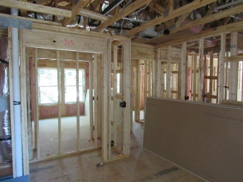
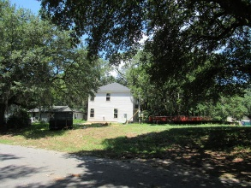
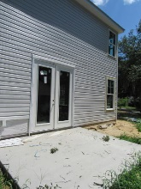
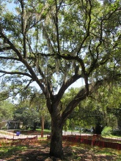
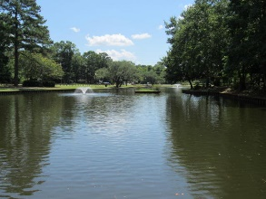
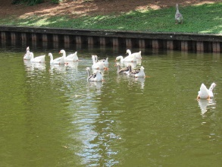
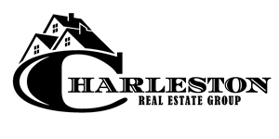

New Construction In Park Circle
1175 Leesville Street
Park Circle
North Charleston, SC 29405
MLS# 16018785
$315,000
1,790 SF
3 Bedrooms :: 2½ Bath
UNDER CONSTRUCTION in Park Circle!! How would you like to live in a BRAND-NEW three bed, two and a half bath home in Park Circle? This is a great location. Enjoy your home on this high lot, nestled amongst the Grand Trees! It's just a short walk to the "Circle", all of the popular shops, restaurants, and night-life! The house is estimated for a September completion. Call us for more information on finishes and builder selections! Builder to provide "2-10 Builder Warranty".
Eric Draper
(843) 442-7118
eric.draper@gmail.com
www.charlestonrealestategroup.com
Charleston Real Estate Group | 792 Folly Rd. C1 | Charleston, SC 29412

