Slide 1
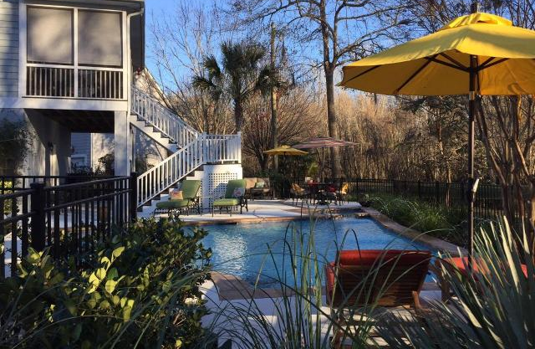
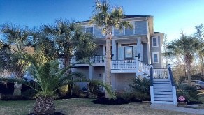
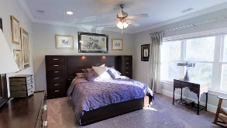
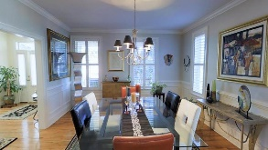
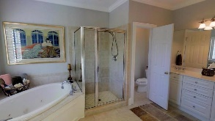
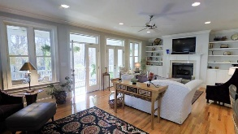
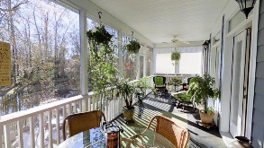
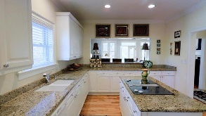
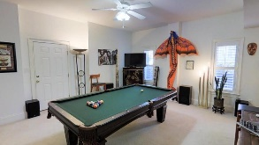

1175 Quick Rabbit Loop
Hunt Club | Charleston, SC 29414 | MLS# 16002797 |$450,000
Outdoor Oasis
GORGEOUS custom built home with spectacular showcase in-ground pool including 4 bedrooms, 2 full baths, 2 half baths and over 3000 sqft living area. This beautiful and immaculate home shows like a model! Elevated construction, a grand entry, handsome hardwood floors, plantation shutters, an abundance of natural light and loads of storage. The oversized great room has a gas fireplace, built-in shelves, and two sets of double French doors leading onto the large screened-in porch that overlooks the resort style pool and pond. The home boasts an open gourmet kitchen and includes an island, custom built cabinets, and granite countertops. The kitchen is a chef's delight that is perfect for entertaining! There is a separate flex room/dining room with wainscoting and plenty of windows that lead directly to the kitchen. The master bedroom is also located on the third level and has a walk-in closet, large window with stunning views , and a spa-like master bath with a garden tub, separate shower, dual sinks, tile floor, separate commode, and 2 linen closets. The third floor offers 2 additional bedrooms, a nice full bath, a spacious laundry room, and an additional walk-in closet. The first level has a large entertaining area that could be an office, media room, or a fourth bedroom by adding a closet and has a half bath, private patio and separate entrance making it perfect for a mother-in-law or teen suite. The fenced back yard, pool and spa with wi-fi, and screened-in porch with a view of the pond is perfect for entertaining or relaxing with a cup of coffee in the morning or a good book in the afternoon. Hunt Club is a wonderfully landscaped community with a play park and community pool! The neighborhood is close to local shopping and grocery stores and is a short drive to downtown Charleston with 5-star restaurants, world class shopping and iconic history as well as a short drive to the beaches, the airport, Boeing and Daniel Island. Come take a look because you will not find another home that offers as much as this one: a chef's delight, entertainer's dream, breathtaking views, private resort-style pool and perfect family home!
Stan Huff
843-670-2835
stan.huff@agentowned.com
Jill Marcacci
843-297-5590
jill@agentowned.com
www.agentownedrealty.com
AgentOwned Realty Co. Preferred Group, Inc. | 824 Johnnie Dodds Blvd | Mt Pleasant, SC 29464

