Slide 1
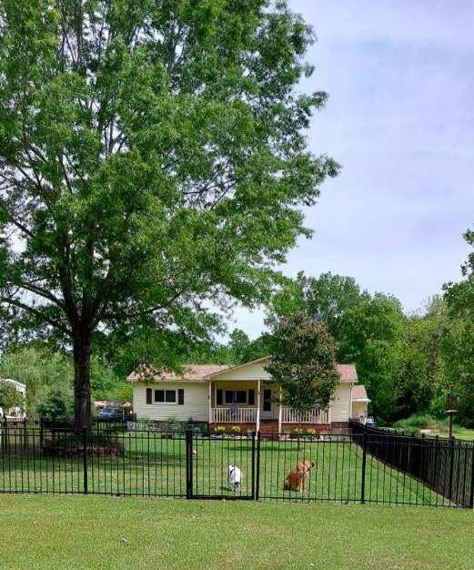
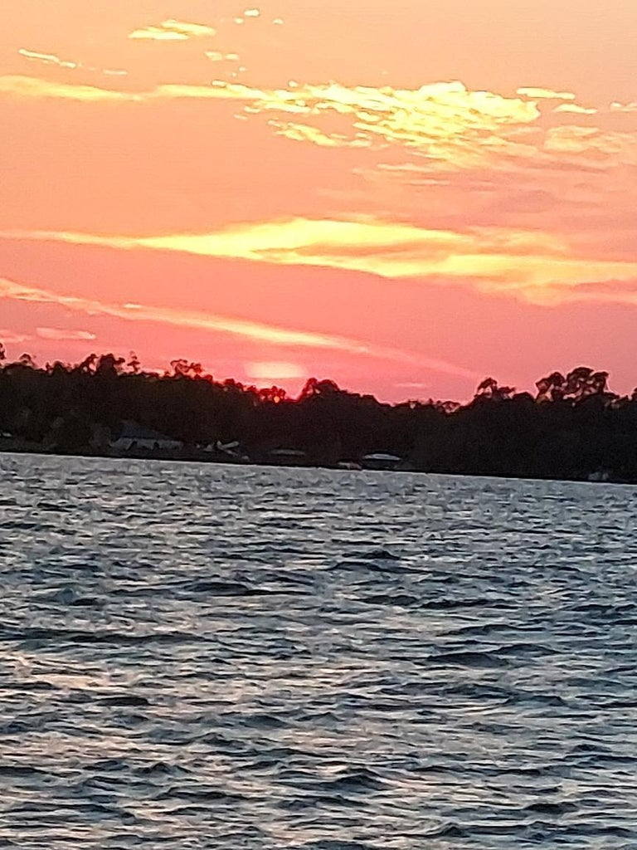
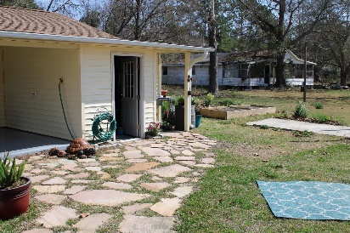
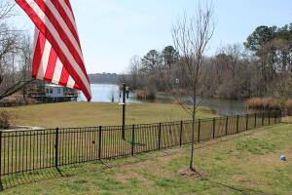
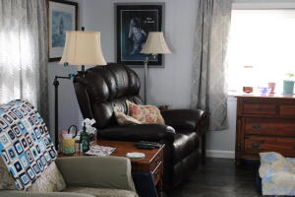
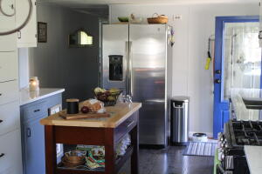
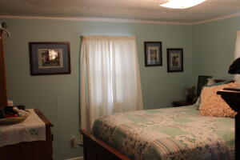
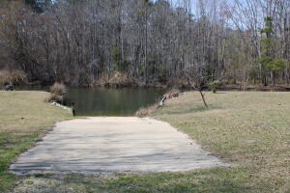
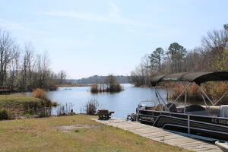


1175 Falcon Lane
Summerton, SC 29148 | MLS# 23008616 | $325,000
Come Enjoy the Lake Marion Life
Welcome to Lake Marion! Nestled on Potato Creek across from the Santee Wildlife Refuge, you will find this quaint 3 bedroom, 1 bath home with 2 covered-lake-view porches. Home sits on a deeded ½ acre lot with approximately 75 ft of waterfront and a shared boat slip. Home is being sold AS-IS, but not to worry - this home is MOVE-IN ready with an open living area, eat-in kitchen with all new stainless steel appliances, all of which convey with the property. Some features include: quartz countertops in a tastefully renovated kitchen and bath, Caribbean Maple LVP throughout, new energy efficient windows and doors, new light fixtures, new water pump & water heater. Enjoy the beautiful landscape and natural surroundings with year-round boating, fishing, skiing, kayaking or just chilling under the mature shade trees. LAST BUT NOT LEAST. . . . there is a 66' X 24' shop/garage with three (3) bays, all of which have new garage doors and electric openers. This property is a must see.
Kelly Rozier
(843) 209-3129
kellywrozier@gmail.com
Brand Name Real Estate
4 Carriage Lane Suite 106
Charleston, SC 29407

