Slide 1
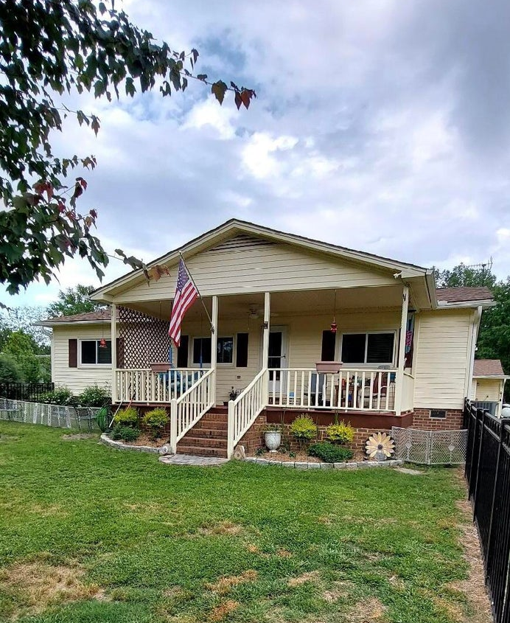
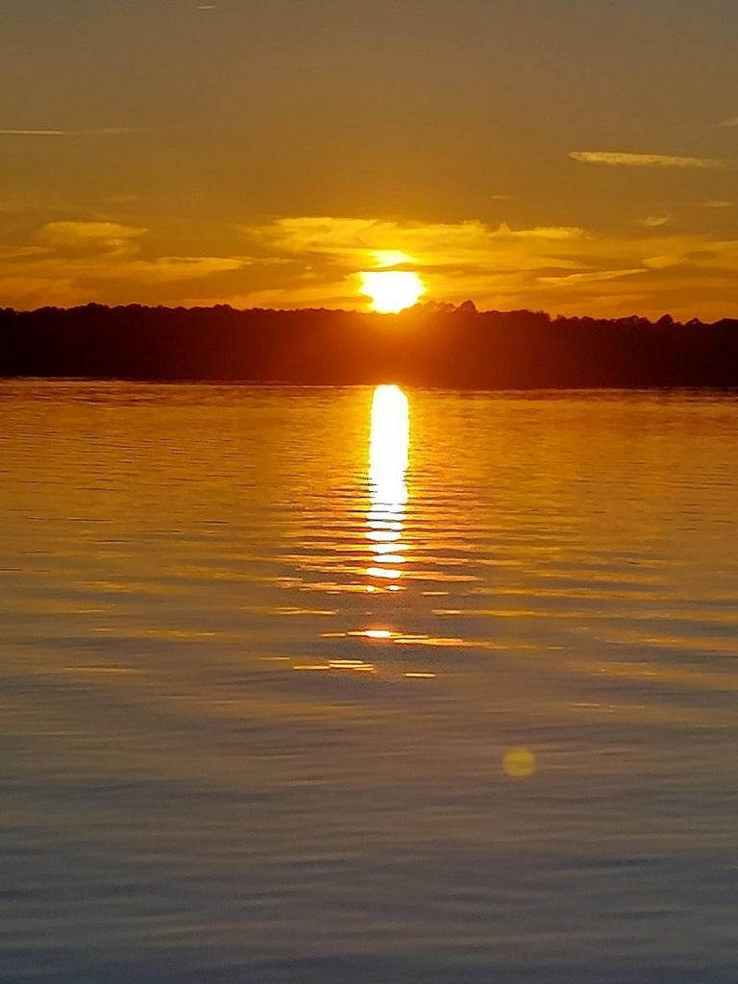
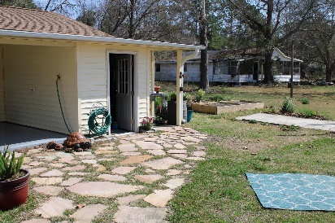
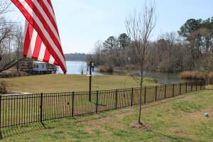
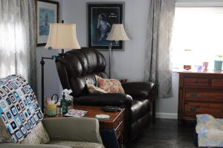
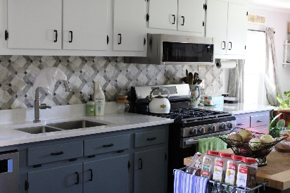
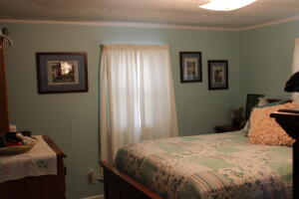
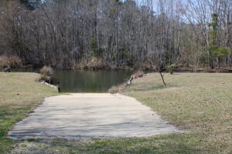
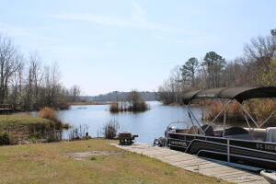


1175 Falcon Lane
Summerton, SC 29148 | MLS# 23008616 | $299,000
Enjoy the Lake Marion Life
Welcome to Lake Marion! This home would make an amazing primary or short term vacation home! Nestled on Potato Creek across from the Santee Wildlife Refuge, you will find this quaint 3 bedroom, 1 bath home with 2 covered-lake-view porches. Home sits on a deeded ½ acre lot with approximately 75 ft of waterfront and a shared boat slip. Home is being sold AS-IS, but not to worry - this home is MOVE-IN ready with an open living area, eat-in kitchen with all new stainless steel appliances, all of which convey with the property. Some features include: quartz countertops in a tastefully renovated kitchen and bath, Caribbean Maple LVP throughout, new energy efficient windows and doors, new light fixtures, new water pump & water heater. Schedule a showing today to see this gem in person. Enjoy the beautiful landscape and natural surroundings with year-round boating, fishing, skiing, kayaking or just chilling under the mature shade trees. LAST BUT NOT LEAST. . . . there is a 66' X 24' shop/garage with three (3) bays, all of which have new garage doors and electric openers.This property is a must see.
Kelly Rozier
(843) 209-3129
kellywrozier@gmail.com
Brand Name Real Estate
4 Carriage Lane Suite 106
Charleston, SC 29407

