Slide 1
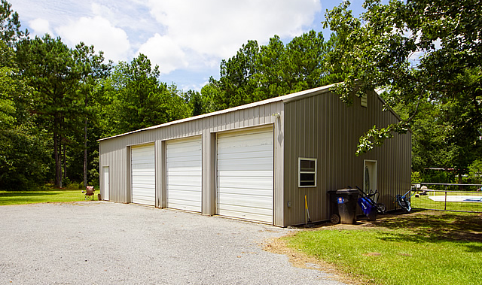
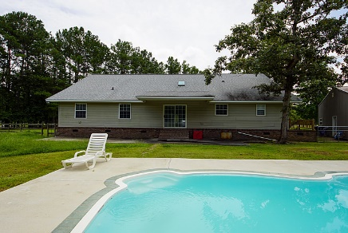
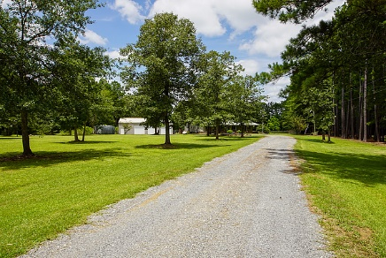
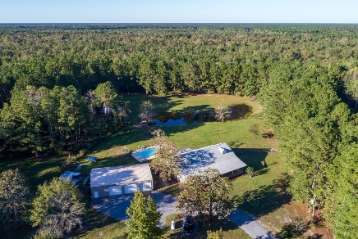


1176 Witherbee Road
Cordesville Area :: Moncks Corner, SC 29461
MLS# 19021689 :: $398,750
5 Bed :: 2/2 Bath
Back On The Market
Open House Saturday
December 7th ~ 1-3pm
Back on the market pending release of contract &
Appraised for $402,000!!!!!!!
Modern Country Living on 4.17 acres! This home has it all....full front porch, stocked pond, in ground salt water swimming pool, 4 stall barn, and a 6 car detached garage. Open modern floor plan and freshly painted. Vaulted ceiling, gas stainless stove and stainless appliances plus a tankless hot water heater.
No description will capture the beauty of the home and land!
Connie White, Broker
843-532-3356
connie@chrepros.com · conniewhiterealestate.com
Charleston Homes · 597 Old Mt. Holly Road · Suite 301 · Goose Creek, SC 29445

