Slide 1
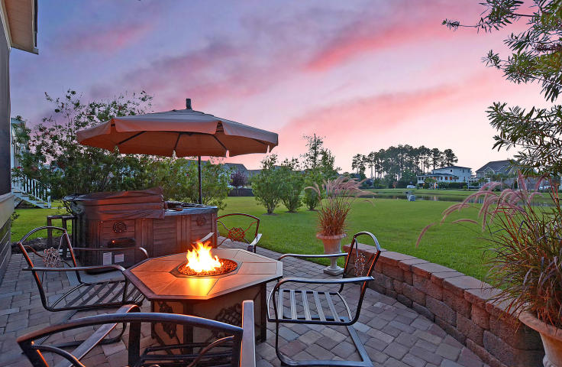
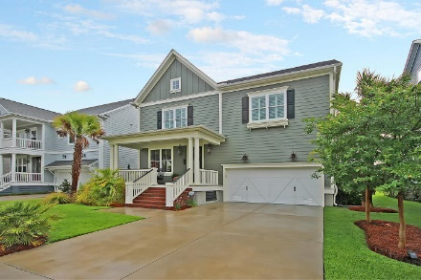
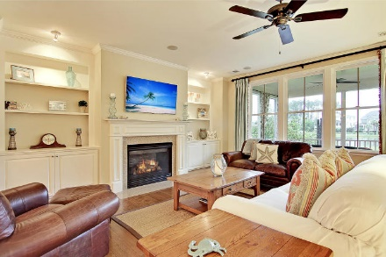
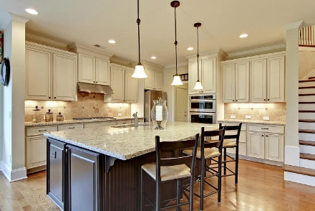
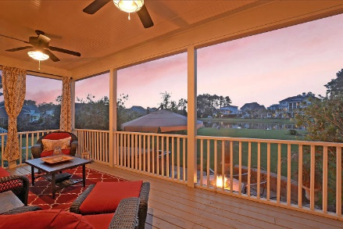
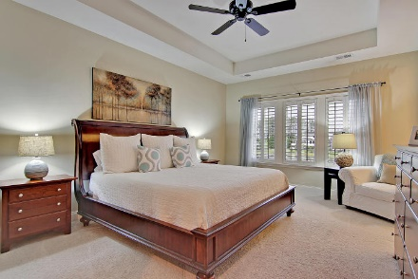
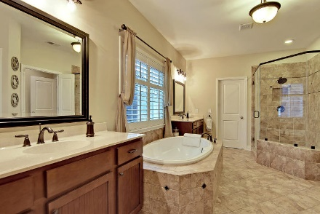
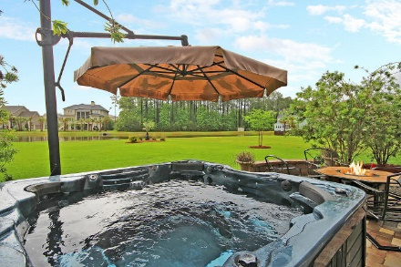
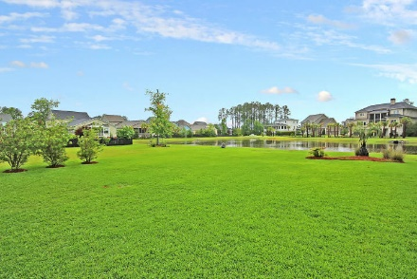
Best Lot Location And Most Upgrades
Of Homes In This Price Range In This Area
Reduced $200k!
1177 Ayers Plantation Way
Dunes West ~ Mount Pleasant, SC 29466 ~ MLS# 17011732 ~ $618,000
This pristine home on its premium pond site shows like a model and boast features to impress the most discerning of buyers. Meticulously kept, this incredible home is still covered by a builder warranty. At the heart of the home is the gourmet eat-in kitchen opening to the dining and living room with cozy fireplace. Living spaces extend onto a screened porch & brick patio where you can enjoy pond views and a hot tub that comes with the home. In addition to 3 bedrooms, full bath with dual sinks, laundry & loft area, you will love the spacious owner’s retreat with tray ceiling, sitting area, en-suite bath w/dual vanity, soaking tub, walk-in shower & 2 walk-in closets. This desirable gated community offers great amenities with a crabbing dock a short walk from home, miles of walking, biking and jogging paths, golf course, boat landing, pool and tennis courts. Close to beautiful beaches, county park, shopping and dining, and historic downtown Charleston.
Additional features include:
Inside you'll find beautiful hardwood floors, plantation shutters, central vacuum, a tankless hot water heater, speakers in the family room and screened porch, and many other unique features
Outside you'll find a brick patio, a well for irrigation, a dehumidifier under the crawl space, natural gas lanterns at the front entrance, and a mosquito mist barrier
The gorgeous eat-in kitchen includes granite countertops, a tile backsplash, lots of cabinet space, updated stainless steel appliances, a gas cooktop with vent hood, a large island with breakfast bar, and an eat-in nook
The spacious master bedroom includes tray ceilings, a sitting room, lots of natural light, 2 walk-in closets, and a gorgeous master bathroom with dual vanities, a soaking tub, a frameless walk-in shower, and tile flooring
Second floor loft / bonus room
Mud room / cubby helps keep your family organized
Half bath on first floor
Great patio with hot tub, natural gas hookup, and large backyard with tranquil pond views
Storage loft in garage
Book your showing today!
Lisa Quick lisa@mattoneillteam.com 843-452-6688

