Slide 1
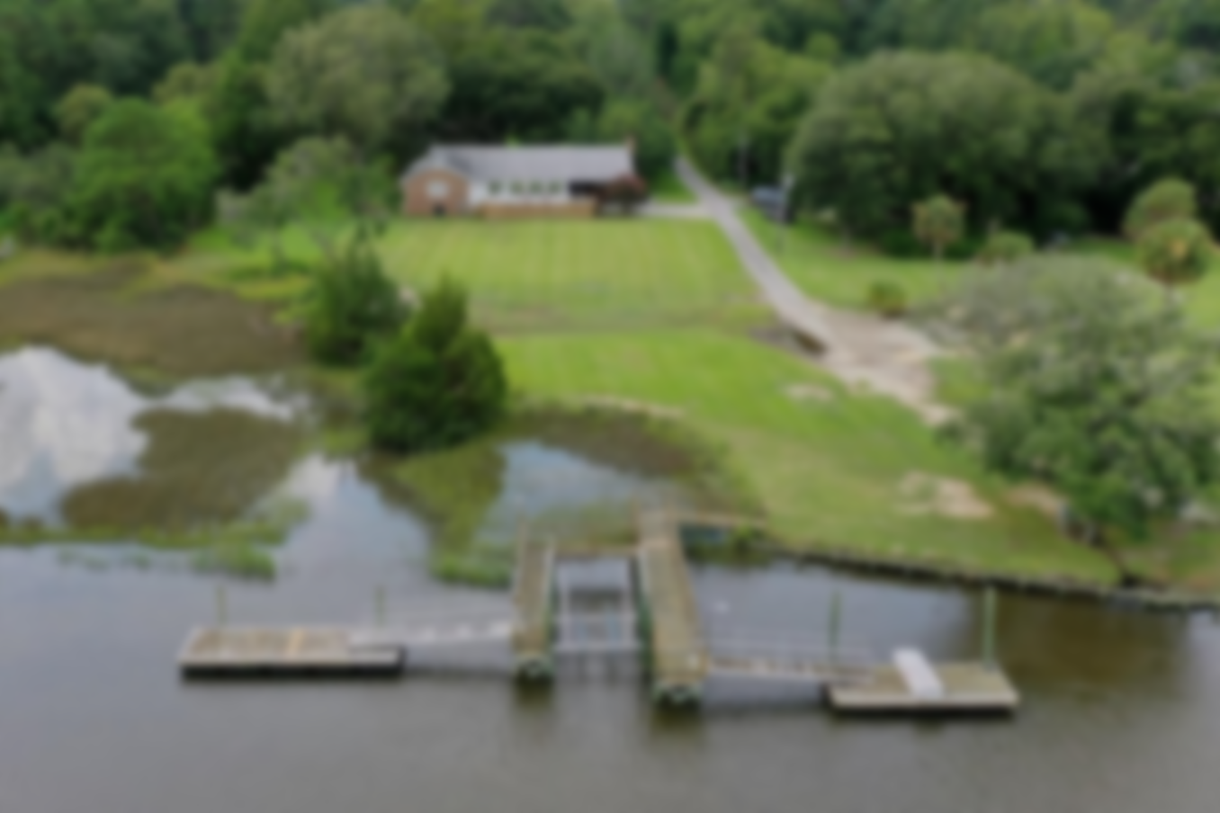
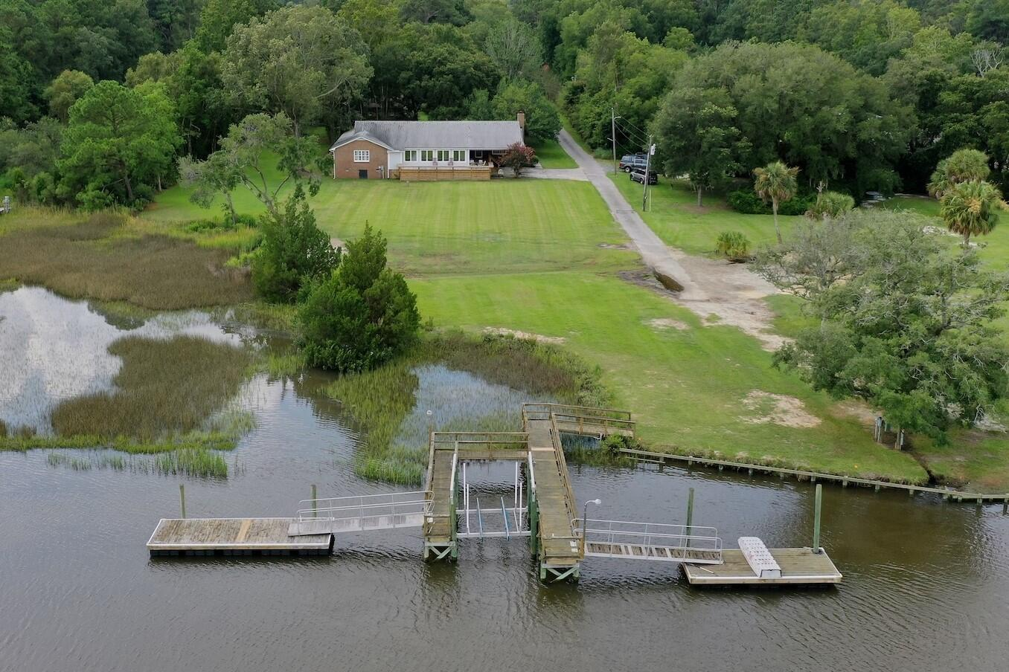
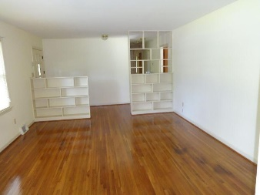
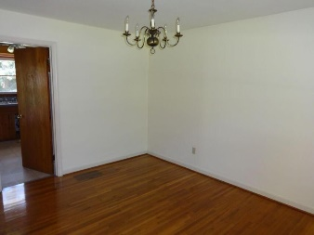
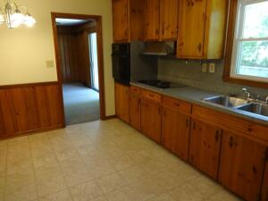
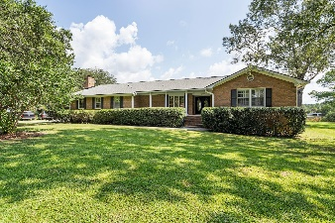
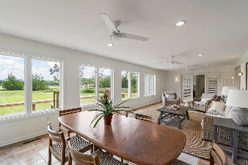
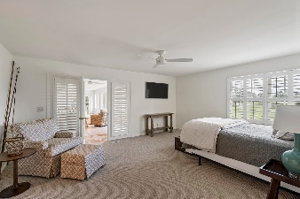
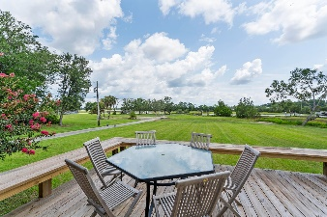
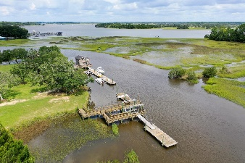

Open House Thursday 11a-2p Check Out This Beautiful New Home And Enjoy A Light Lunch
True Deepwater Retreat • No HOA
1177 River Road
Johns Island, SC 29455 | MLS# 23018846 | $2,590,000
True deep water home on sought after and protected Penny Creek just off the Stono River with no height restrictions. Your short private dock features two floating docks and a 10,000lb boat lift. Just bring your yacht and enjoy approximately 6 feet at low tide and no ICW boat traffic! The 3453 square foot home sits on just over 2 acres and features 3 spacious bedrooms 3 full baths a large living room, sunroom and game room/den with a wood burning fireplace. The grounds also feature a large two garage with room for a workshop or gym. This opportunity for true deep water close to everything is a must see and won't last long.
Take a Virtual Tour
Frank Thornhill
(843) 224-7997
frank@askfrankrealestate.com
The Boulevard Company, LLC
806 Johnnie Dodds Blvd | Suite 100 Mt Pleasant, SC 29464 www.askfrankrealestate.com

