Slide 1
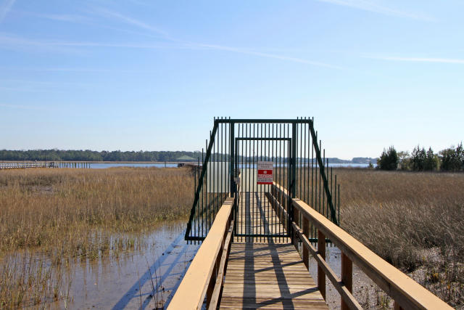
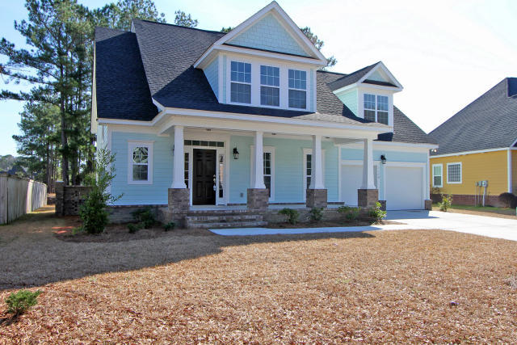
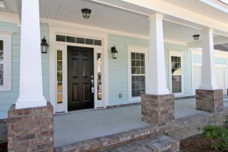
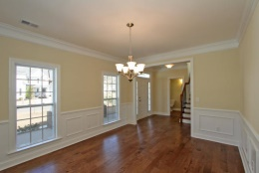
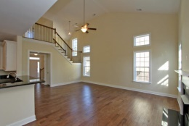
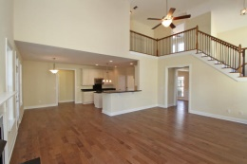
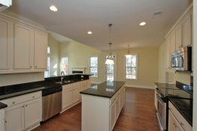
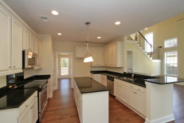
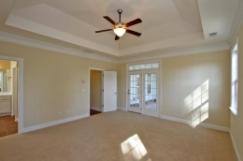


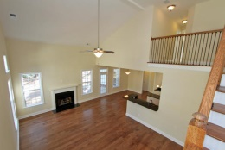
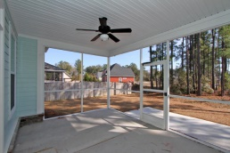
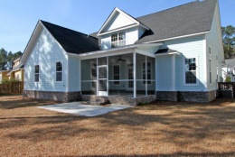


Waterfront Community with
Dock to Wando
1178 Rivers Reach Dr
Wando, SC 29492
River Reach Pointe
MLS# 15002314 - $439,000
NEW SEMI-CUSTOM CONSTRUCTION in WATERFRONT community
with neighborhood dock on Wando River!
Welcoming Southern style front porch offers tremendous curb appeal to this Coastal Cottage style home
Bright, spacious, open family room & interior
Roomy Master on main level with en-suite Bath & private access to screened porch
Entertainers' delight-open kitchen with serving bar AND large ISLAND, GRANITE & STAINLESS
Very popular
Screened porch & fireplace for all to enjoy along with crabbing, shrimping, fishing or just relaxing on your neighborhood gazebo & dock!
Please ask your agent to add this Southern Charm home to your ''must see'' list today!
Sheila Romanosky
(843) 224-0242
sromanosky@carolinaone.com

