Slide 1
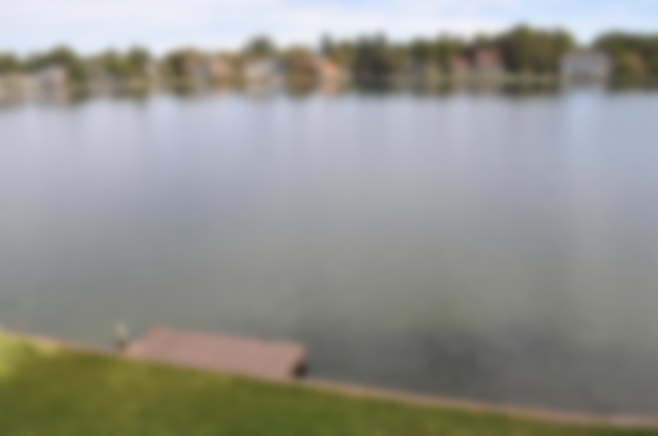
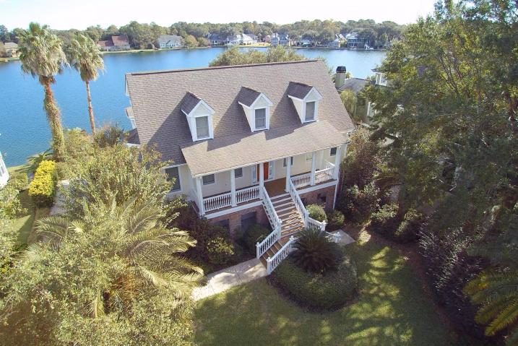
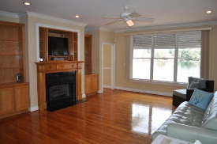
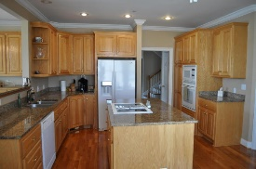
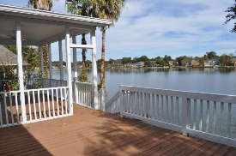
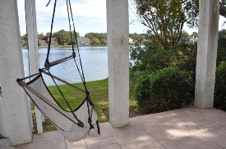
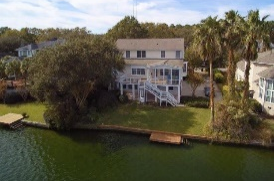
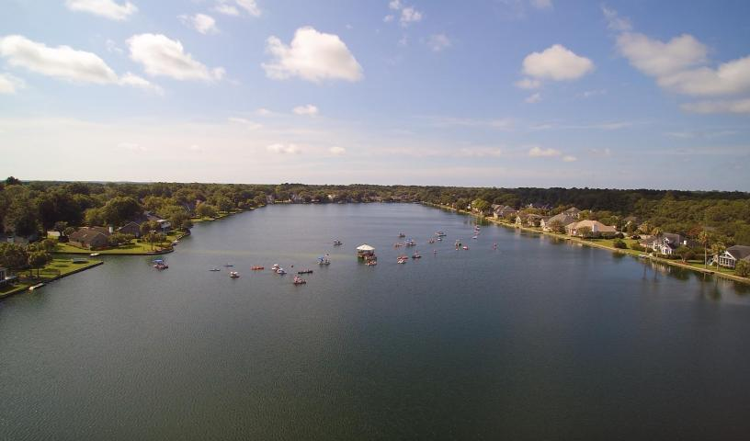



On The Big Lake in Hidden Lakes
1138 Waterfront Dr
Hidden Lakes ~ Mt Pleasant ~ MLS# 16000069 ~ $765,000
1178 Waterfront Drive
Mt Pleasant MLS# 16028875
Reduced to $869,000
WOW! Gorgeous lake views AND location right in the middle of Mount Pleasant?! This beautiful elevated home on the big lake in gorgeous Hidden Lakes gives you all the benefits of living on the water without some of the typical high costs. (X-Flood Zone) The ground floor features a 3 car garage and mother-in-law suite with living room, bedroom, full bath, and partial kitchen. On the main floor you'll find a formal dining room, powder room, large family room with gas fireplace, spacious kitchen with granite and an island, large laundry room, and huge Master Suite. Upstairs there are 3 guest rooms and a second Master/Guest Suite. Upgrades abound including metal hurricane shutters, fire suppression sprinkler system, lake-fed lawn irrigation, and more. Don't miss all neighborhood amenities!
The Boulevard Company, LLC
Mark Macpherson
mark@beachbreak-properties.com
843.367.5640 Mobile

