Slide 1
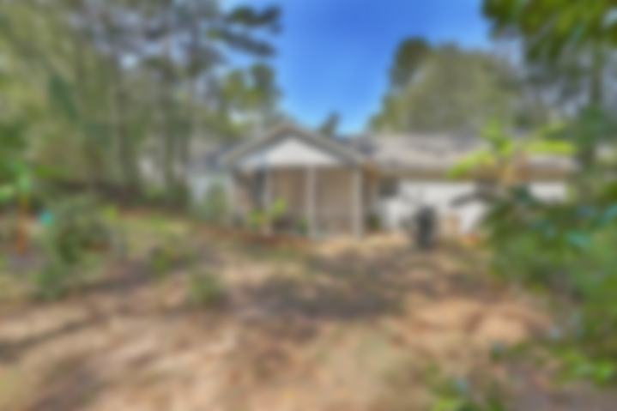
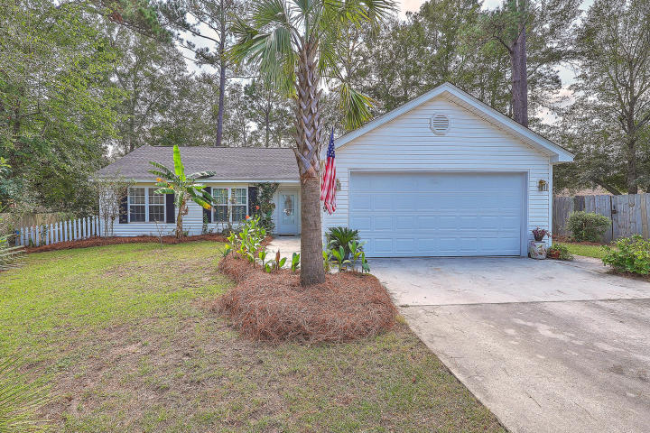
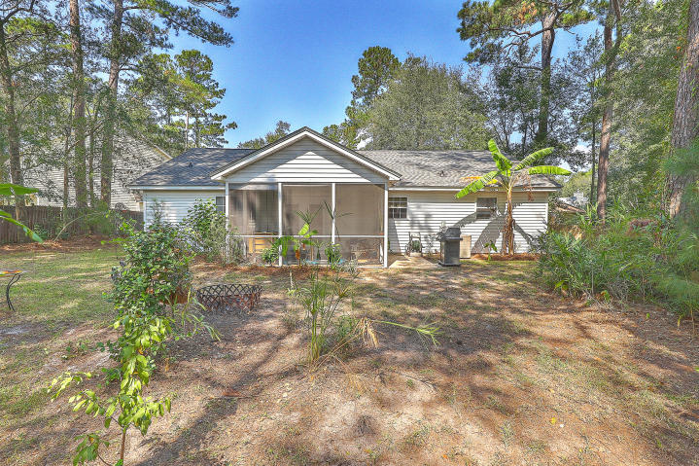
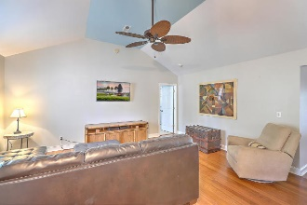
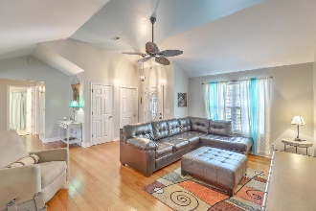
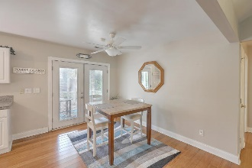
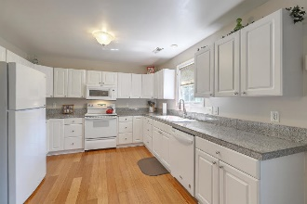
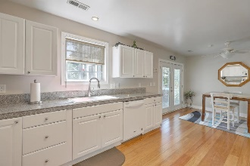
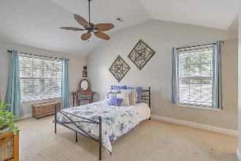
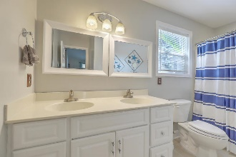
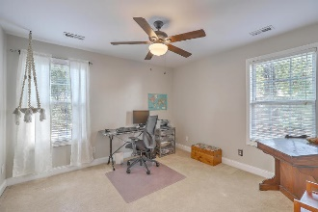
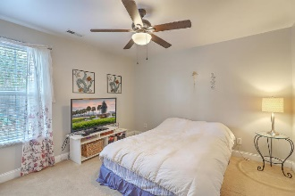
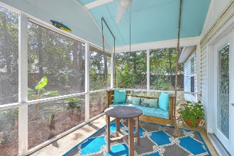


JUST LISTED!! Loaded with Features! Open House Saturday 1-3pm
1179 Equinox Court
Summertrees | Johns Island, SC 29455 | MLS# 19027861 | $269,975
Welcome home to this awesome 1-story home with open floorplan. Situated amongst a lush, private tropical backdrop with multiple fruit trees, your new home is located in a cul de sac of the popular Summertrees but with NO HOA! Features include: Bamboo floors throughout main area**Spacious kitchen with granite counters and plenty of cabinet and counter space**Large master ensuite with vaulted ceiling on one side of home with 2 guest bedrooms and guest bath on other side to allow plenty of privacy for everyone**Newer screened porch to enjoy those quiet summer nights**Perfectly sized Great Room with vaulted ceiling**Double insulation in the walls and ceilings to help with those energy bills**Not in a Flood zone & street is not in the HOA! Enjoy the quiet country feel of Johns Island with beaches, shopping and restaurants close by!
Desiree Maurer Office - (843) 416-2000
Mobile - (843) 327-9010 desiree.maurer1@gmail.com
www.yourcharlestonhousesearch.com
Keller Williams Realty 496 Bramson Ct Ste 200 Mt. Pleasant, SC 29464

