Slide 1
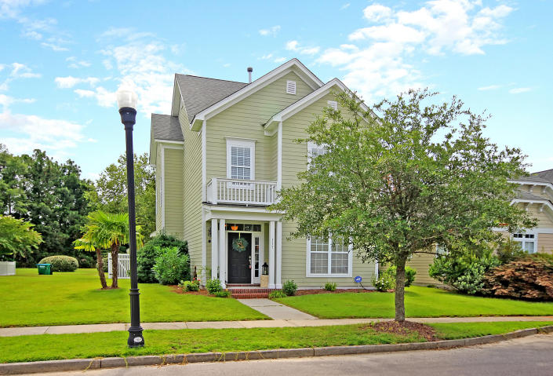
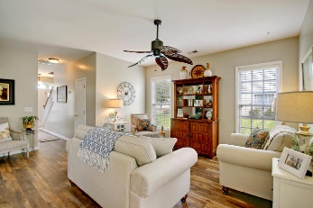
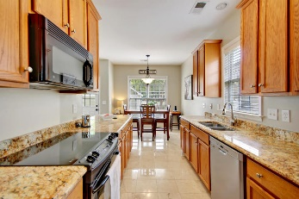
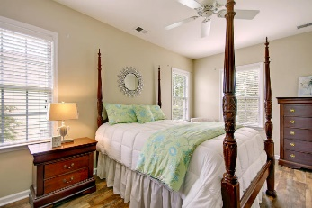
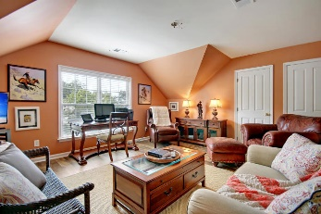
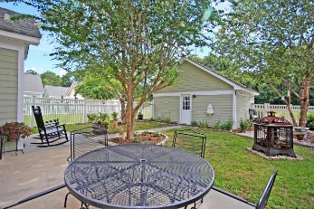


STUNNING 3 STORY HOME!
$15,000 Agent Bonus
with ratified contract by 4/15/18
117 Blue Bonnet Street
White Gables
Summerville, SC 29483
MLS# 18020266
$255,000
Masterpiece! This Stunning, fully detached 3 story home is situated on a quiet tree-lined street and is surrounded by a beautiful fenced landscaped yard. This Immaculate freshly painted White Gables home is appointed with 9ft+ ceilings, offers 4 large upstairs bedrooms featuring select vinyl wood floors including a spacious master bedroom suite with tray-ceilings, Garden tub, and a huge walk-in closet. The main floor includes gorgeous select vinyl wood flooring in the charming formal dining room and large family room. The exquisite Kitchen spotlights marble floors, granite counter tops, stainless steel appliances, an amazing pantry and a fantastic eat-in kitchen. The 3rd floor is technically the 4th bedroom but could be used as a bonus room, playroom, or man cave!
Ginger Sanders
(843) 822-4618
ginger.sanders.remax@gmail.com
RE/MAX Pro Realty, 9209 University Blvd, Charleston, SC 29406

