Slide 1
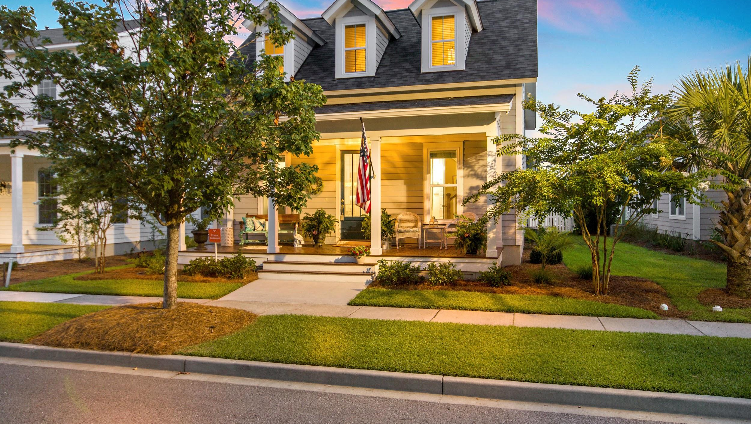
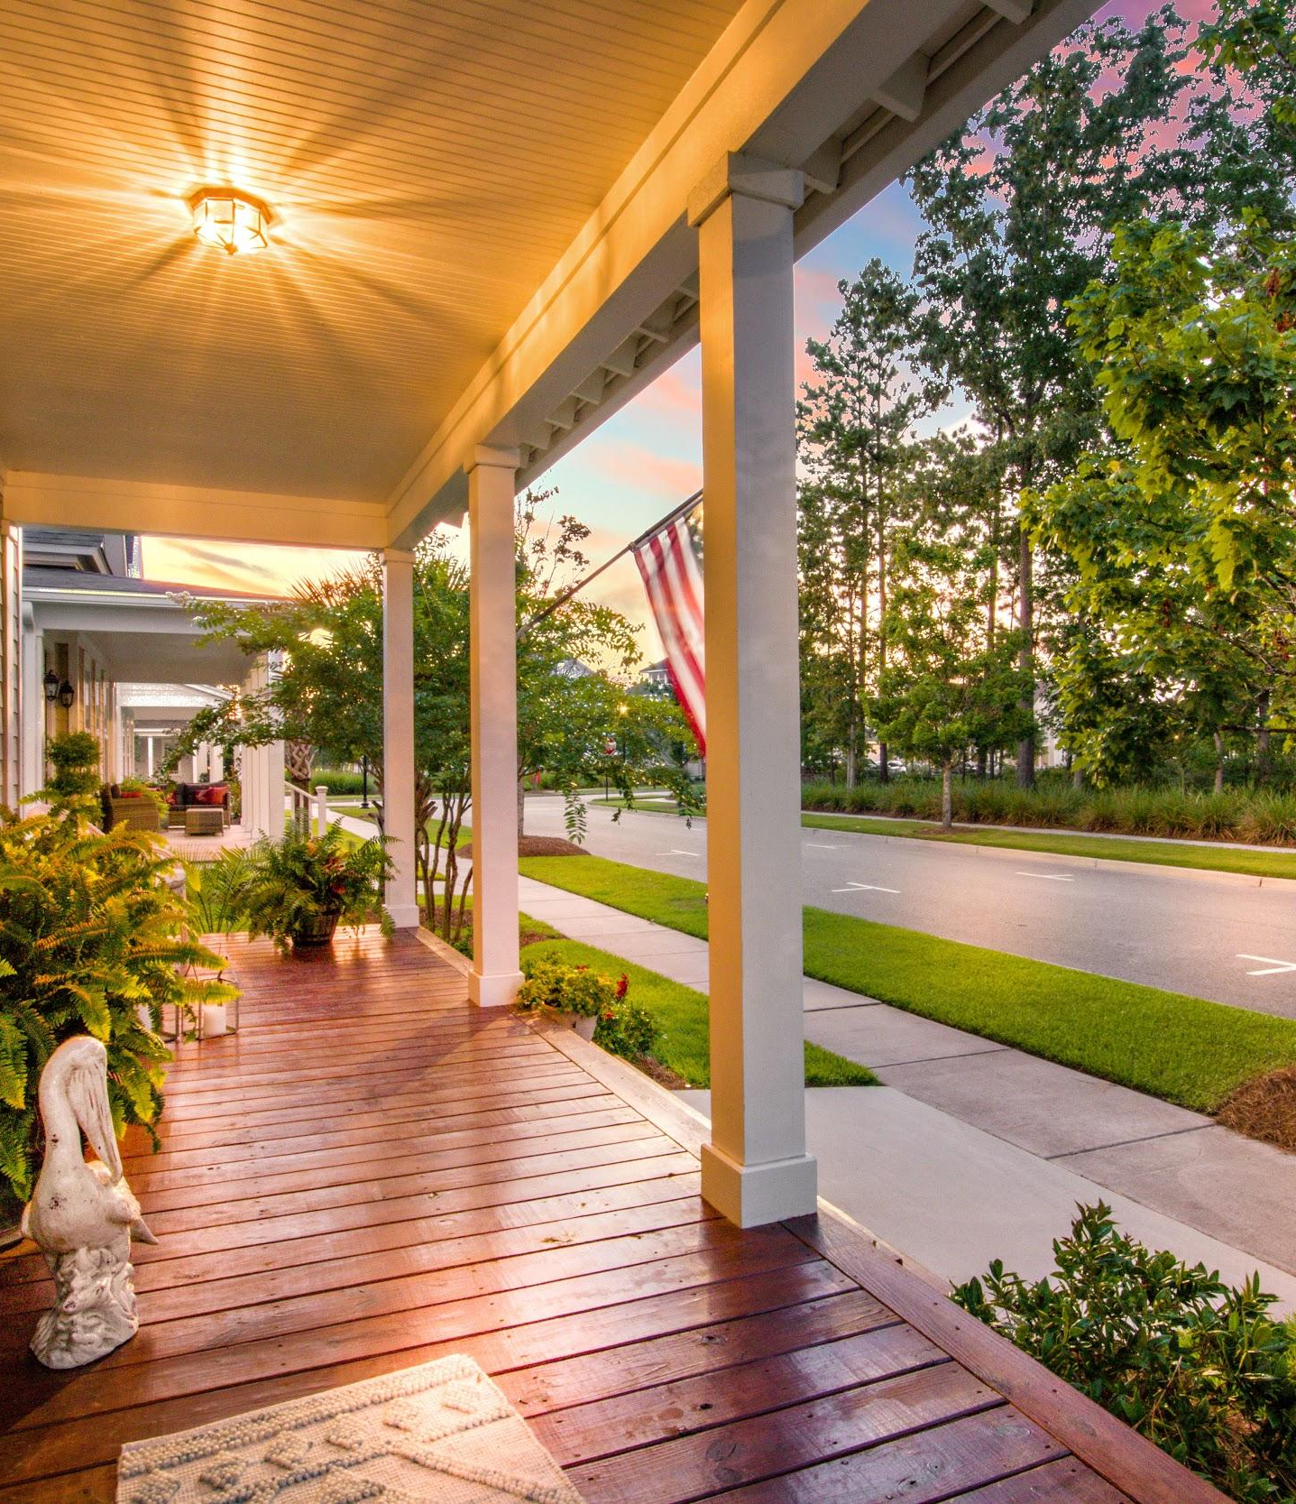
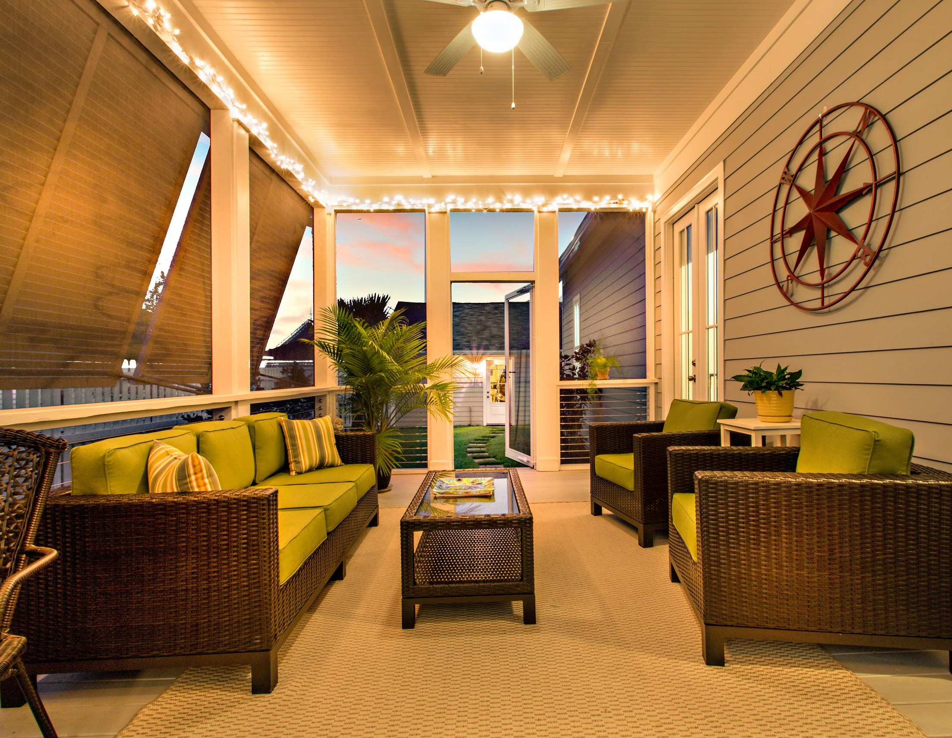


OPEN HOUSE
August 1st 2019 1pm til 3pm
117 Canopy Lane
Summers Corner
117 Canopy Lane
$364,500
3 Beds
2.5 Baths
1,824 SqFt
Join us for Lunch catered by Relish and check out this amazing home!
Lisa Horan
REALTORⓇ
843-501-8856
Lisa@AgentOwned.com
www.lisarocksrealestate.com
James Cook
REALTORⓇ
843-1754-7558
james.cook@AgentOwned.com
www.lowcountryluxurygroup.com
Notes:
DO NOT ALTER LAYOUT. YOUR FILE WILL BE RETURNED OR EDITED IF IT IS RECEIVED ALTERED.

