Slide 1
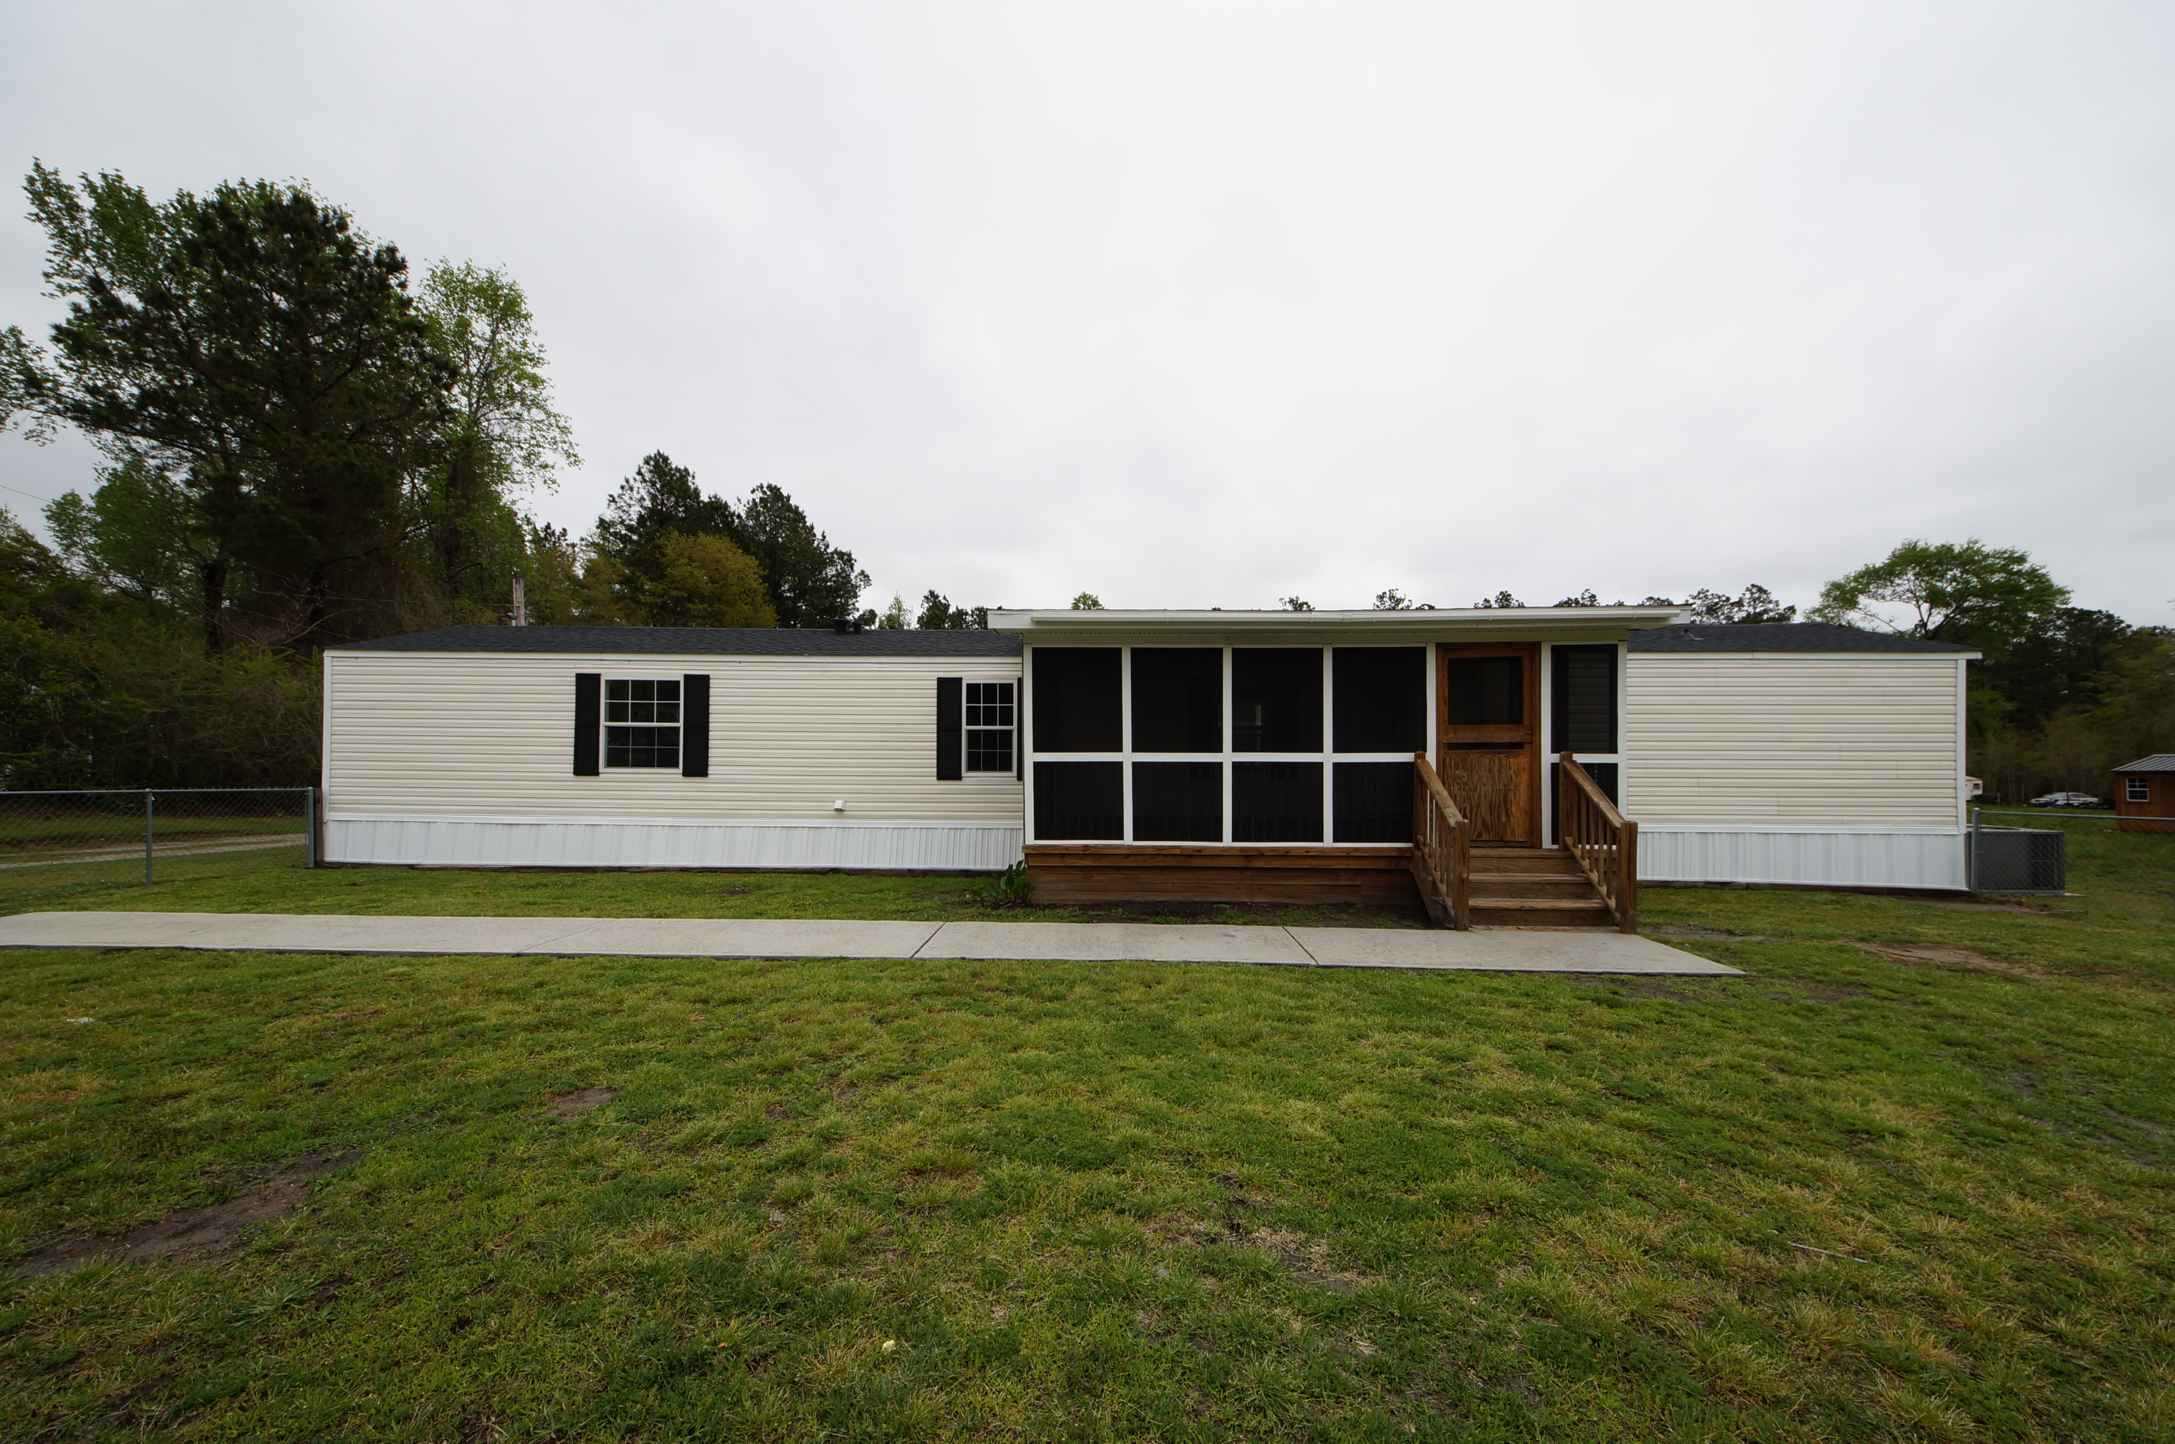
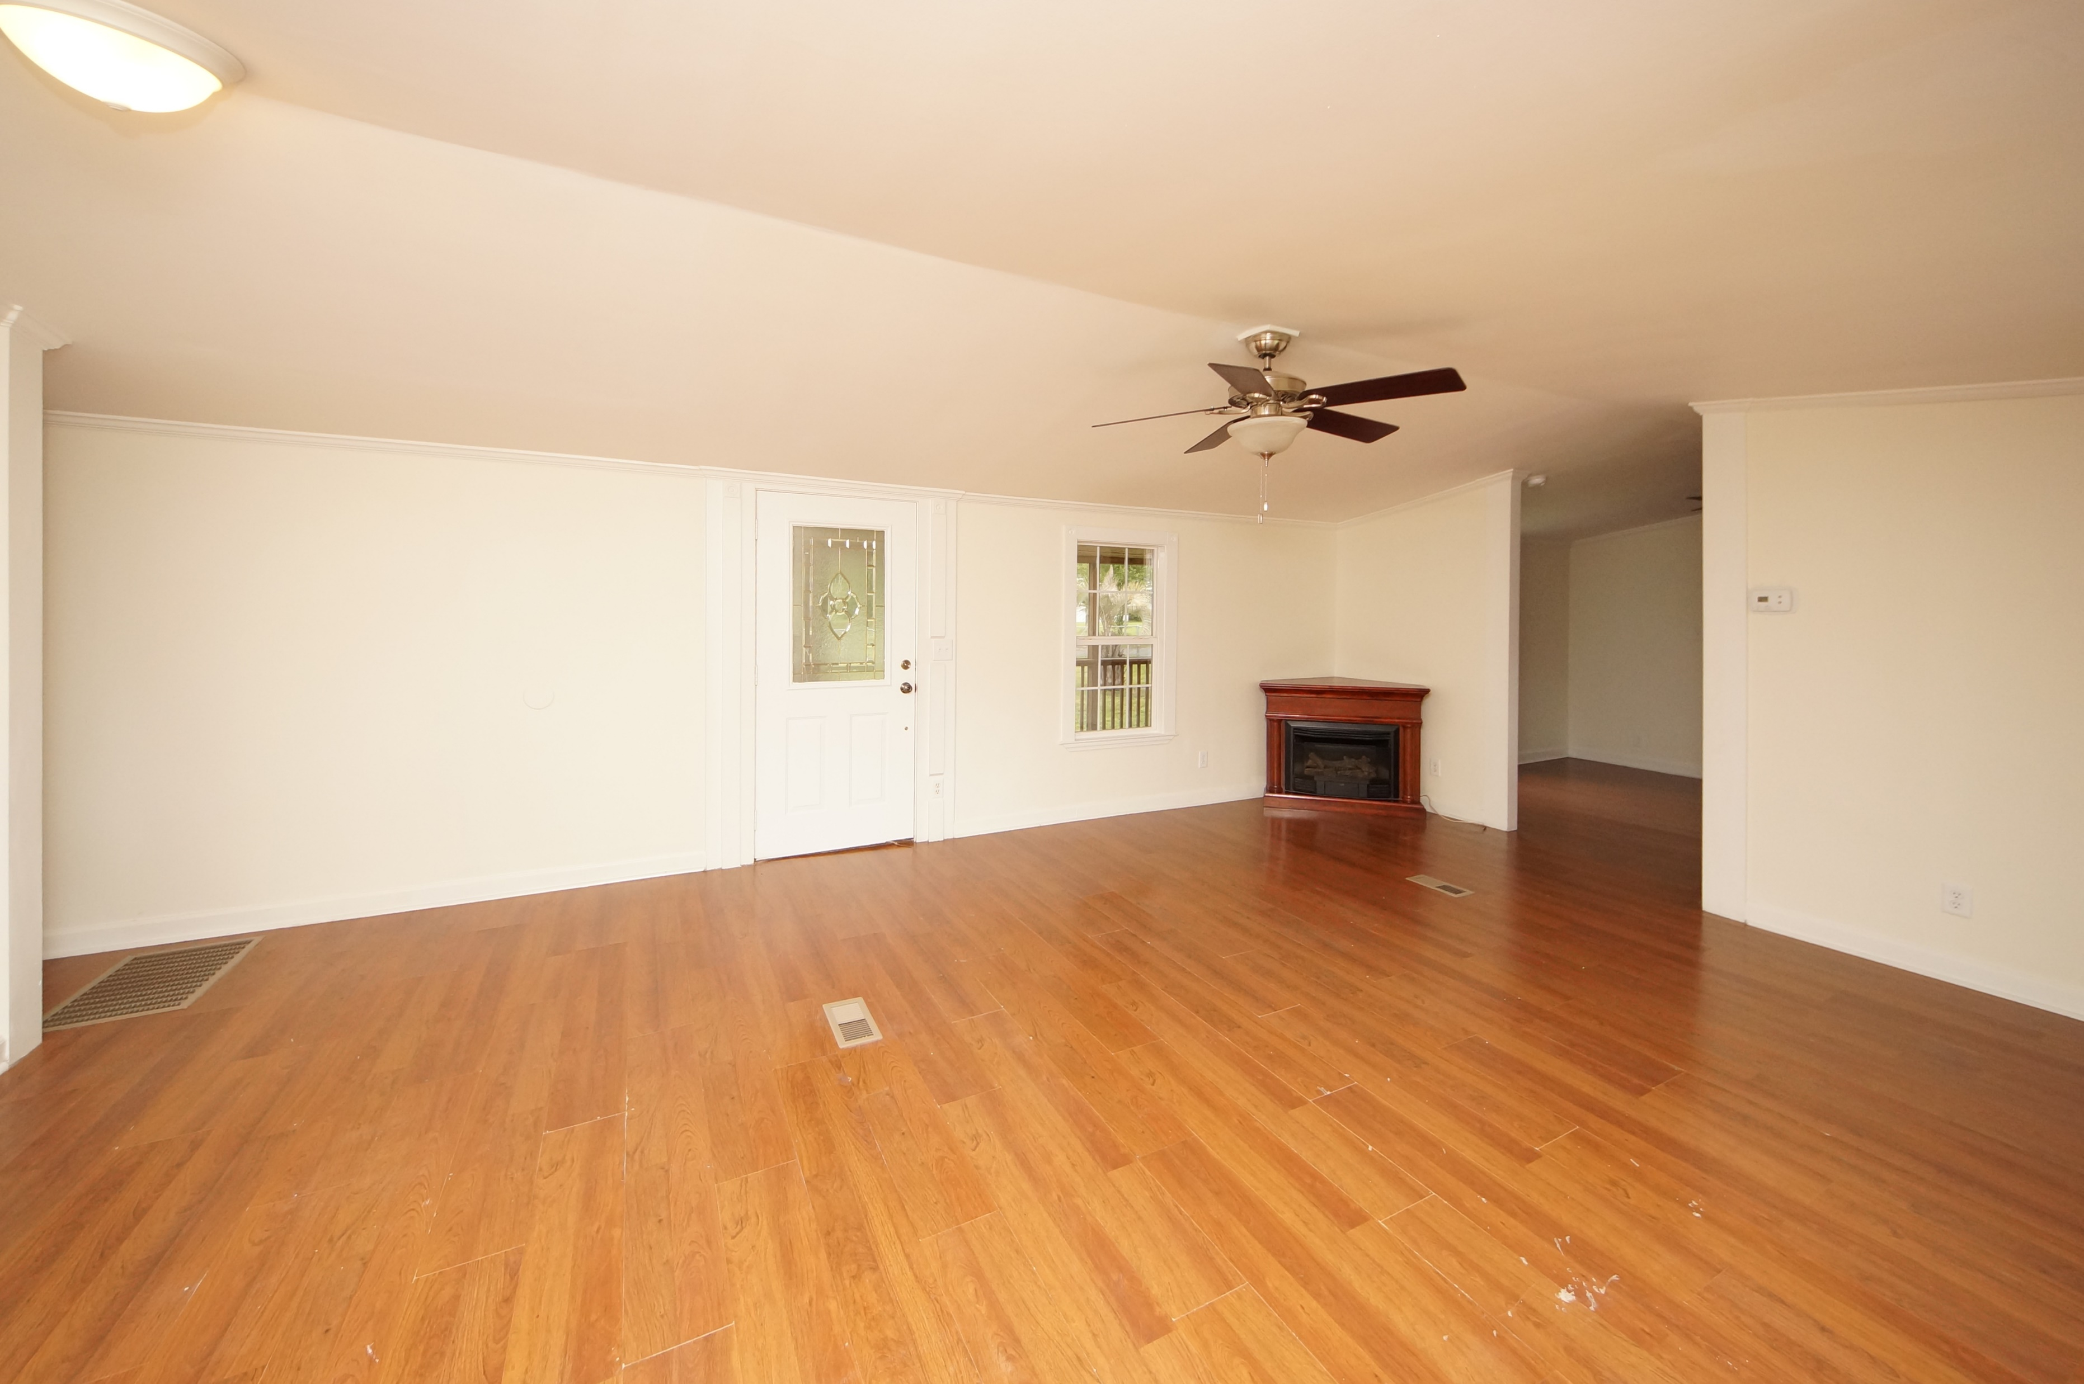
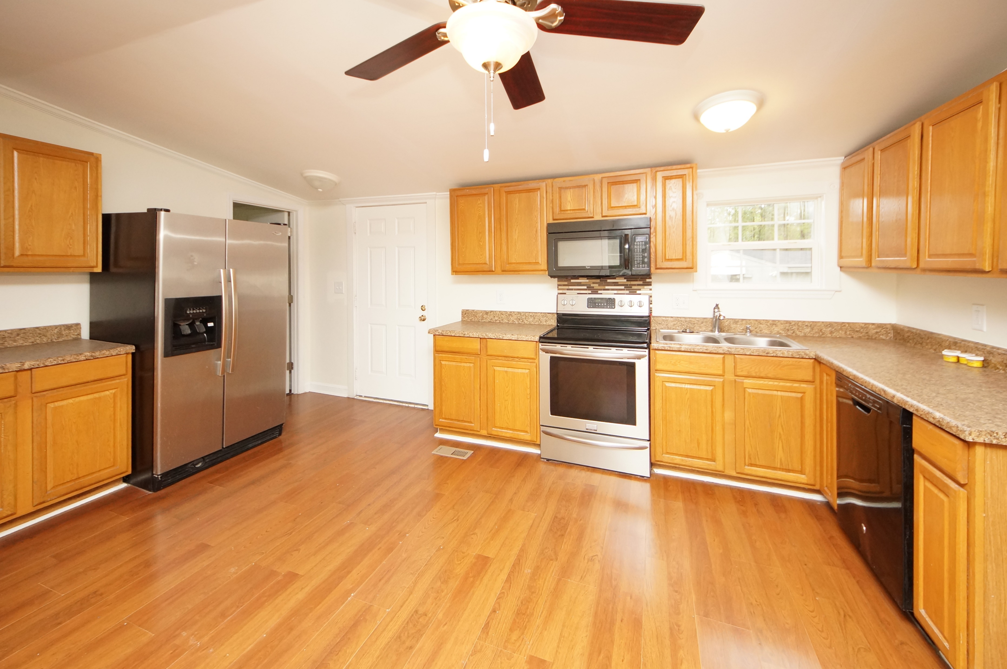
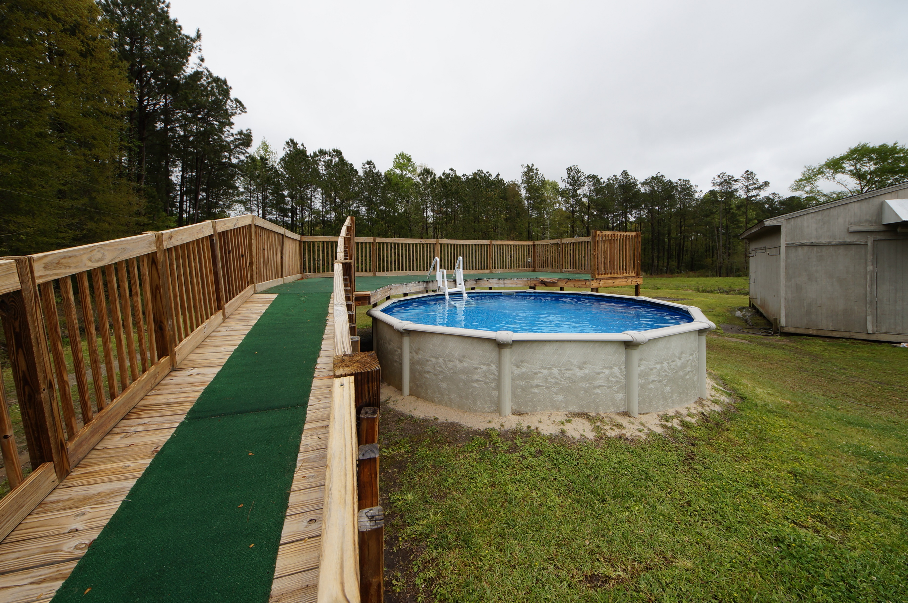


117 Kingsville Road Moncks Corner, SC 29461 MLS# 18010024 :: $135,000 3 Bed / 2 Bath
New Roof, New Paint, New Carpet, And More!
Move-in Ready
New roof, new paint, new carpet, polished floors, crown molding and move in ready! This single wide manufactured home has style, space and sits on an acre of land. Home features 3 bedrooms but seller removed the closet in the end bedroom to enlarge the bathroom. Above ground swimming pool is ready for summer time and the storage building has electrical to use as a shop or entertainment space. Seller has built a screen porch and addition of third bedroom was permitted through Berkeley County. Seller is motivated to sell his remodeled home to a new owner!
Connie White, Broker
843-532-3356
conniesyouragent@gmail.com
Charleston Homes · 597 Old Mt. Holly Road · Suite 301 · Goose Creek, SC 29445

