Slide 1
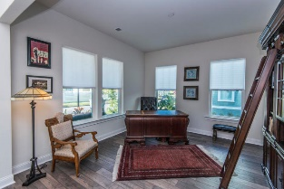
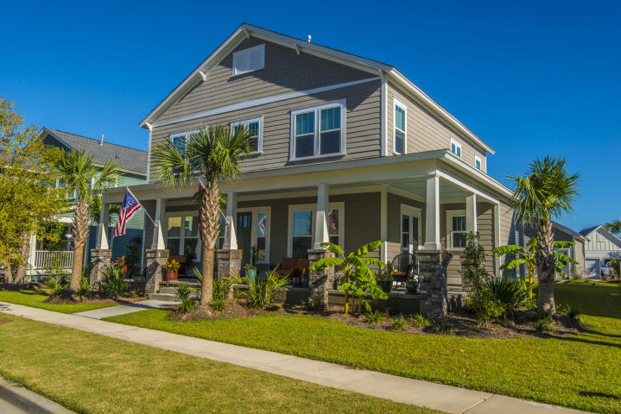
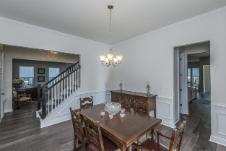
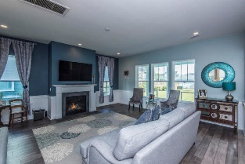
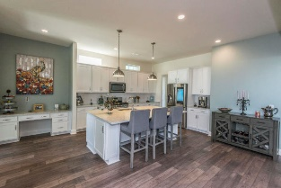
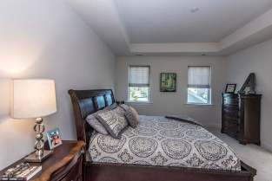
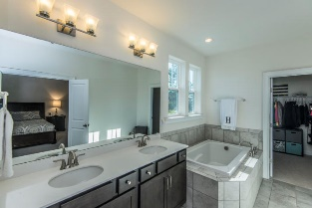
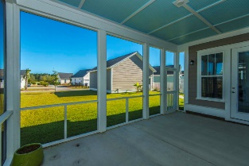
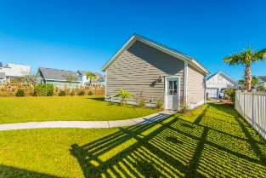
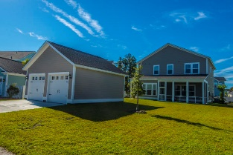


117 Nutmeg Way Summerville, SC 29485 ~ MLS# 18028559 ~ $437,400
Open House Sunday 12-2
Beautifully maintained 4 bedroom, 2 car garage, Dan Ryan Custom home with significant attention to detail (completed only 3 months ago!). The front of the home welcomes you with a large wrap-around front porch, and to the left of the large foyer, there is a formal office or living space; to the right, a formal dining room perfect for entertaining. The open living area includes a stunning gourmet kitchen, butler pantry, and spacious family room area. Upstairs, there is a formal master suite and 3 more generous-sized secondary bedrooms. Most of the home furnishings are negotiable with purchase. SMART HOME: Fiber optic wired, broadband-ready home with gigabit internet access. Home equipped with programmable thermostat.
A $2,200 Lender Credit is available and will be applied towards the buyer's closing costs and pre-paids if the buyer chooses to use the seller's preferred lender. This credit is in addition to any negotiated seller concessions.
Kristin Schatmeyer
Cell - (843) 697-7370
kristin.schatmeyer@carolinaone.com
www.KristinSchatmeyer.com
Carolina One Real Estate
2713 Highway 17 North
Mt. Pleasant, SC 29466

