Slide 1

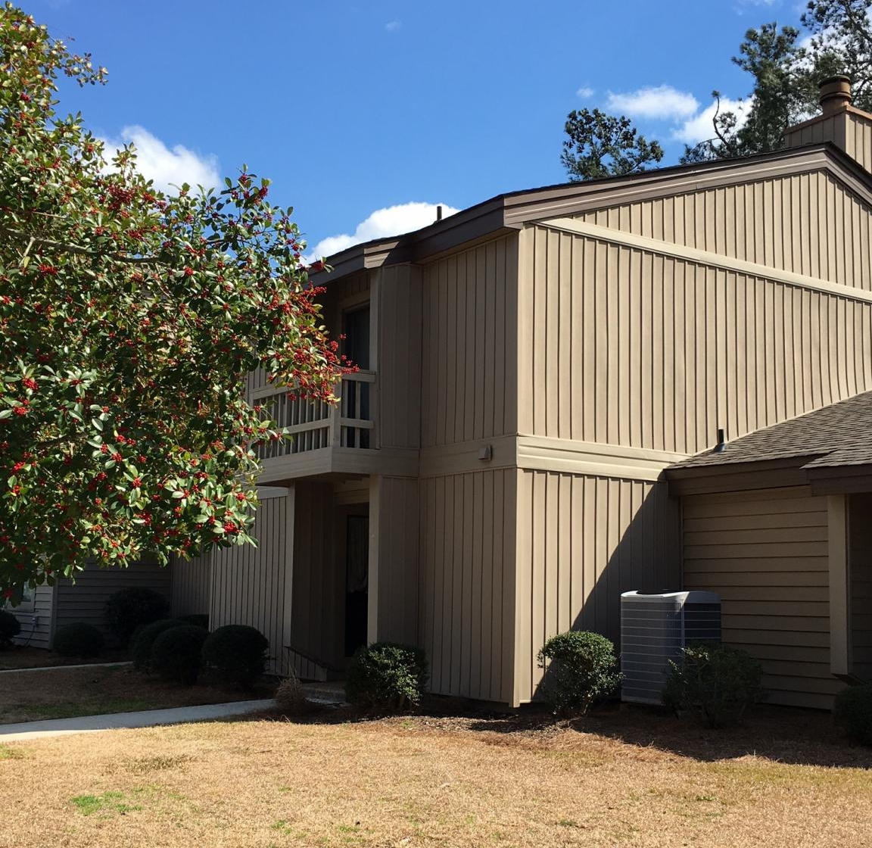

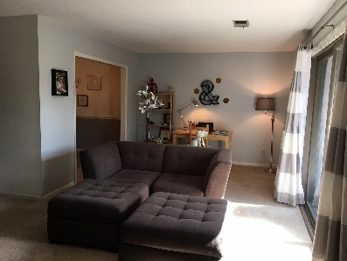
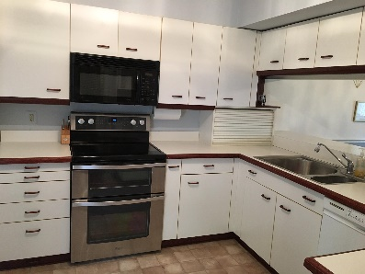
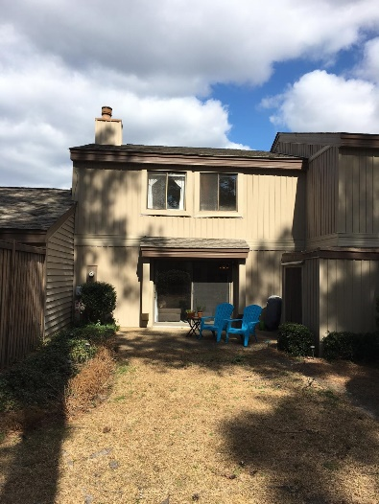
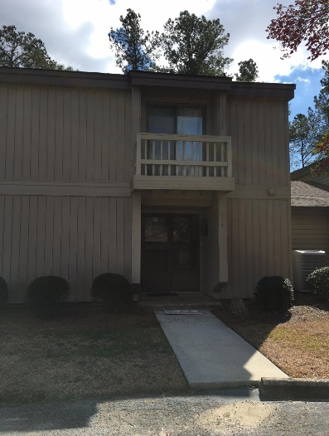


117 The Bunkers
Aiken, SC 29803 MLS# 93491 / $112,500
Pristine 3 bedroom, 2.5 bath two story unit, great Southside location.
Freshly painted with Custom Woodmode kitchen, wood burning fireplace and charming private patio.
Shows great!
Valli Catchpole 803.617.8540 / valli1@me.com Property Consultants of the South, 1429 Lyon Dr SE, Aiken, SC 29801 / www.FineSouthernLiving.com

