Slide 1
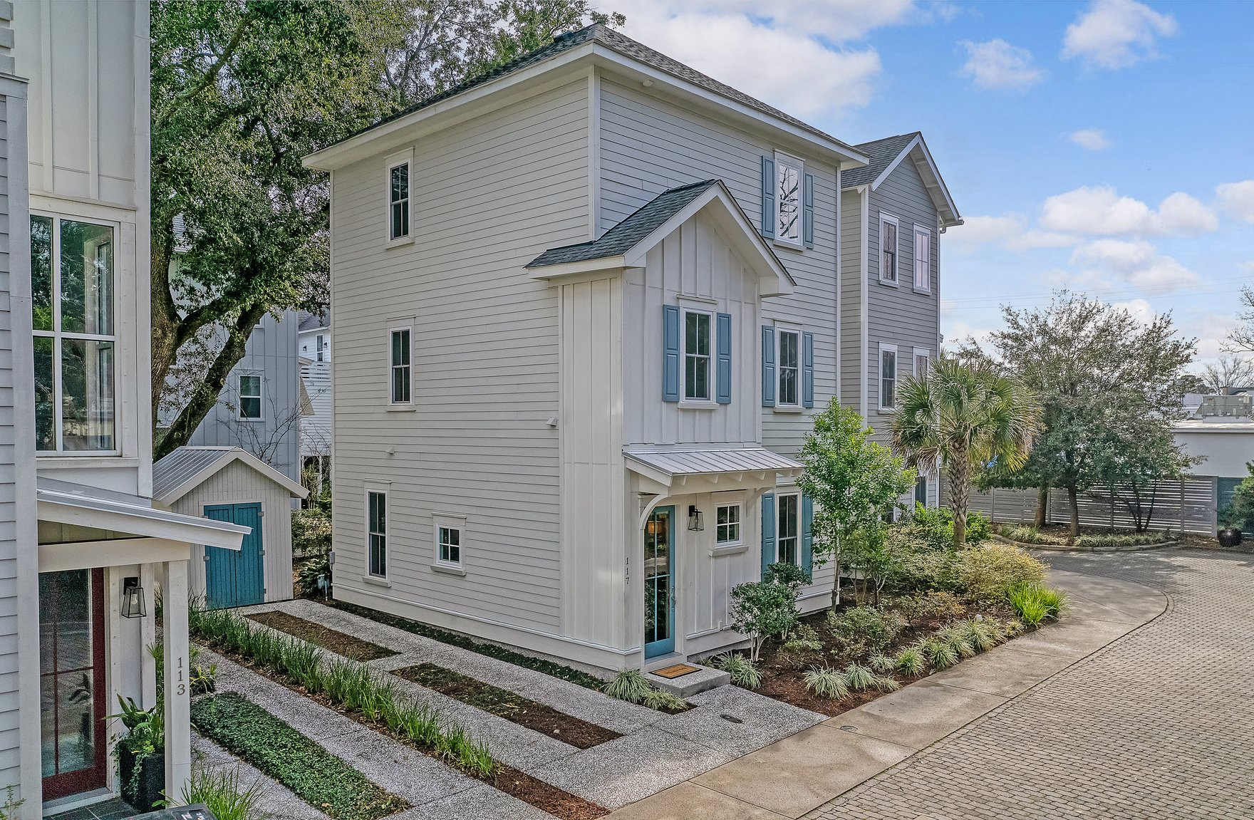
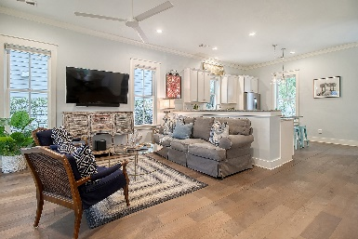
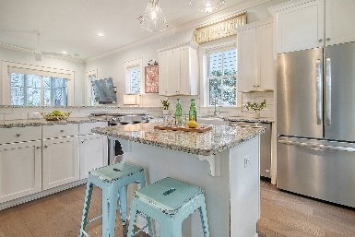
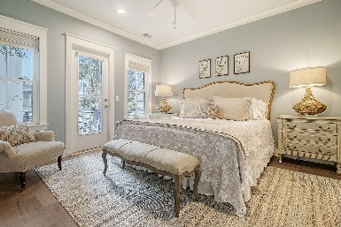
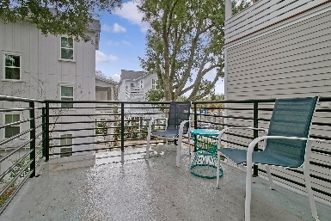
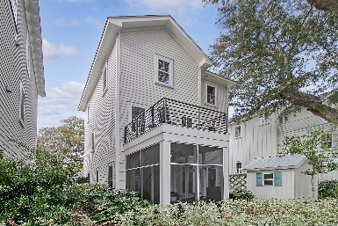

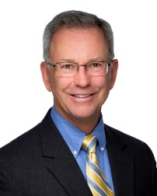
117 Bratton Circle Village Park | Mount Pleasant, SC 29464 | $870,000
VILLAGE PARK - BROKER EVENT
Thursday, January 18th, 10am-1pm | Light Lunch Provided
3 Bedroom | 3½ Bath | 1,935 sf | Centrally Located
Steve Kaul 843-817-5547
skaul@carolinaone.com
http://www.charlestonhousehunt.com/
Carolina One Real Estate
195 W Coleman Blvd
Mt Pleasant, SC 29464-3495

