Slide 1
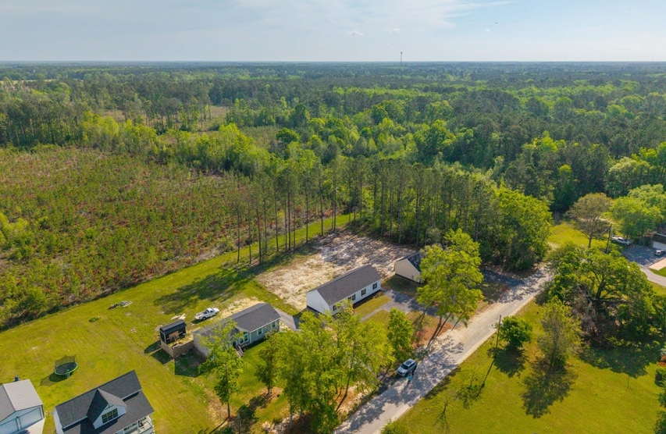




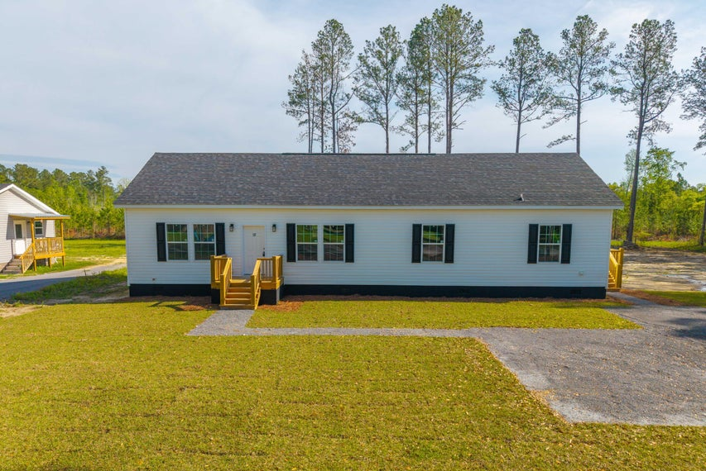
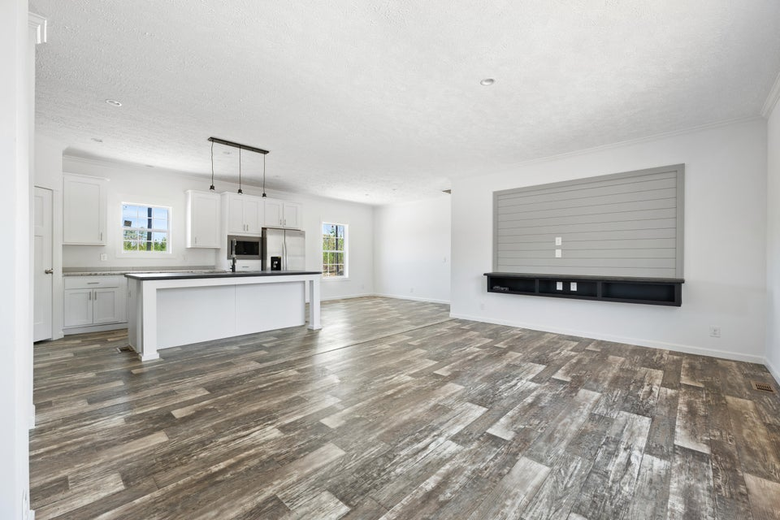
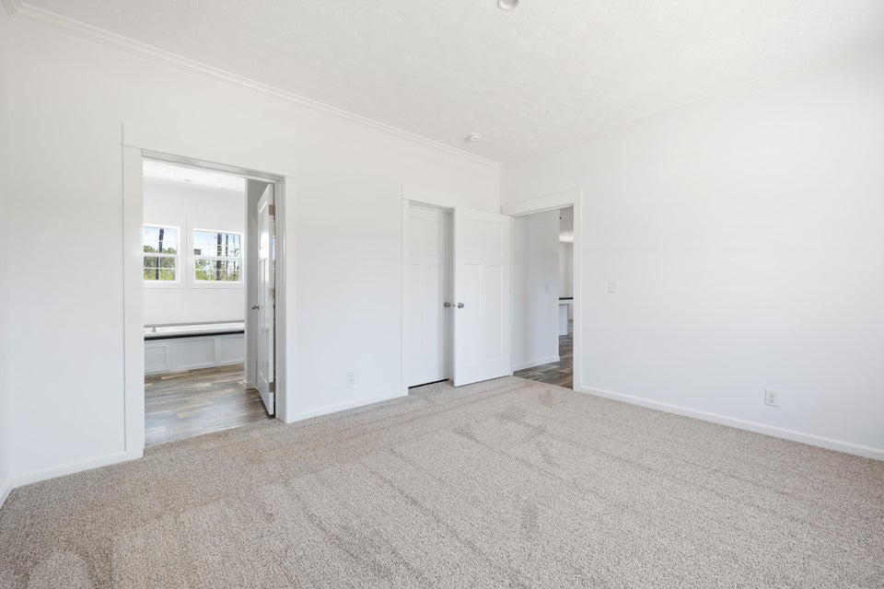
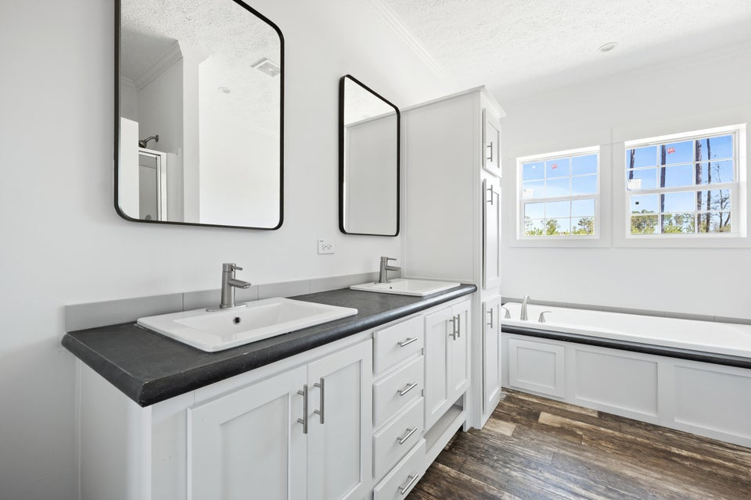

NEW CONSTRUCTION
117 Dotson Street
Harleyville, SC 29448 | MLS# 25009306 | $329,900
NEW CONSTRUCTION located in the town limits of Harleyville.
Nestled on a quiet street on a half acre lot with no HOA! 2 miles off I-26 & easy commute to I-95, Summerville, St George, Holly Hill Walmart Distribution Center and Volvo. This lovely home is a modern 4 bedroom 2 bath open kitchen and living area. The large kitchen has all stainless steel Energy Star appliances, craftsmen style cabinets, and a centrally located island for friends and family to enjoy. An adjacent dining area and living room with the 9' ceilings. Bedrooms are carpeted and vinyl flooring throughout. This home is turnkey and ready to move in!
Telecia Bilton
843-412-3586
tmbilton@rogcoastal.com
Amber Cammer
843-972-9450
acammer24@gmail.com
Realty ONE Group Coastal | 1510 Trolley Rd | Summerville, SC 29485

