Slide 1
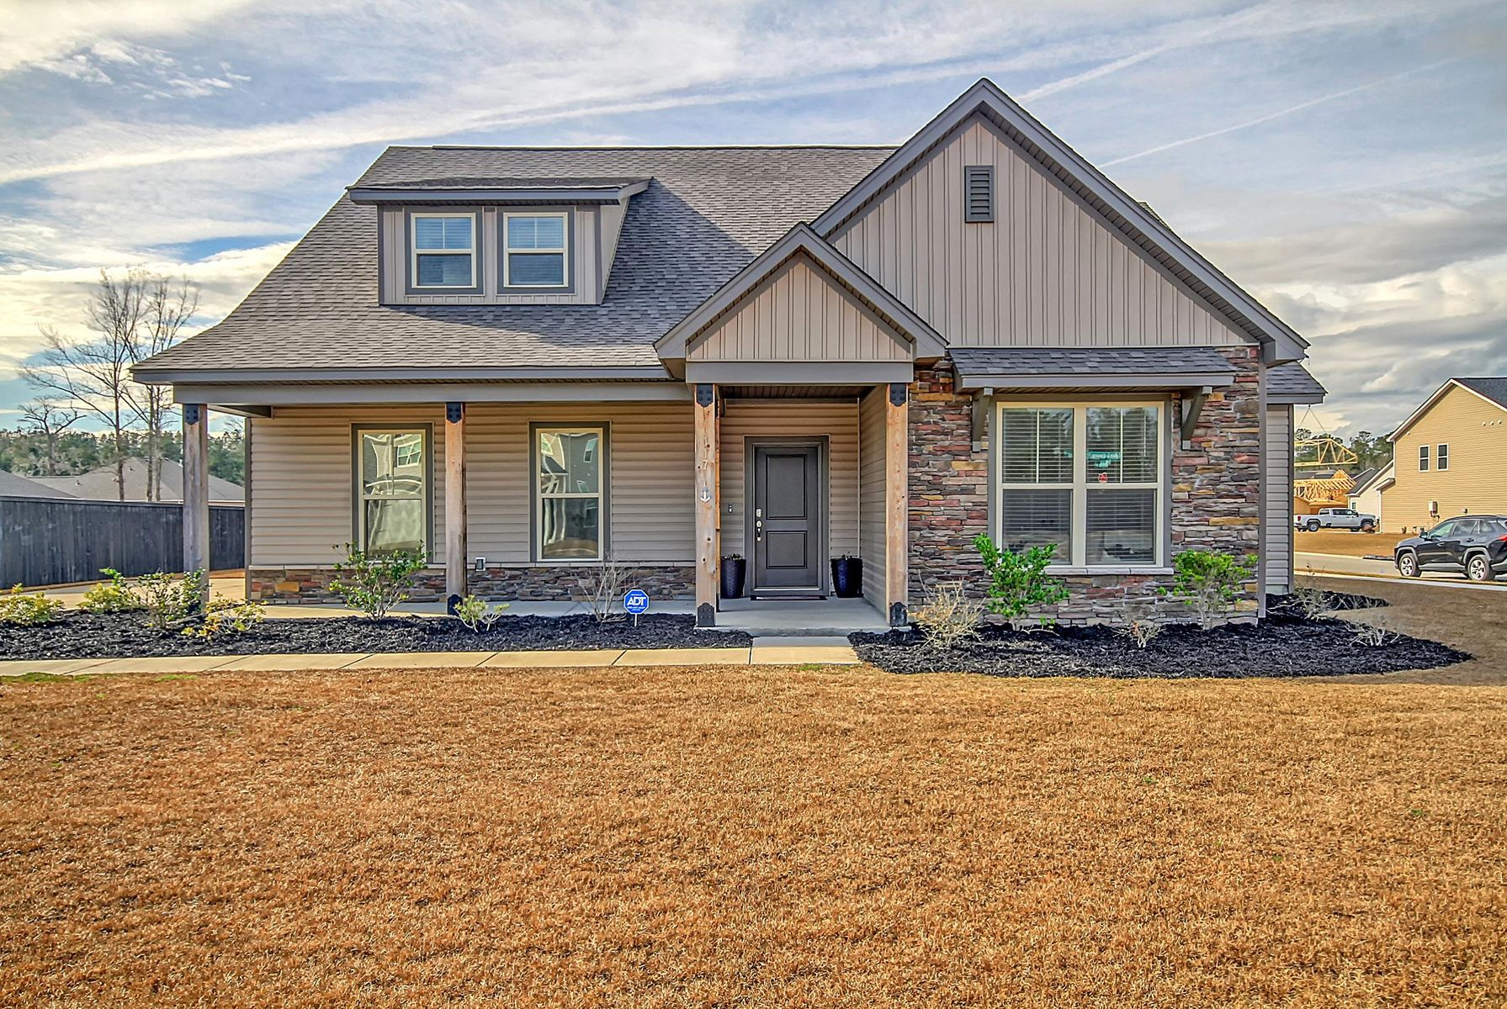
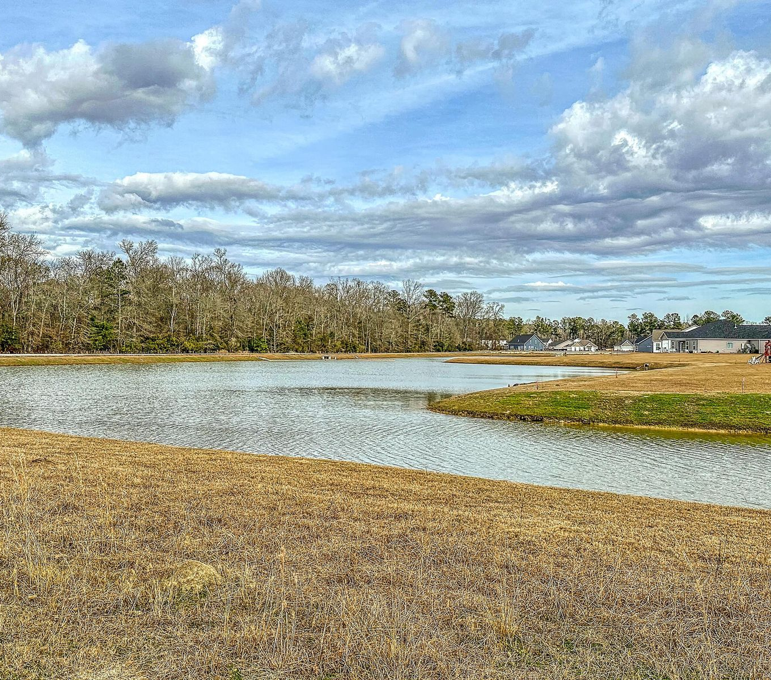
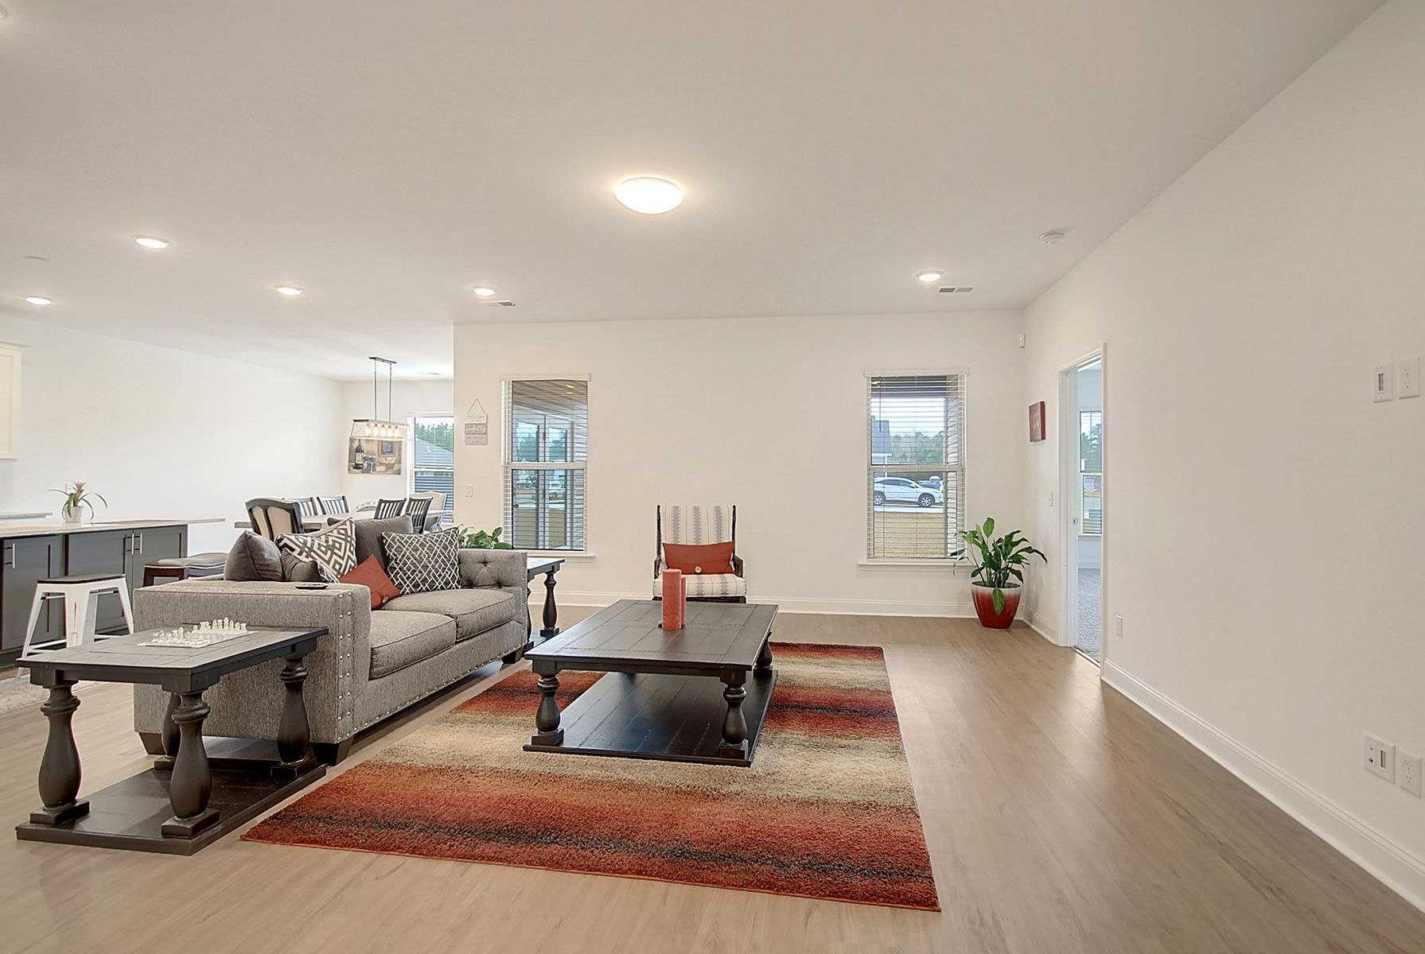
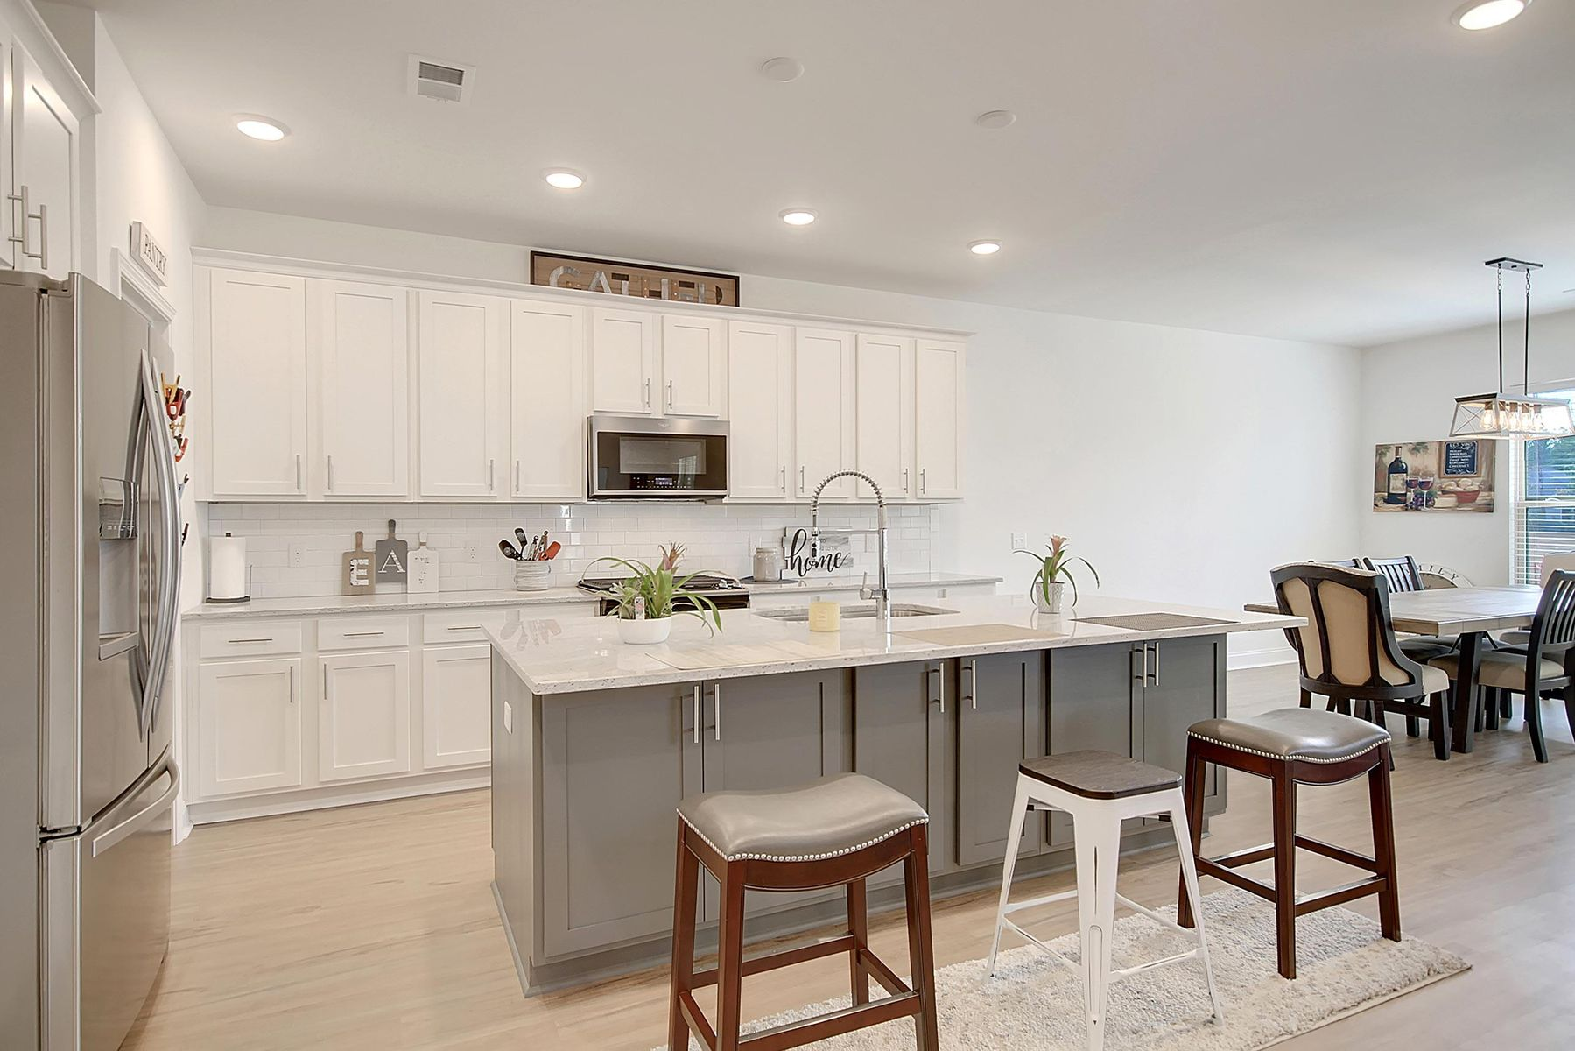
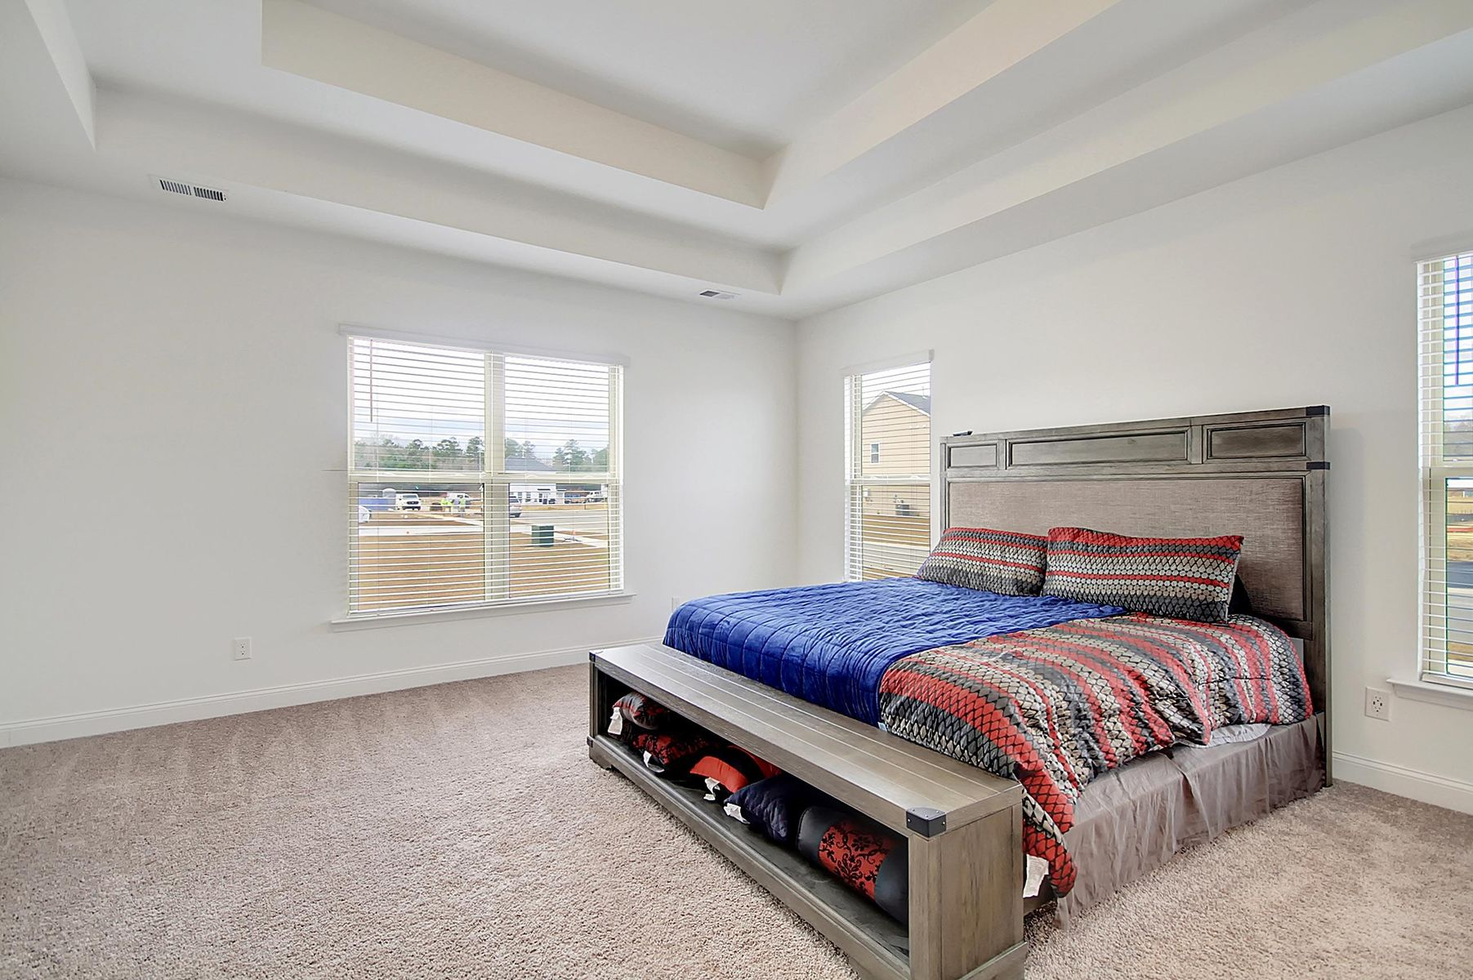
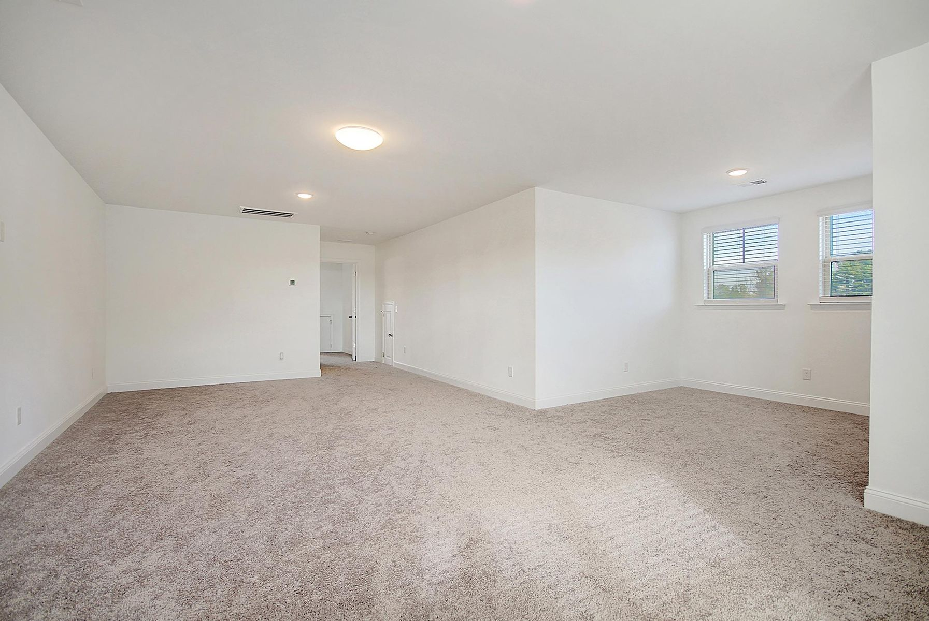
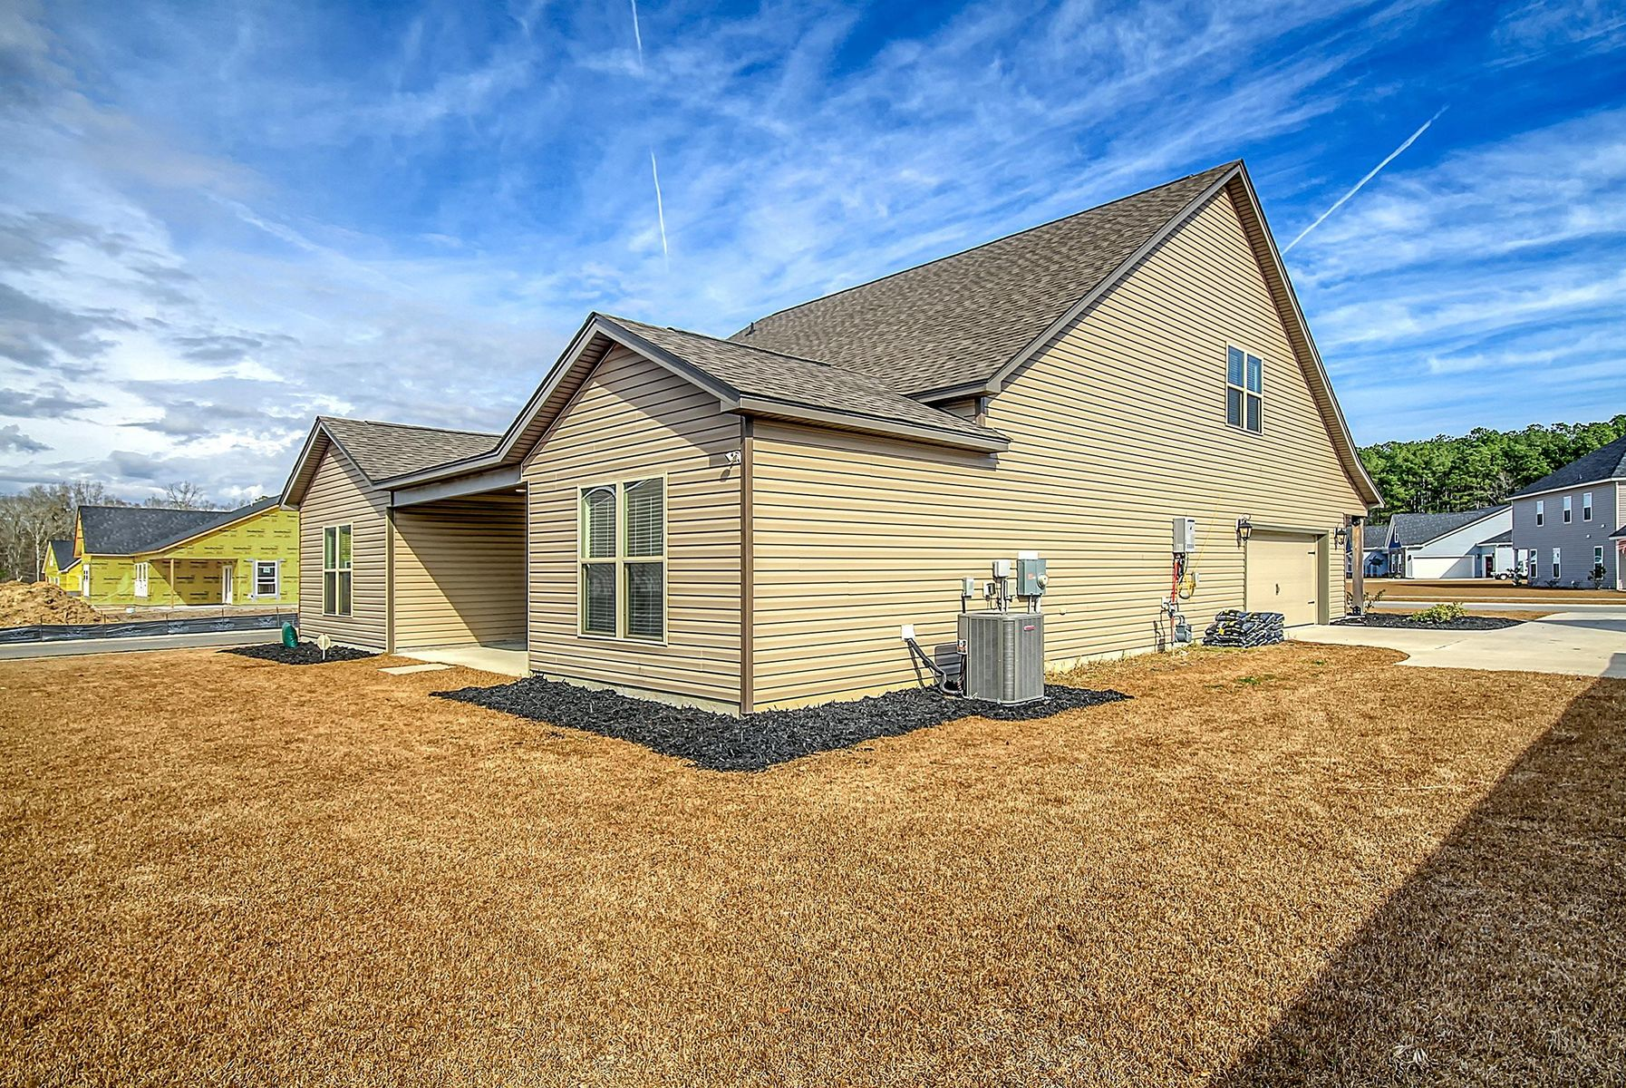


$5000 Selling Agent Bonus!
117 Edisto Xing Court
Timothy Lakes | Ridgeville, SC 29472
MLS# 23023975 | $499,900
Welcome to Timothy Lakes! Located in the Ridgeville area, close to the new Walmart Distribution Center, the interstate, Volvo, Summerville, and the list goes on. This home is just what the doctor ordered. Built in 2021 with an amazing layout and an impressive location, yes...you can have it all. This home features a full front porch with wood columns. Side entry garage. Corner lot. But...the best is on the inside. This home is impressive from the door. Large open and wide hallway greets you on the other side. This home features a split bedroom layout. Guest rooms with a bath are off the front hallway. At the end of the hall you will find that the home comes alive. It opens up into a large family room that is overlooked by the gourmet kitchen. Adjacent to the kitchen is a massive dining room. To the rear of the home is a covered porch. This home features plenty of space for entertaining, inside and out. The master suite holds the real treat. A tray ceiling, large size, open and spacious bathroom, inviting shower, and a huge closet. The owner opted for the additional upstairs, so this home has a large loft that could be a game room along with another bedroom and full bath. You don't want to buy without seeing this one. Schedule your showing today.
Corwyn Melette
843-364-3095
corwyn@corwynmelette.com
www.exitlowcountry.com
Exit Realty Lowcountry Group | 3294 Ashley Phosphate Rd, 1-E | North Charleston SC 29418

