Slide 1

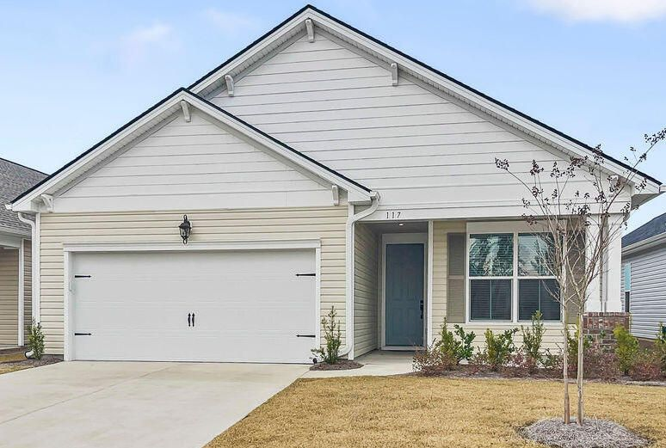

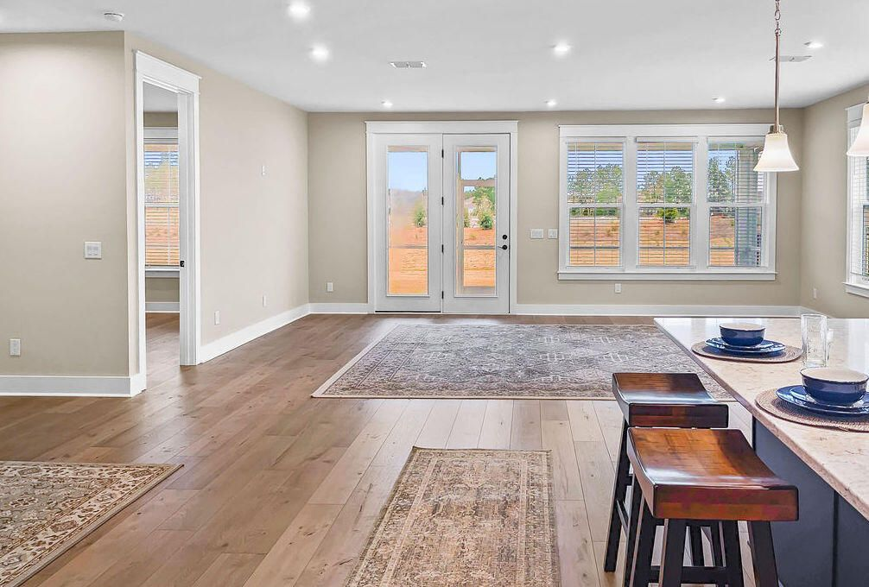
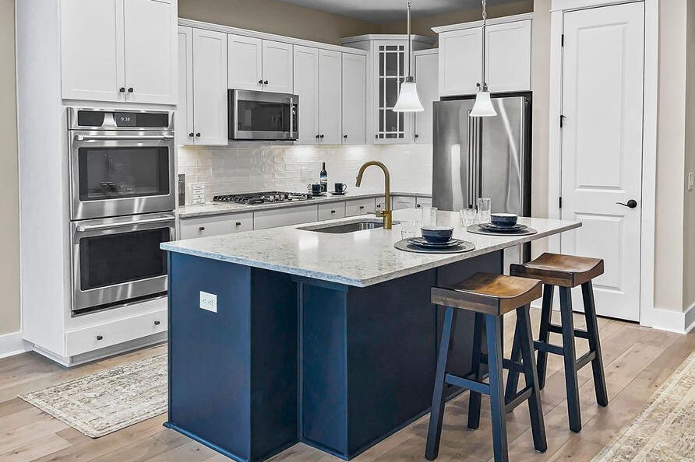
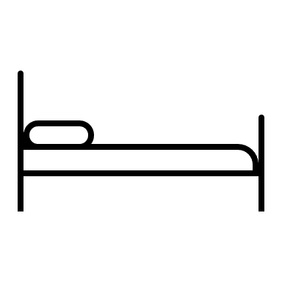


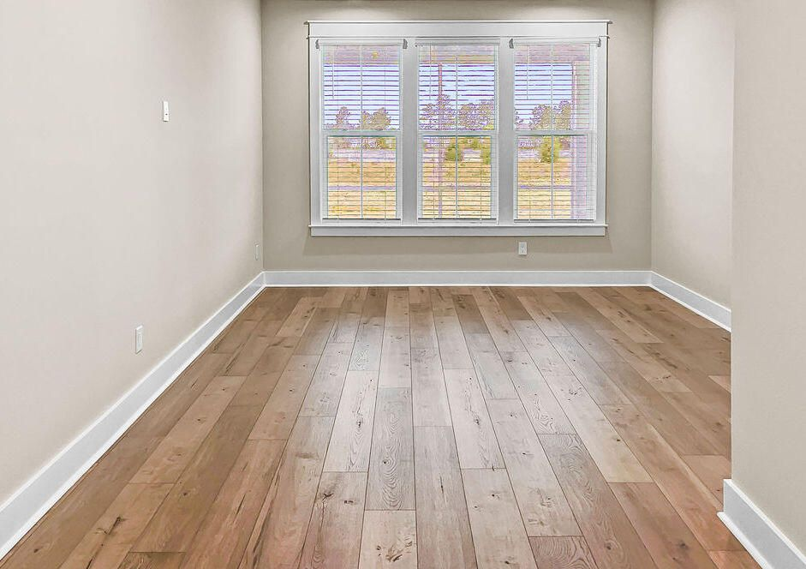
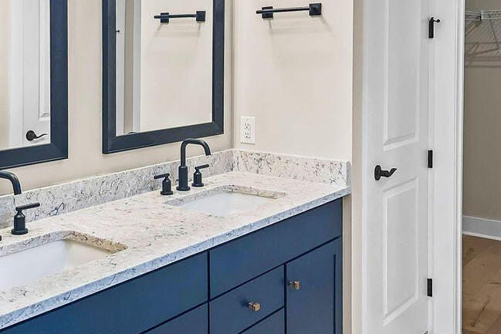



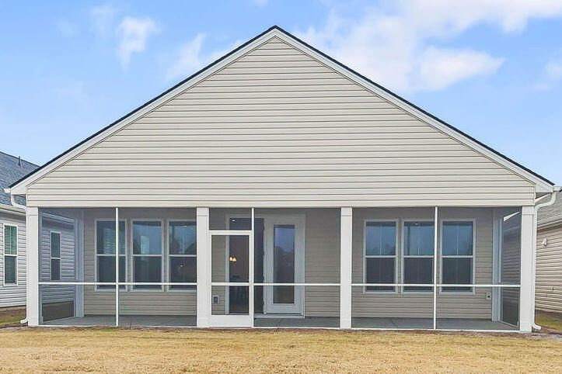
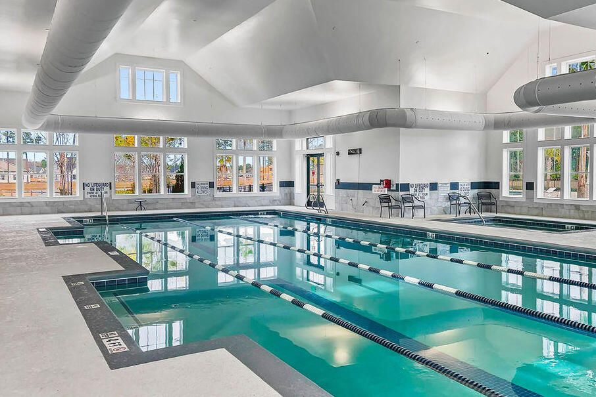

Better than new
117 Leeward Landing
Cane Bay Plantation | Summerville, SC 29486 | MLS# 24000813 | $470,000
Better than new in Four Seasons, laminate & tile flooring throughout, open floor plan with large eat-in kitchen with quartz counters and beautiful appliances. Open living & dining area leads into large screen porch w/great backyard. Two large bedrooms & two full baths. The primary bedroom has ensuite bath, double vanities, walk-in shower, & large walk-in closet. The second bedroom has nicely sized closet & direct access to the second bathroom. You'll enjoy irrigation, upgraded paint & epoxy garage floor. Adult community, one resident must be 55+ years of age.
2 Bedroom
2 Bath
1,540 sf
Four Seasons
Kim Chambers
843-371-9047
kim.chambers@carolinaone.com
www.carolinaone.com
Carolina One Real Estate | 191 Rutledge Ave | Charleston, SC 29403

