Slide 1

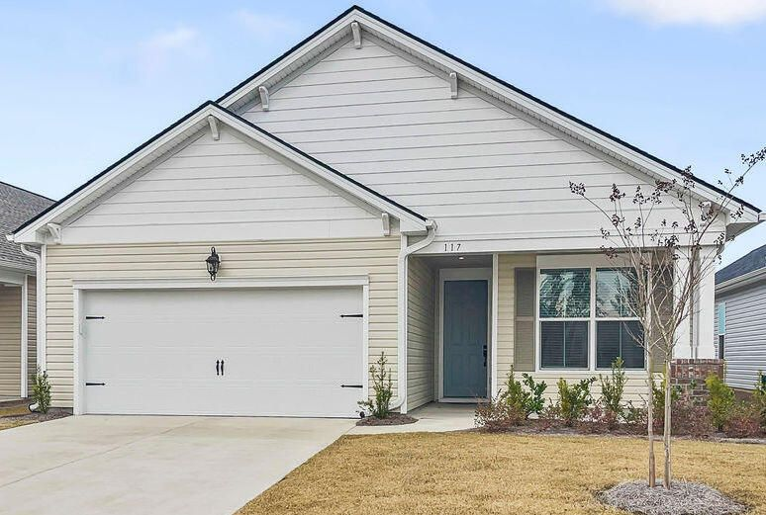
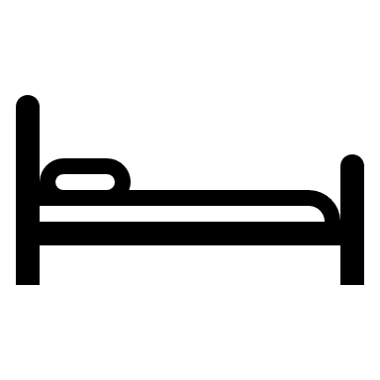
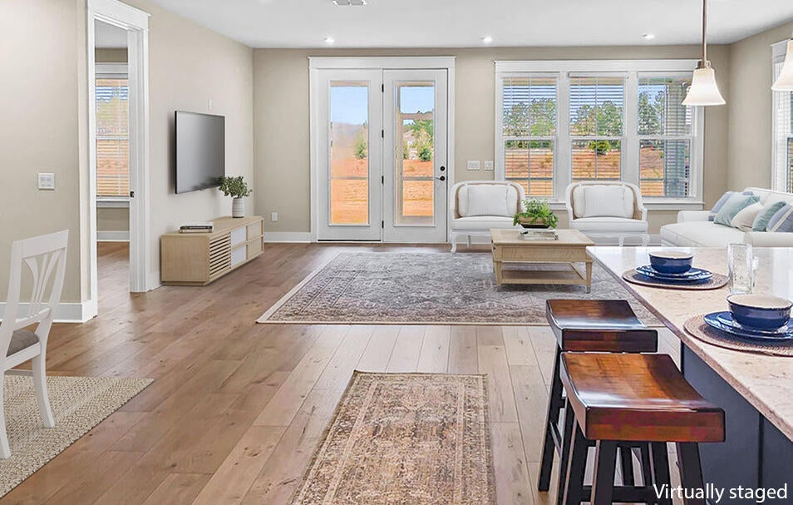
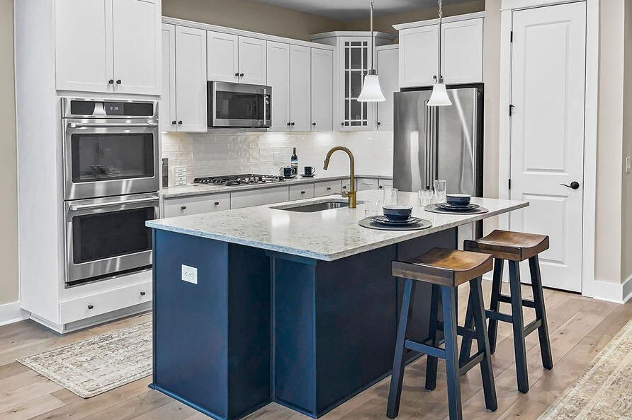
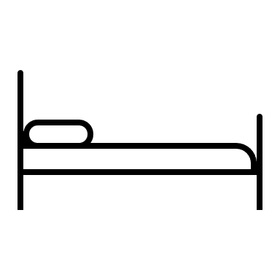
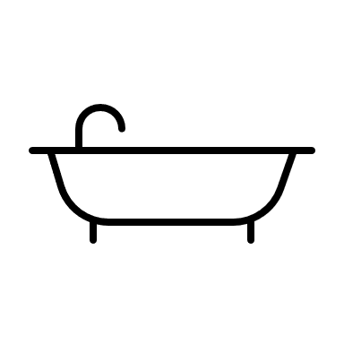

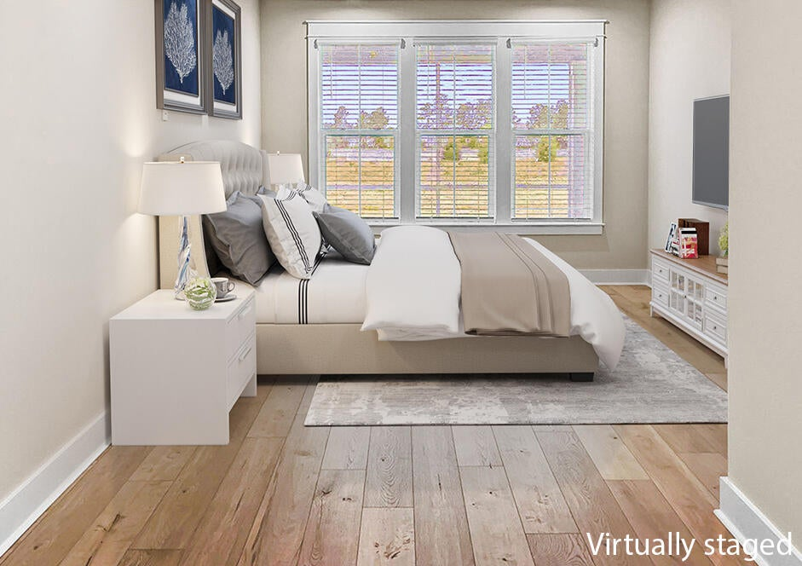
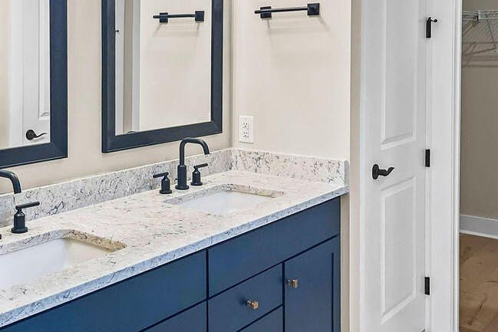



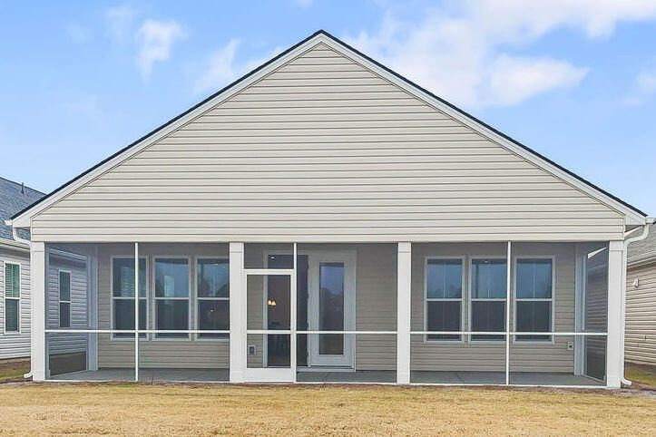
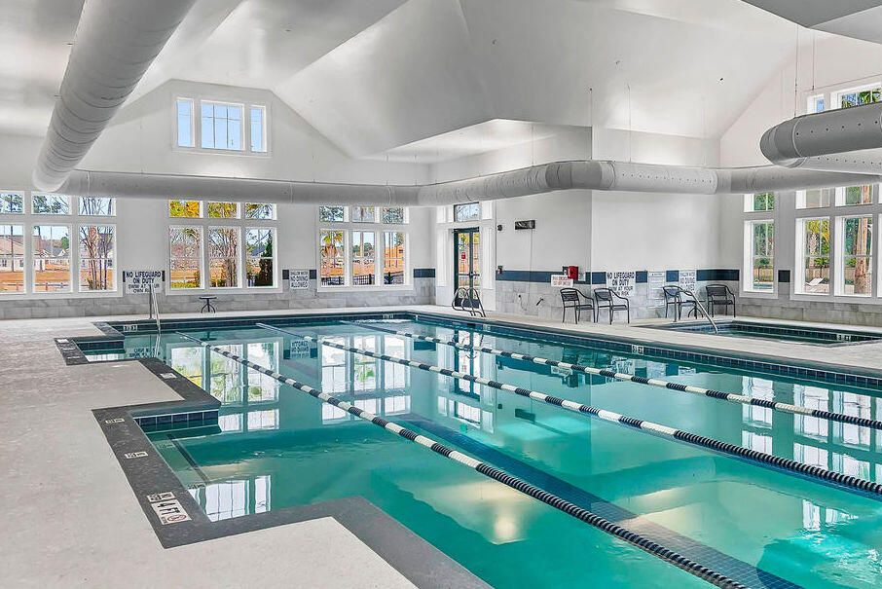

Improved Price
117 Leeward Landing
Cane Bay Plantation | Summerville, SC 29486 | MLS# 24000813 | $435,000
PRICED EXTREMELY COMPETITIVELY
with over $8k in upgrades!
Come visit this BETTER THAN NEW spotless
2-bedroom 2-bath home in Charleston's Premier Active Adult Community, Four Seasons At The Lakes Of Cane Bay. This popular Athens floor plan home has a gourmet kitchen, high ceilings, great light, screened in porch, laminate flooring throughout, upgraded lighting, upgraded paint, rain gutters, lawn irrigation and a 2-car garage with a professionally epoxy floor. Enjoy coffee on the screened in porch in the morning and cocktails on the front porch in the evening. You also have access to the 300+ acre lake and the Activities Center featuring a ton of indoor and outdoor activities.
2 Bedroom
2 Bath
1,540 sf
Four Seasons
Kim Chambers
843-371-9047
kim.chambers@carolinaone.com
www.carolinaone.com
Carolina One Real Estate | 191 Rutledge Ave | Charleston, SC 29403

