Slide 1
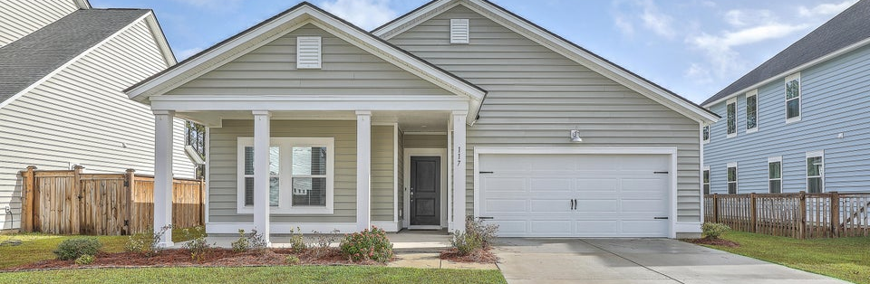
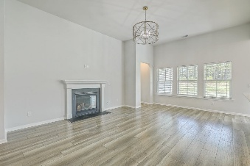
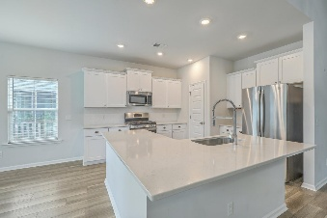
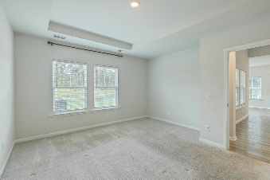
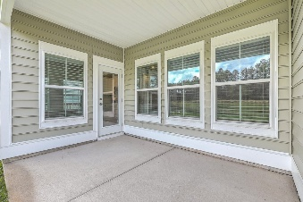
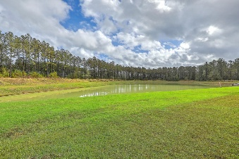

Quick Move-In Opportunity
on This Stunning 1-Story!
Michael Moseley
843-442-0959
michaelsmoseley@gmail.com
charlestonrealestateandgolf.com
117 Oyster Tide Avenue
Summers Corner | Summerville, SC 29485 | MLS# 25015427 | $375,000
THE ONLY 1 STORY AVAILABLE in the sought-after Azalea Ridge subsection of Summers Corner. This beautifully designed Litchfield II floor plan offers a serene pond view and a layout perfect for modern living. Inside, you'll find gorgeous flooring, high ceilings, and a cozy gas fireplace that enhance the open and inviting atmosphere. A versatile flex room provides the perfect space for a home office, craft room, or reading nook. The gourmet kitchen is a chef's dream, featuring a large island, ample counter space, abundant cabinetry, a gas range, and a pantry—everything you need to create culinary masterpieces. Step outside to the covered patio, ideal for enjoying your morning coffee or winding down with an afternoon cocktail while taking in peaceful pond views. The primary suite boasts a tray ceiling, walk-in closet, and a spa-like bathroom with dual sinks and a stand-up shower. Located in the vibrant Summers Corner community, you'll enjoy access to walking trails, parks, a pool, and much more.
Coming soon, The Club at Summers Corner, which is set to become a premier recreational destination, offering residents a true resort-style experience. Enjoy multiple pools designed to resemble a beach-entry lagoon, plus a dedicated splash park, thrilling water slides, and an adults-only pool with a walk-up bar. Relax and unwind at the open-air Oyster Barn, complete with shaded seating, cozy fire pits, and an on-site restaurant and bar. It's the perfect blend of leisure and community, ideal for gathering with neighbors, family, and friends. Come see this stunning home in person - the only thing missing is YOU!
Carolina Elite Real Estate | 706 N Cedar St | Summerville, SC 29483

