Slide 1
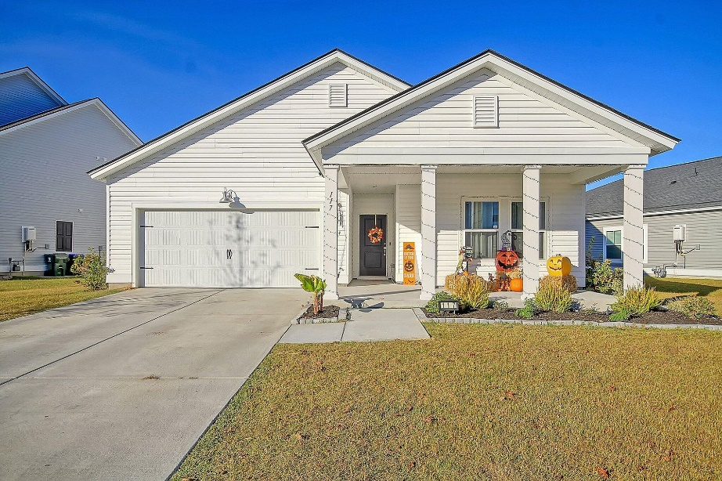
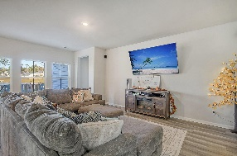
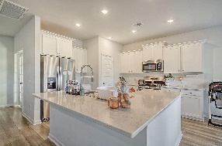
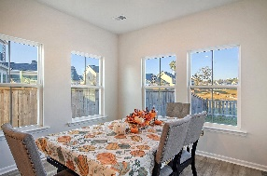
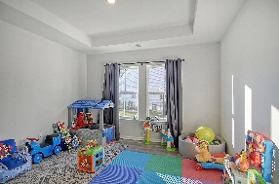
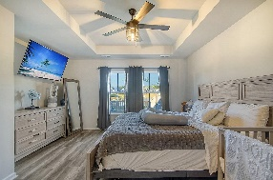
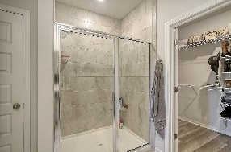
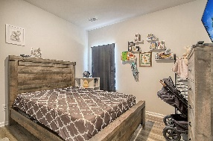
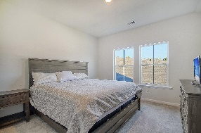
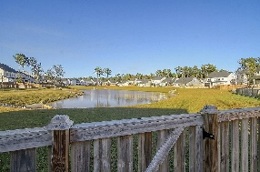
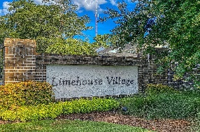
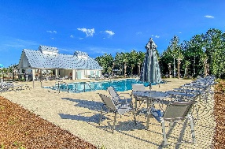


Move-In Ready in Summerville! Like New!!
117 Red Bluff Street
Limehouse Village
Summerville, SC 29483
MLS# 23024989
NEW PRICE $417,500
4 Bedrooms | 3 Baths | 2,469 sf
Immaculate condition home with new interior paint for entire home plus trim in 2024! Move in ready with no work. This is the ONLY home in Limehouse Village currently listed with a master bedroom and two other bedrooms downstairs! This home is 2,469 Sq. Ft. and loaded with upgrades! Downstairs buyers will find a large family room open to the gourmet kitchen which features a huge island with sitting bar, gas cooktop, spacious pantry and upgraded cabinetry as well as a eat-in kitchen area. Beautiful LVP flooring downstairs as well as a office / playroom with french doors. The master bedroom is downstairs with a great master bathroom featuring dual vanities, spacious shower and walk-in closet. Two more bedrooms and a full bathroom can also be found downstairs in addition to the laundry room.
A covered back patio overlooks the fenced-in backyard with beautiful pond views beyond! Upstairs buyers will find a 4th BR and full BA in addition to a spacious bonus room which could be an upstairs family room, exercise room or perhaps a 5th BR if needed. The home has a 2 car garage, tankless hot water heater and a few other nice upgrades. Limehouse Village has a community pool and playground and community events with food trucks. A neighborhood back entrance / exit is planned which will come out on the Berlin G Meyer extension and make the short drive to downtown Summerville even faster! Very few homes in this neighborhood are primarily one story homes with 3 BR's downstairs so this home is a MUST SEE!
Larry & Kathy Mazalatis
Larry Cell 843-693-0529
Kathy Cell 843-693-0159
mazteamrealty@gmail.com
AGENTOWNED REALTY | 1800 TROLLEY RD | SUMMERVILLE, SC 29485

