Slide 1
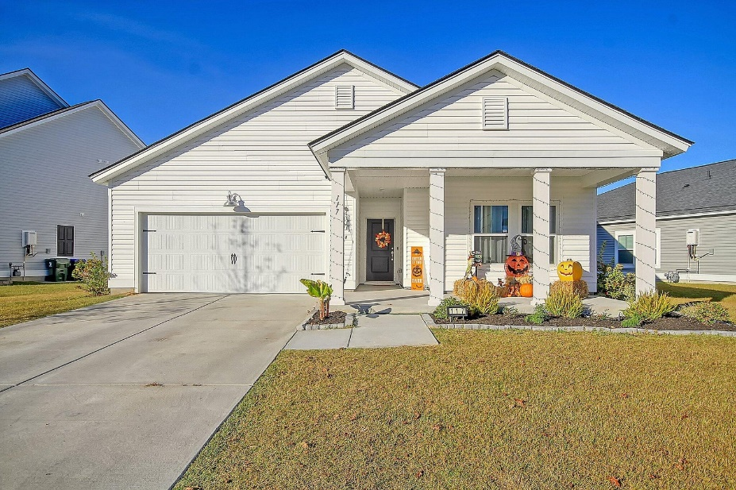
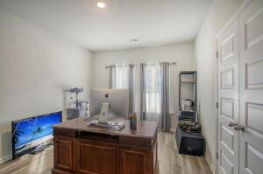
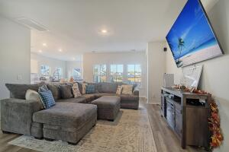
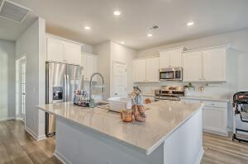
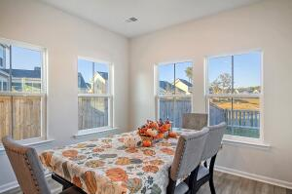
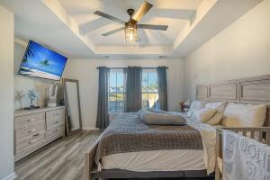
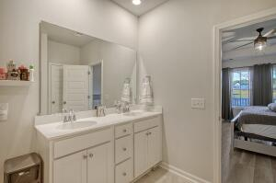
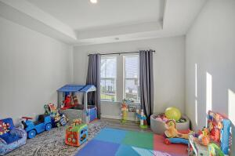
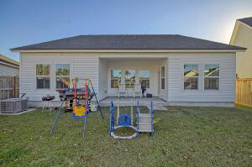
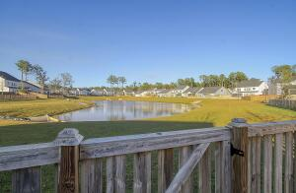
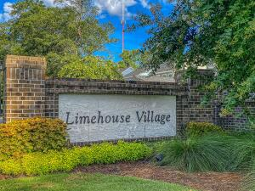
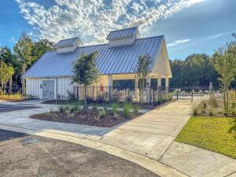
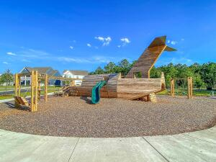


Why Wait for New Construction? Like New Summerville Beauty!
117 Red Bluff Street
Limehouse Village
Summerville, SC 29483
MLS# 23024989
$419,000
4 Bedrooms | 3 Baths | 2,469 sf
This is the ONLY home in Limehouse Village currently listed with a master bedroom downstairs! This home is 2,469 Sq. Ft. and loaded with upgrades! Downstairs buyers will find a large family room open to the gourmet kitchen which features a huge island with sitting bar, gas cooktop, spacious pantry and upgraded cabinetry as well as a eat-in kitchen area. Beautiful LVP flooring downstairs as well as a office / playroom with french doors. The master bedroom is downstairs with a great master bathroom featuring dual vanities, spacious shower and walk-in closet. Two more bedrooms and a full bathroom can also be found downstairs in addition to the laundry room. A covered back patio overlooks the fenced-in backyard with beautiful pond views beyond! Upstairs buyers will find a 4th BR and full BA.
in addition to a spacious bonus room which could be an upstairs family room, exercise room or perhaps a 5th BR if needed. The home has a 2 car garage, tankless hot water heater and a few other nice upgrades. Limehouse Village has a community pool and playground and community events with food trucks. A neighborhood back entrance / exit is planned which will come out on the Berlin G Meyer extension and make the short drive to downtown Summerville even faster! Very few homes in this neighborhood are primarily one story homes with 3 BR's downstairs so this home is a MUST SEE!
Larry & Kathy Mazalatis
Larry Cell 843-693-0529
Kathy Cell 843-693-0159
mazteamrealty@gmail.com
AGENTOWNED PREMIERE GROUP | 1800 TROLLEY RD | SUMMERVILLE, SC 29485

