Slide 1
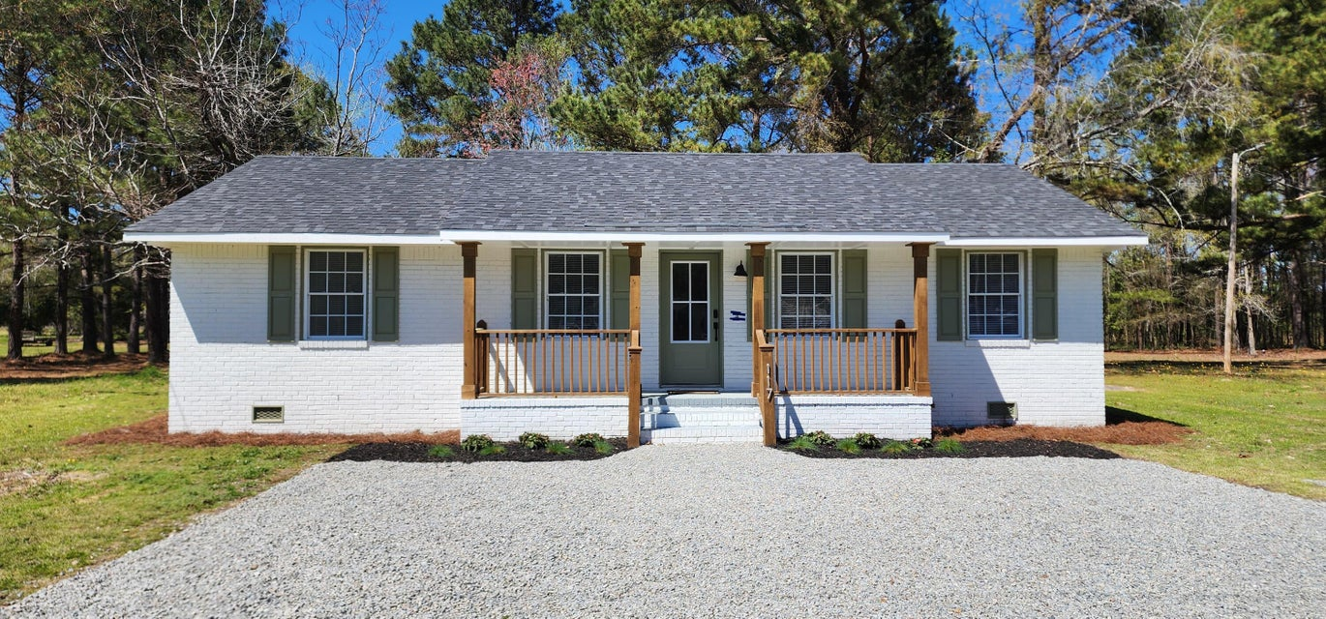
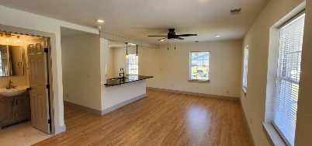
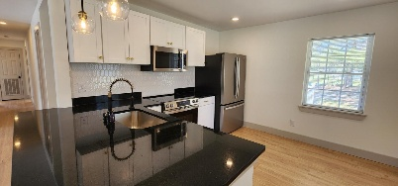
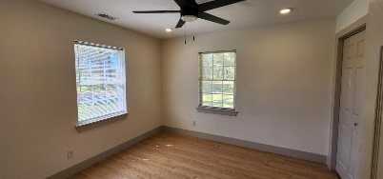
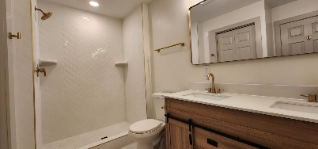
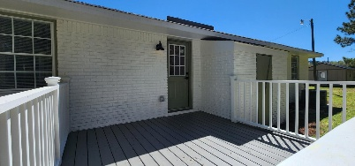
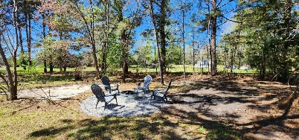


117 Redglobe Court Rivelon | Vance, SC 29163 | MLS# 25007646 | $260,000
Fully Renovated Home Just Minutes from Lake Marion!
Open House
Wednesday, 7/20
3-5PM
Welcome to your beautifully renovated brick ranch home, ideally situated just minutes from Lake Marion! This charming property offers 3 bedrooms and 2 full bathrooms within a spacious 1,125 sq. ft. of living space, all set on a .68-acre lot in a peaceful cul-de-sac. As you approach, you'll appreciate the wonderful curb appeal, highlighted by a large front porch which is perfect for relaxing or enjoying your morning coffee while taking in the serene surroundings. Step inside to discover a bright and airy open concept living space, featuring new luxury vinyl flooring, that flows effortlessly throughout the home. The inviting living area seamlessly transitions into a dining area that overlooks the modern kitchen, making it perfect for both daily living and entertaining. The new windows bring in natural light throughout the space.
The kitchen is equipped with brand-new stainless steel appliances, ample white cabinetry, spacious countertops, and a stylish subway tile backsplash. The peninsula offers additional seating, ideal for quick meals or casual gatherings.
The primary bedroom serves as a tranquil retreat, spacious enough to accommodate various furniture arrangements. The en-suite bathroom features a dual sink vanity and a beautiful walk-in tiled shower, creating a spa-like experience for your daily routine. Two additional bedrooms provide plenty of space for family or guests, accompanied by a full bathroom complete with a tub/shower combo for added convenience.
Outside, the brand-new back deck is perfect for entertaining, grilling, or simply enjoying the expansive backyard. With .68 acres, there's ample space for outdoor activities, gardening, or relaxation. Plus, the home features a brand-new HVAC system, ensuring comfort year-round.
All of this is just minutes away from the stunning Lake Marion, where you can enjoy boating, fishing, and the natural beauty of lake life. Don't miss out on this incredible opportunity to own a newly renovated home in a fantastic location! Schedule your showing today and experience the perfect blend of modern living and outdoor adventure!
Brandon Ray
(843) 499-1928
brandon.ray@carolinaone.com
www.lakelifescstyle.com
Carolina One Real Estate
900 N Main St
Summerville, SC 29483

