Slide 1
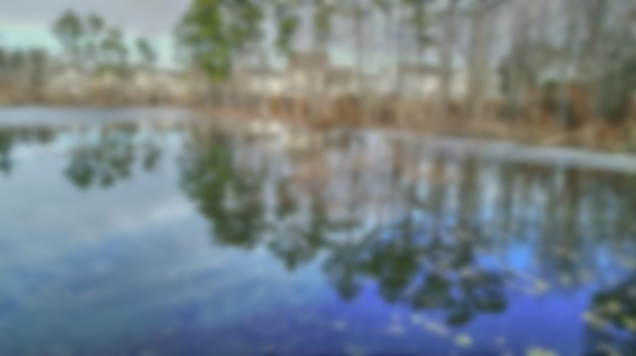
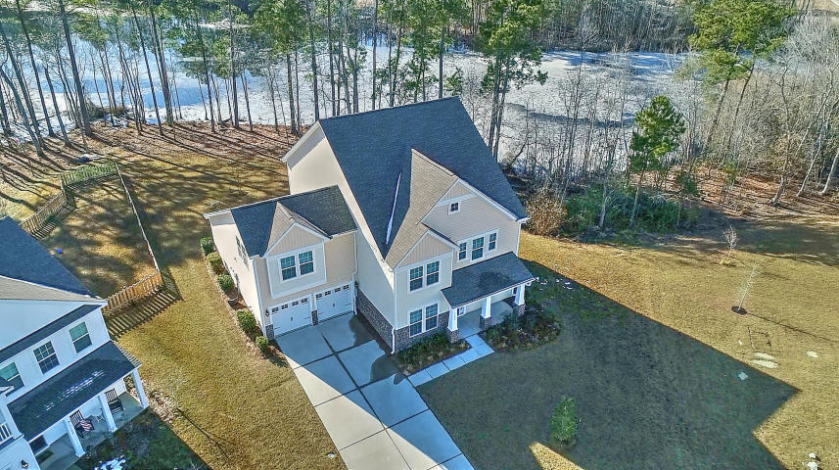

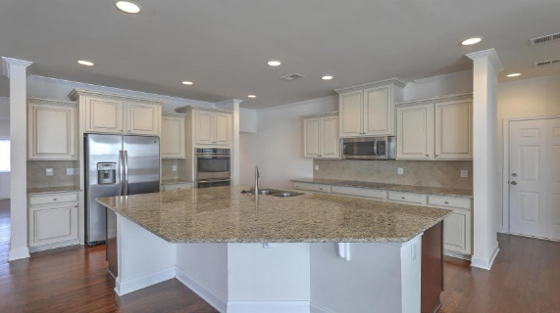
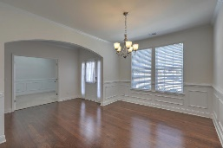
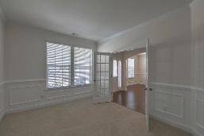
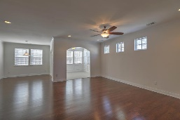
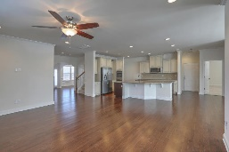
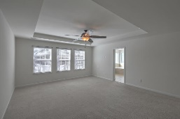
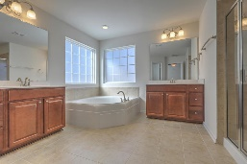
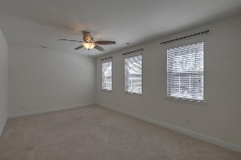
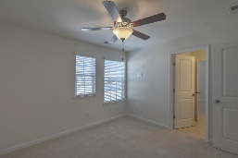
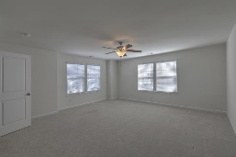
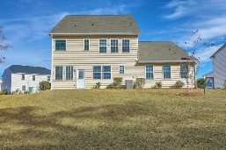
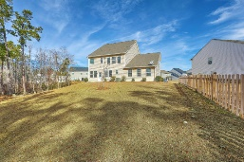
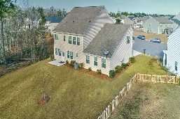


Join Us Saturday from 12-3PM View this Spectacular Waterfront Home!
1180 Moss Grove Drive
Moss Grove Plantation | Moncks Corner
MLS# 18000700 | $338,750
Wow! Why wait for new construction?! This elegant, spacious, no longer built Greyson floorplan, situated on one of the largest lots with gorgeous lakefront views, has over $38,000 in upgrades! Upon entry of the home, you are greeted by beautiful hardwood floors throughout with formal dining room on one side and office on the other, both with custom moldings. Transitioning into the living area, your amazing gourmet kitchen comes complete with massive island, granite counters, plenty of counter and storage space, large pantry and upgraded S/S appliances - a cook's dream and perfect area for entertaining! The large rec room in the rear of the home is perfect for your in-home gym, playroom or craft room. And you have a fantastic sunroom looking out to a beautiful lake! Upstairs you will find the huge Owner's Suite which has a sitting area, perfect for newborn nursery or relaxing retreat as well as a Spa-like bathroom with dual vanities, huge walk-in closet, shower and garden tub. There are also 3 additional bedrooms with 2 bathrooms to complete the second floor. Owner-added upgrades include irrigation system, rec room with separate HVAC zone, sunroom, French doors to office, custom moldings, gourmet kitchen, 5" gutters, window blinds, additional outlets in master bath, 7 TV wall outlets, additional attic insulation, ceiling fans in all rooms, enlarged patio slab, stair railings - over $38K in upgrades! Appraisal in hand!
Desiree Maurer Office - (843) 416-2000
Mobile - (843) 327-9010 desiree.maurer1@gmail.com
www.yourcharlestonhousesearch.com
Keller Williams Realty 496 Bramson Ct Ste 200 Mt. Pleasant, SC 29464

