Slide 1
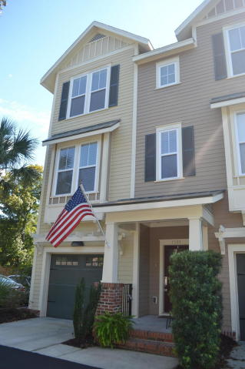
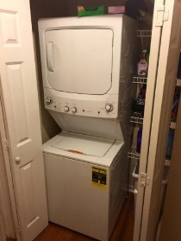
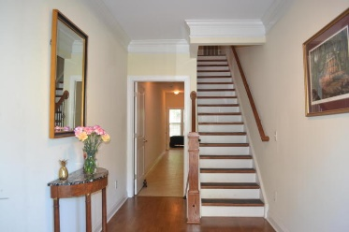
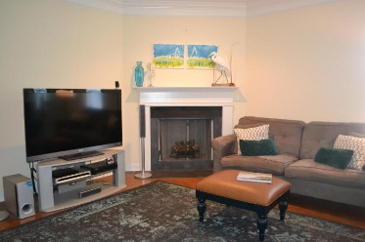
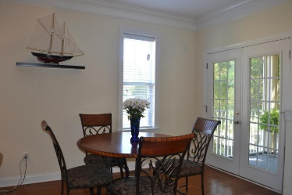
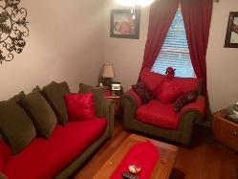
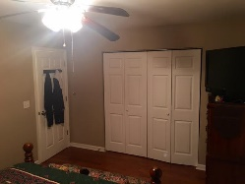
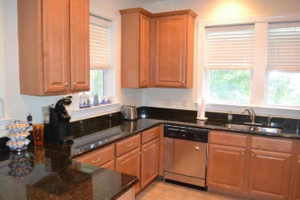
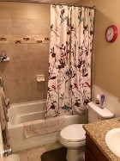
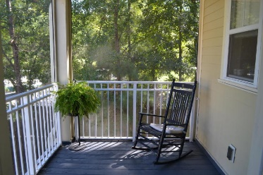
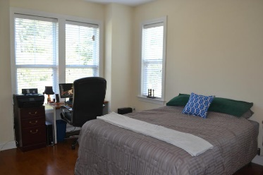
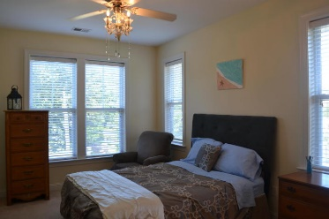
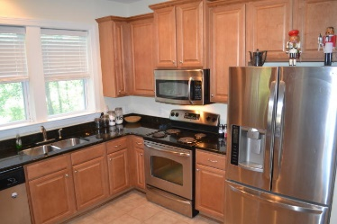

1181 Dingle Road
Royal Palms
Mount Pleasant, SC 29466
MLS# 16023611
$310,000
4 Bedrooms | 2/2 Baths | 2,450 sf
Price Reduced $15,000!
I loved this townhouse so much
I bought one myself!
Come see this great end unit townhouse in Royal Palms. It was the model for the original builder, so there are some upgrades. Four bedrooms, two full baths and 2 half baths with upgrades throughout. Hardwood floors in the living room, dining room and master bedroom. Tiled kitchen and baths. Living quarters on the second level with a screened in patio off the dining area. Large gas fireplace in the living room with extra windows because of the end unit. The garage is about 45 feet long and can store your car and all of your storage items. Owner is offering a one-year home warranty. Come and make an appointment today, because I have a very motivated seller.
Susan & Greg Day
843-900-0477 | 732-757-2904
charlestonbyday@gmail.com
www.charlestonbyday.com
AgentOwned Realty Co. Premier Group, Inc. | 824 Johnnie Dodds Blvd | Mt Pleasant, SC 29464

