Slide 1

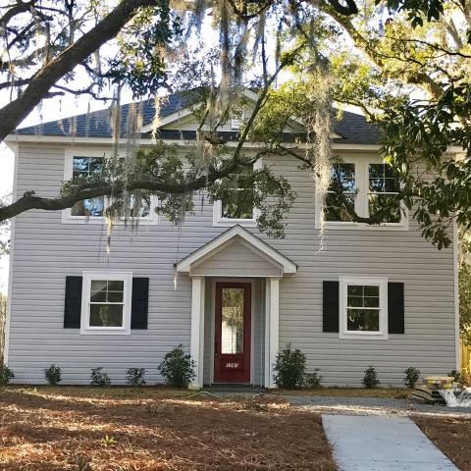
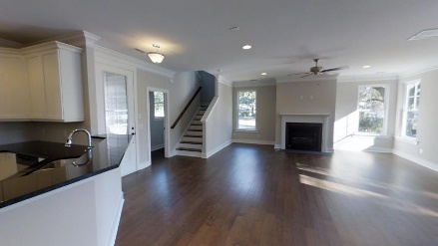
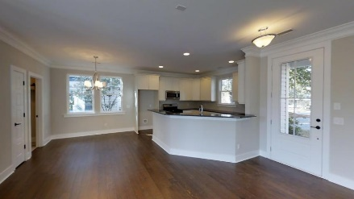
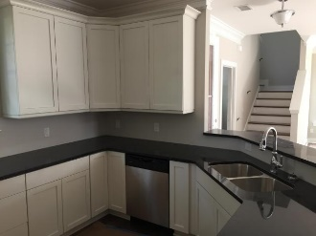
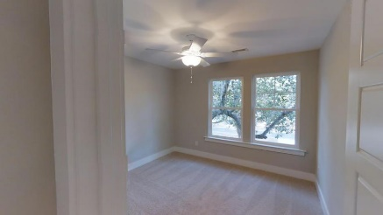
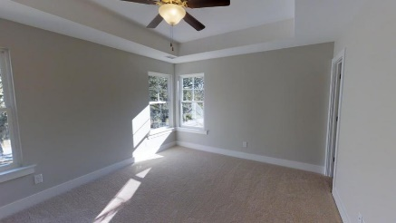
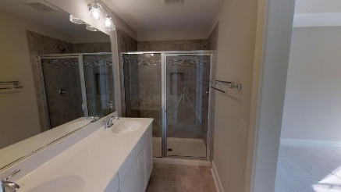
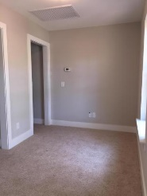
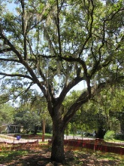
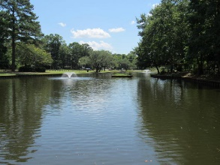


Park Circle New Construction!!
1181 Leesville Street
Park Circle
North Charleston, SC 29405
MLS# 16030206
$315,000
1,790 SF
3 Bedrooms :: 2½ Bath
BRAND-NEW, finished, three bed, two and a half bath home in Park Circle? Granite counter tops, wood floors, fireplace, privacy fence stainless appliances, gas range. Tankless water heater. Save thousands, as no flood insurance is NOT required. Enjoy your home on this high lot, nestled among the Grand Trees! It's just a short walk to the ''Circle”, all of the popular shops, restaurants, and night-life! Builder to provide ''2-10 Builder Warranty''. *** Property qualifies for 100% financing! call for details! Virtual tour available!
Eric Draper
(843) 442-7118
eric.draper@gmail.com
www.charlestonrealestategroup.com
Charleston Real Estate Group | 792 Folly Rd. C1 | Charleston, SC 29412

