Slide 1

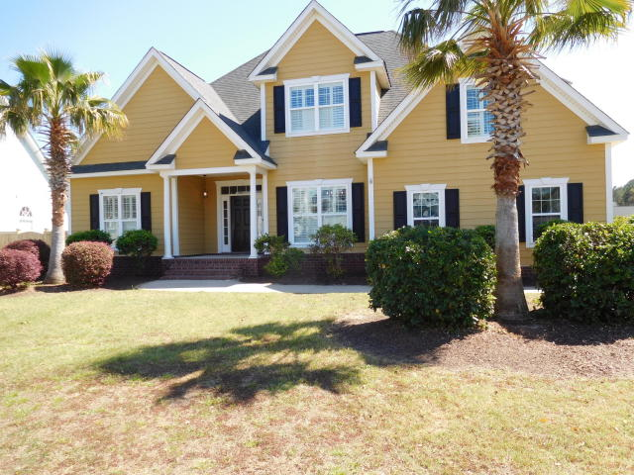
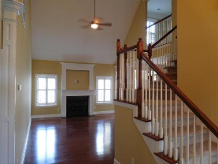
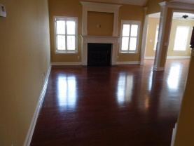
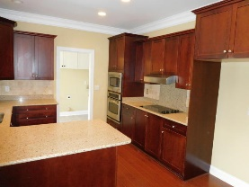
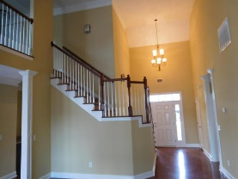
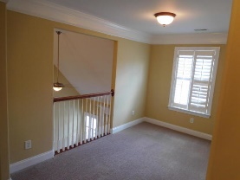
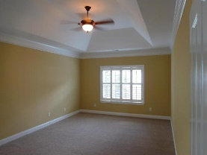
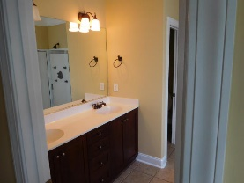
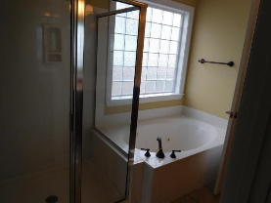
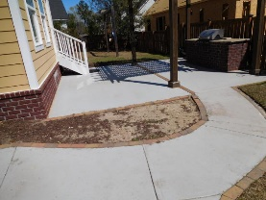
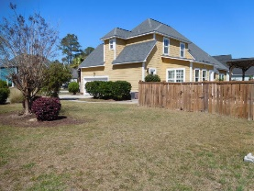
Don C. Mason, CIAS, CNE
(843) 364-9090
nibsc@aol.com
Water Front Subdivision
With Community Dock
1182 Rivers Reach Drive
River Reach Pointe | Charleston | MLS# 17006916 | $425,900
Professionally painted & brand new carpet in bedrooms. Move in ready. Community Dock on the Wando River with a covered family fishing area. New community pool in advance stages. Quiet Subdivision with no through traffic. Very open floor plan with Master Down. Tons of crown molding. Custom plantation shutters. Open kitchen with granite and stainless steel appliances. Nice sunroom added to home from original builder. Large patio with pergola. Gas grill with granite tops. Privacy fenced backyard. Large beautiful mature landscaping.
Real Estate Advocates LC
7613 Hwy 544 | Myrtle Beach, SC 29588
www.realestateadvocates.com

