Slide 1
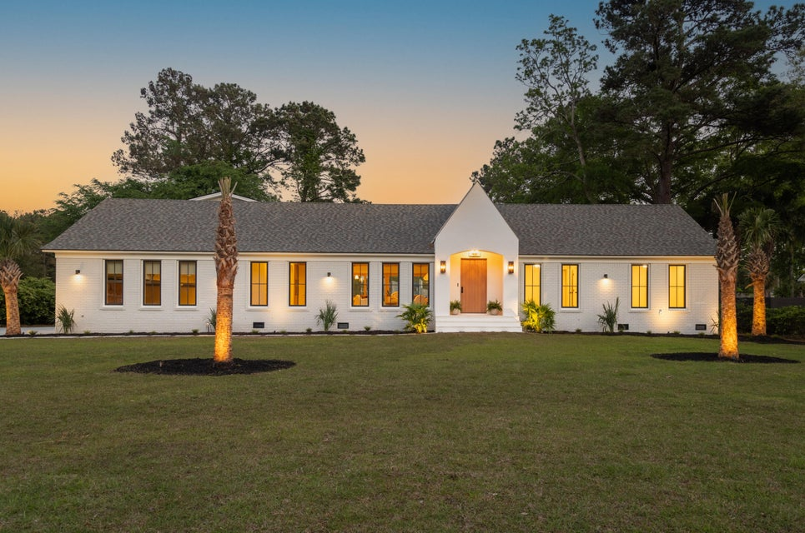


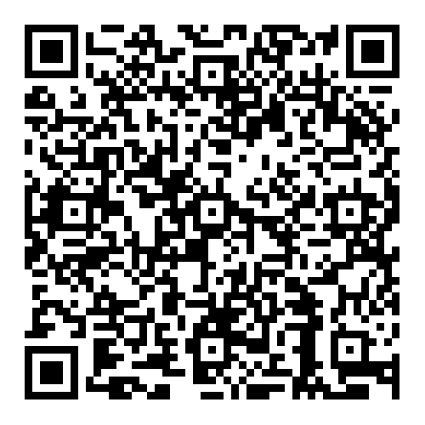

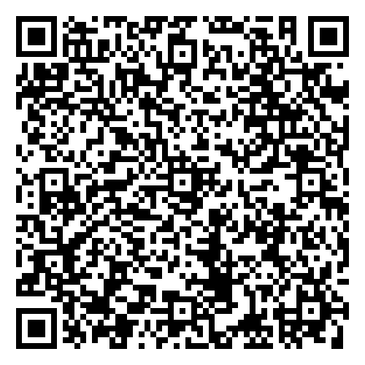


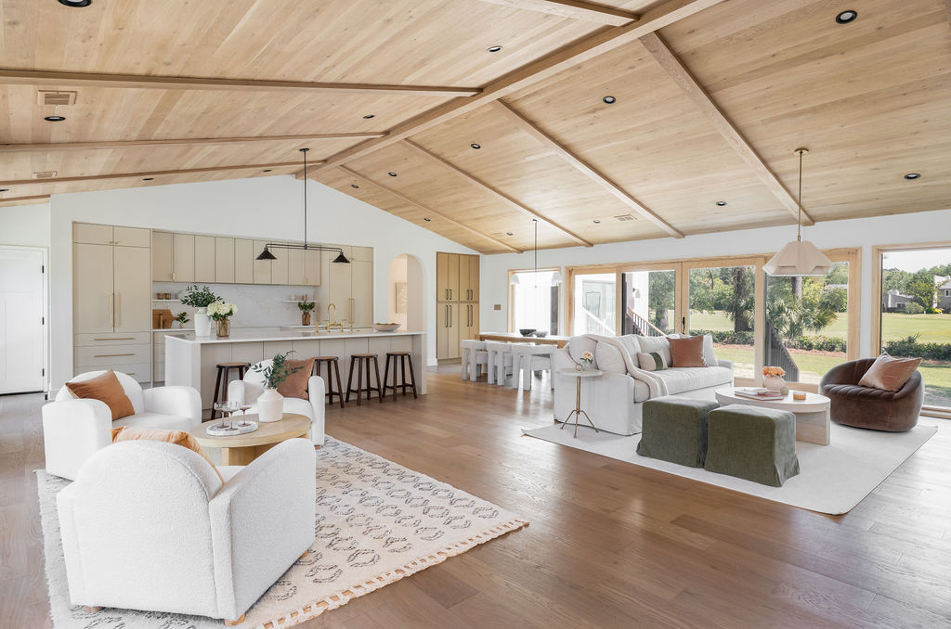
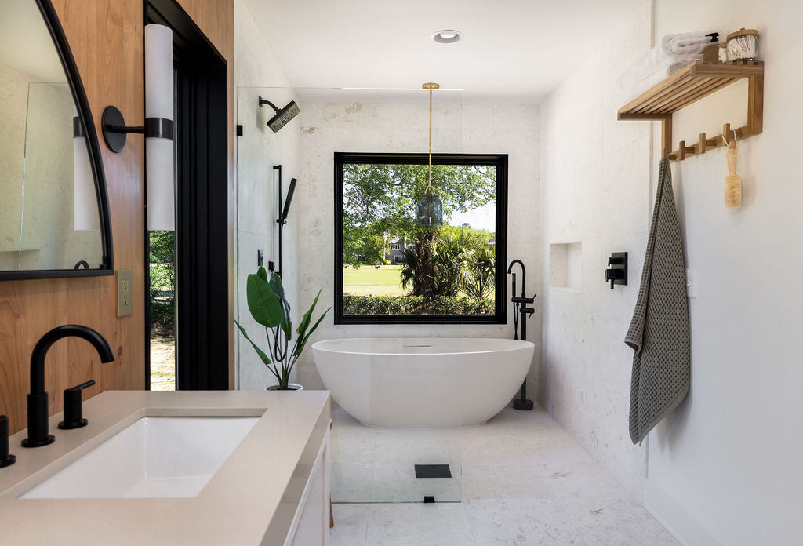
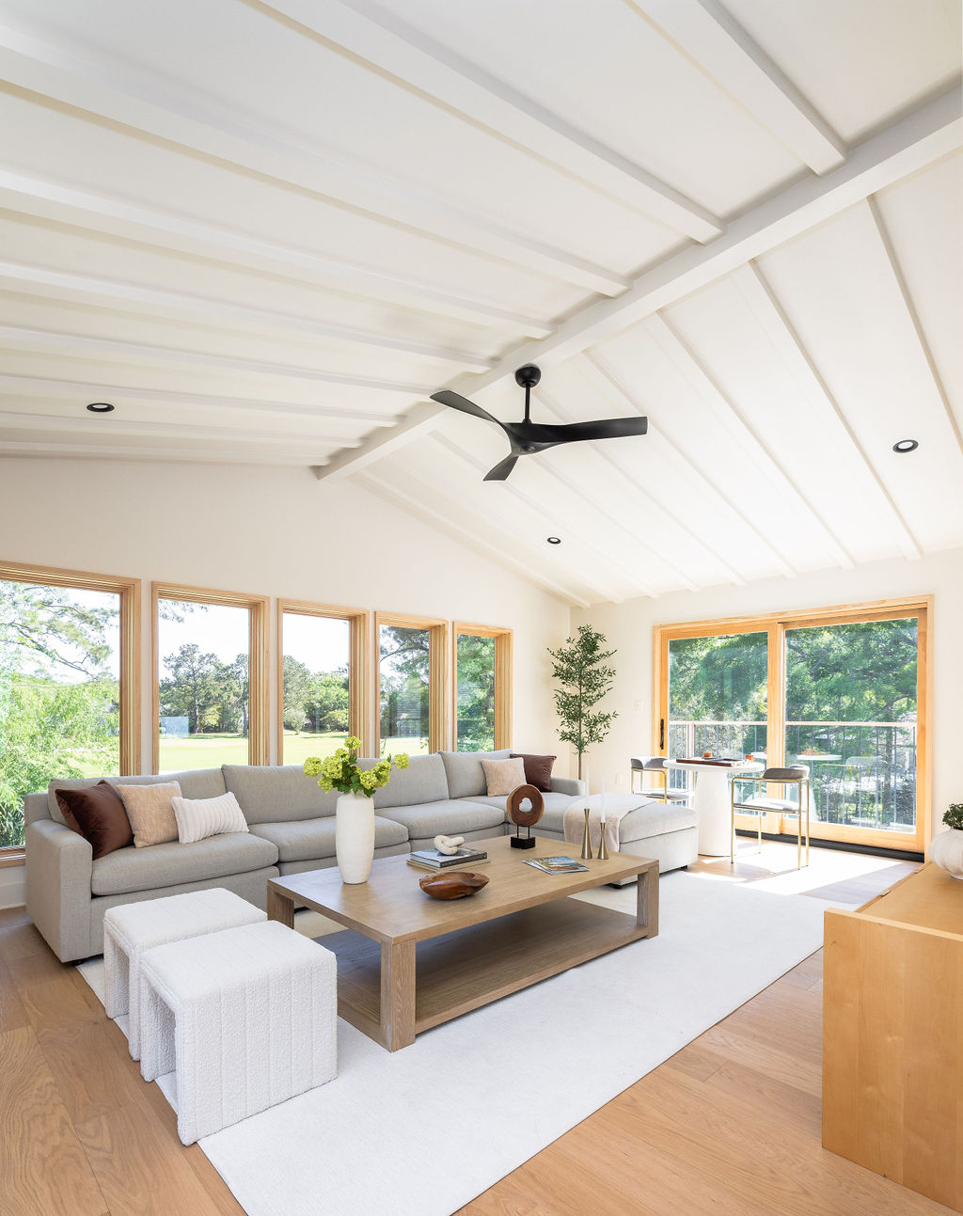
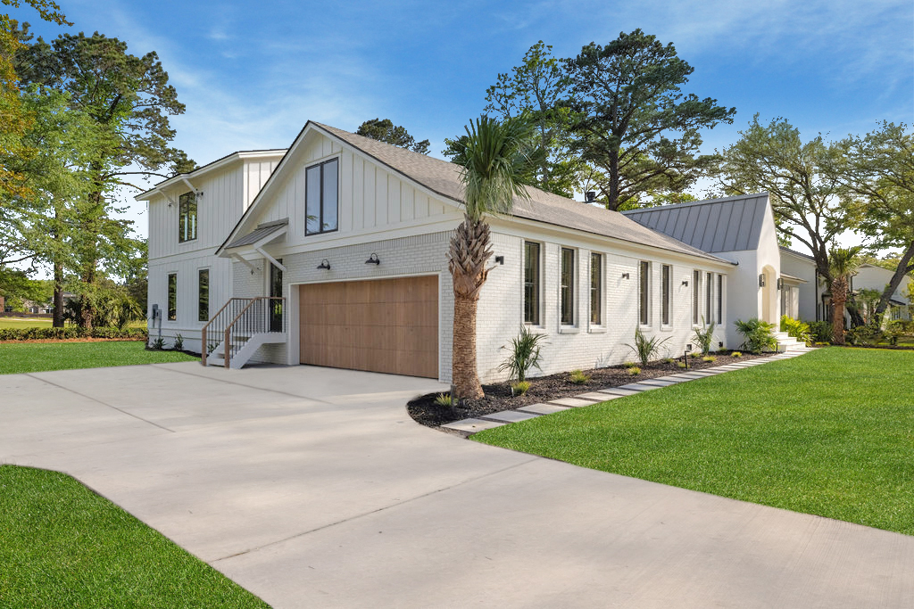
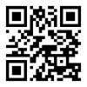


Just Listed in Snee Farm!
Video Tour
Virtual Tour
1183 Farm Quarter Road
Snee Farm | Mount Pleasant, SC 29464 | MLS# 25010704 | $2,850,000
This stunning 6BR, 5BA custom golf course home is better than new with luxury finishes, sweeping views, and unbeatable location. Priced below appraised value—instant equity! Just minutes to beaches & downtown Charleston.
Resort-style living awaits at 1183 Farm Quarter Road. Don’t miss this rare opportunity—schedule your private tour today!
Video Tour
Ellen O'Neil
Broker/Owner, ABR, e-PRO, CNE
Charleston Realtor of Distinction
843-300-8530
www.EllenONeilProperties.com

