Slide 1
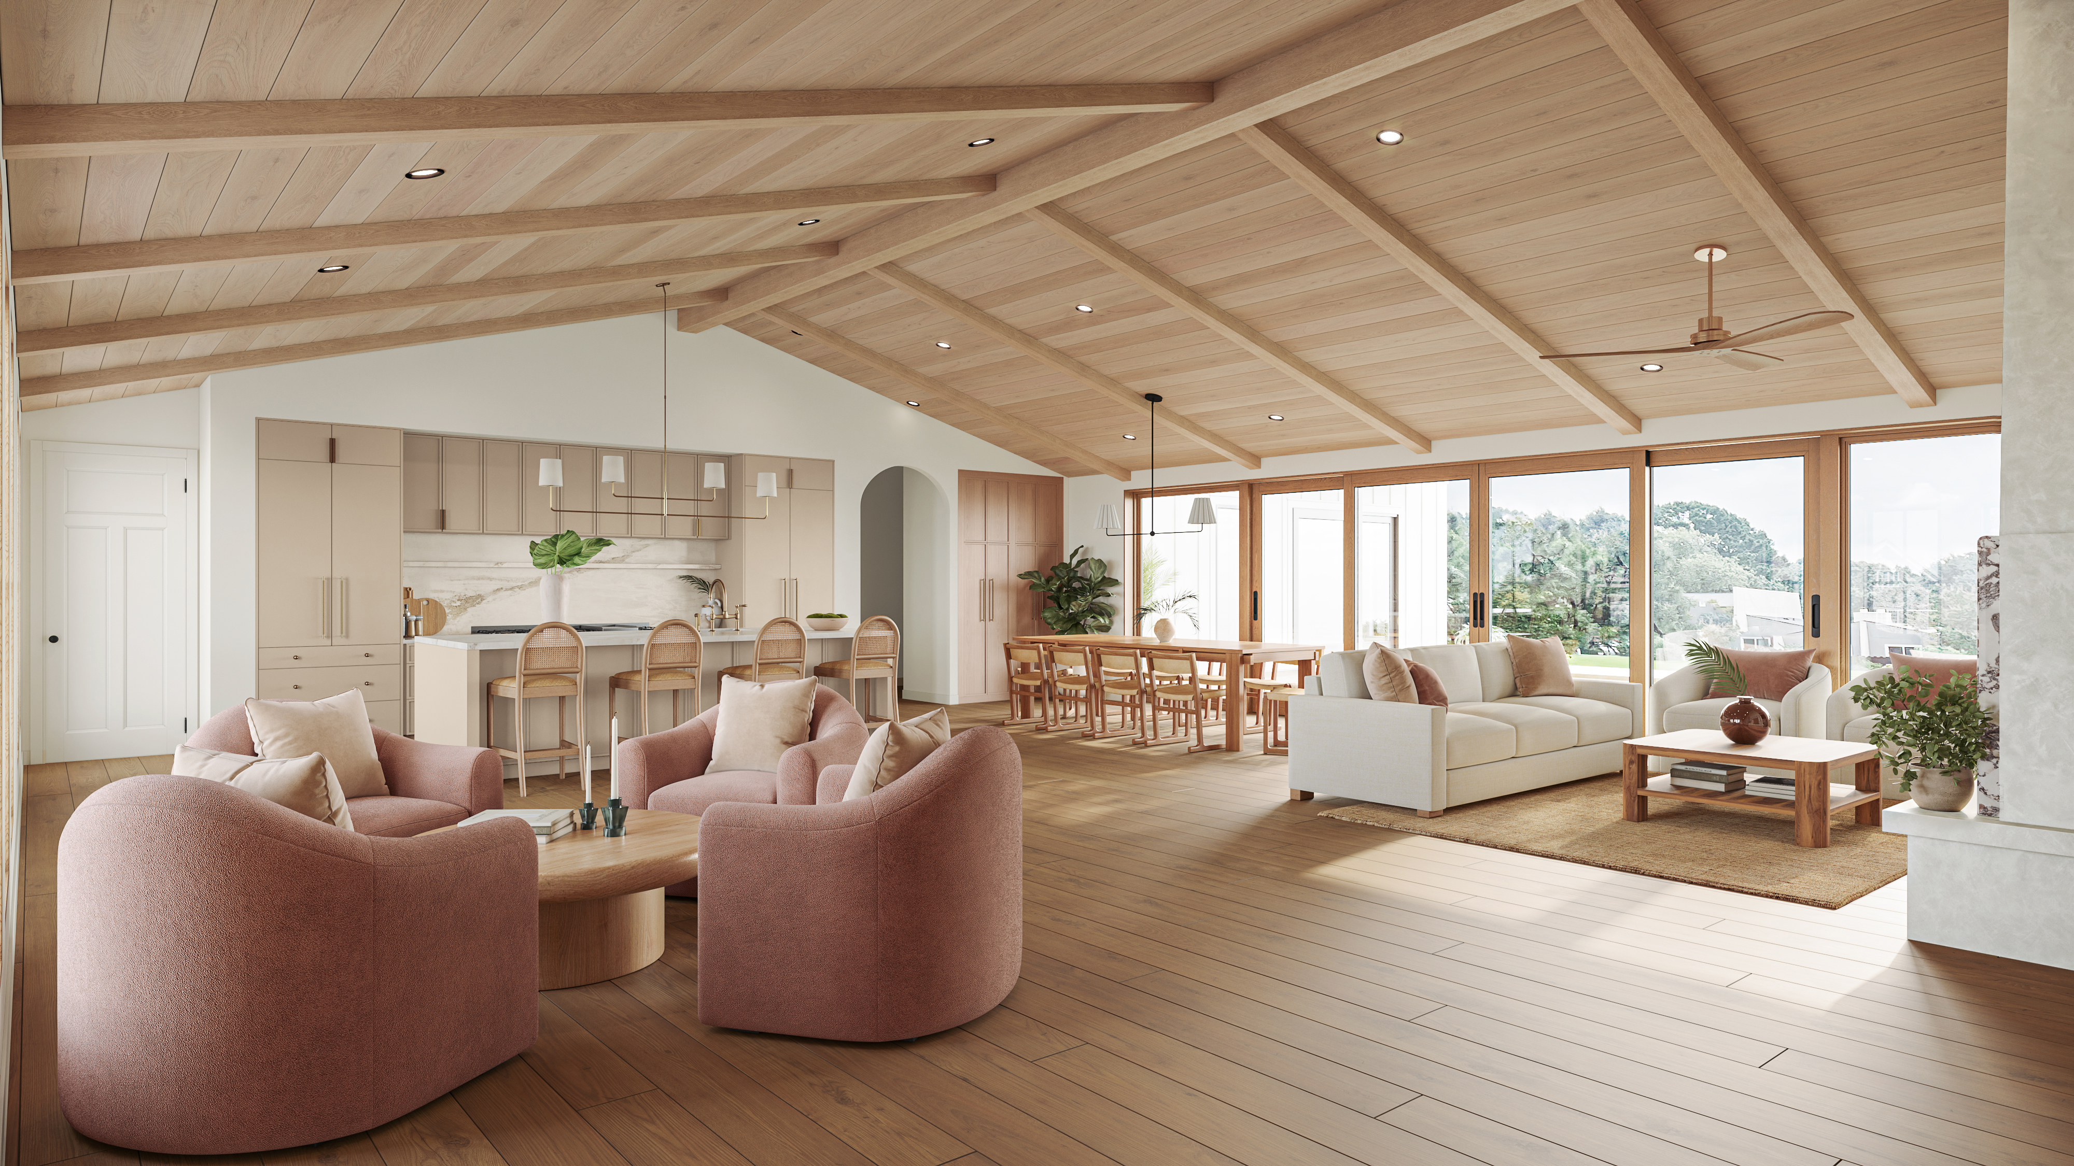
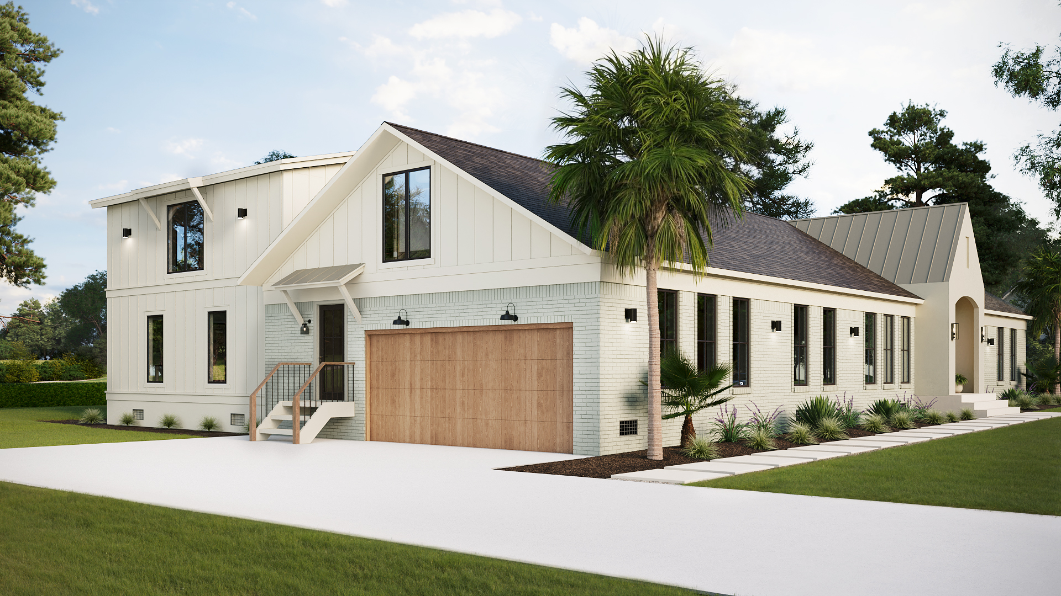
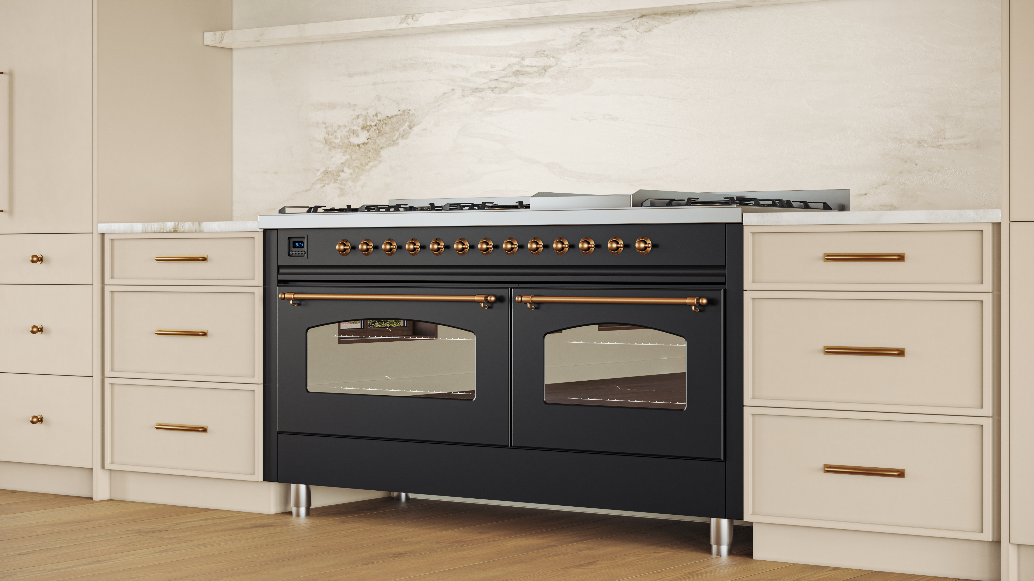
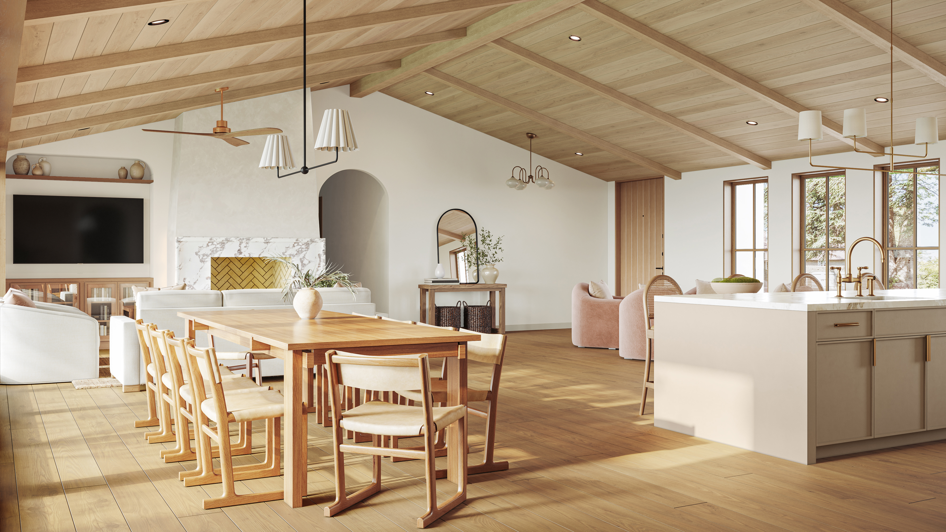
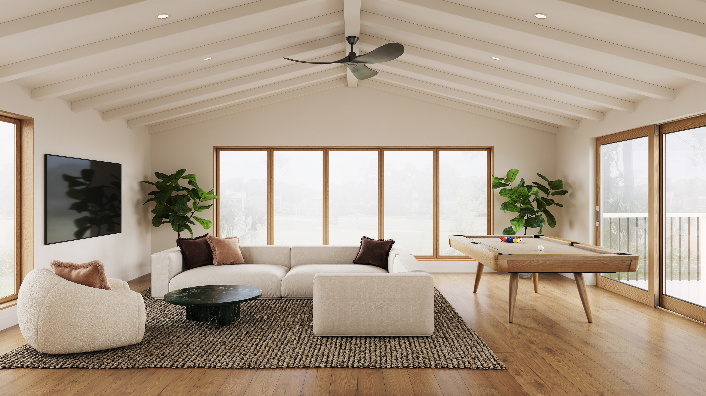
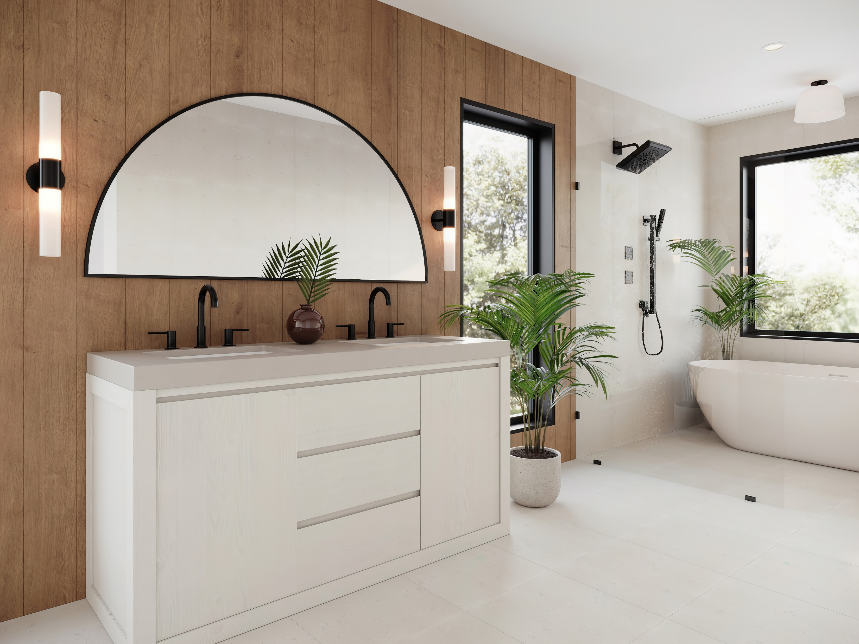
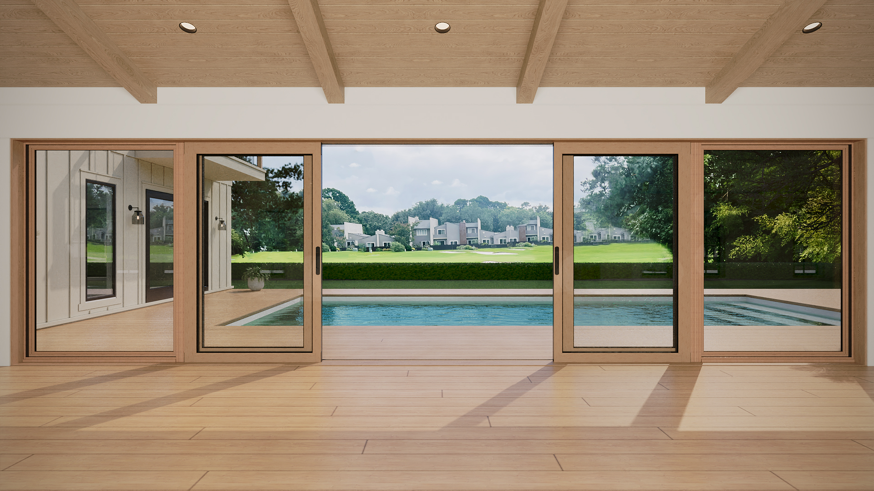
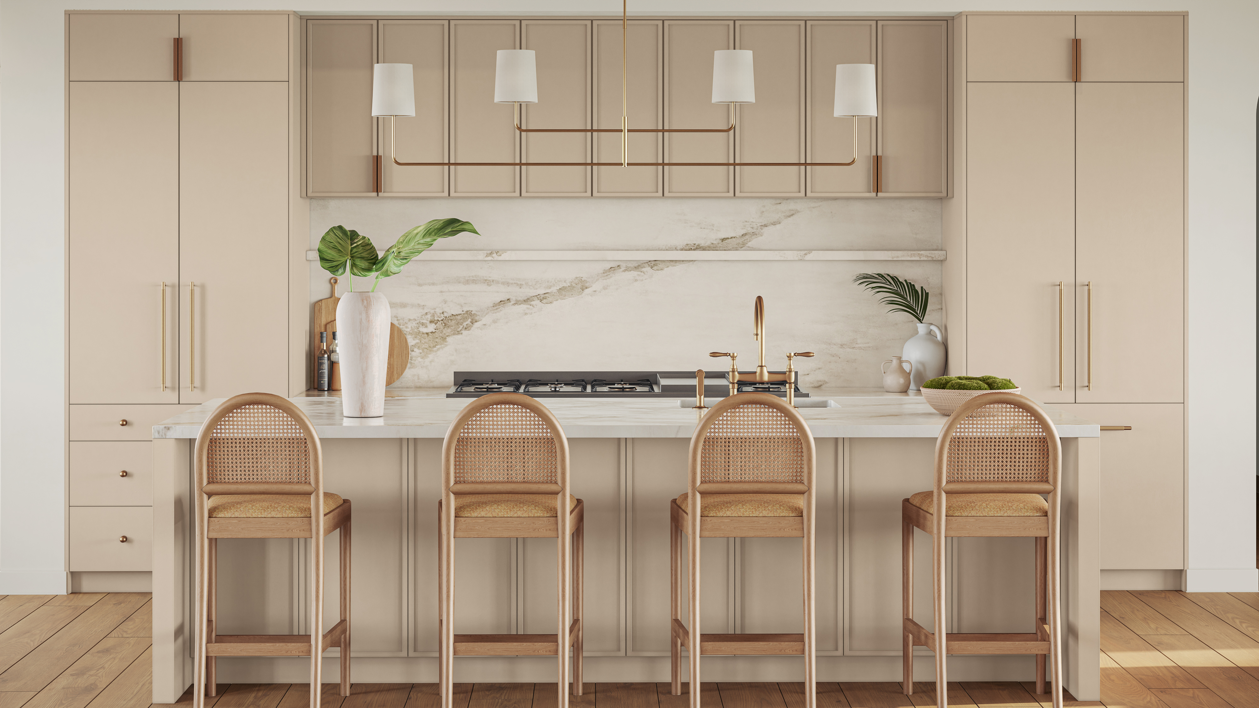
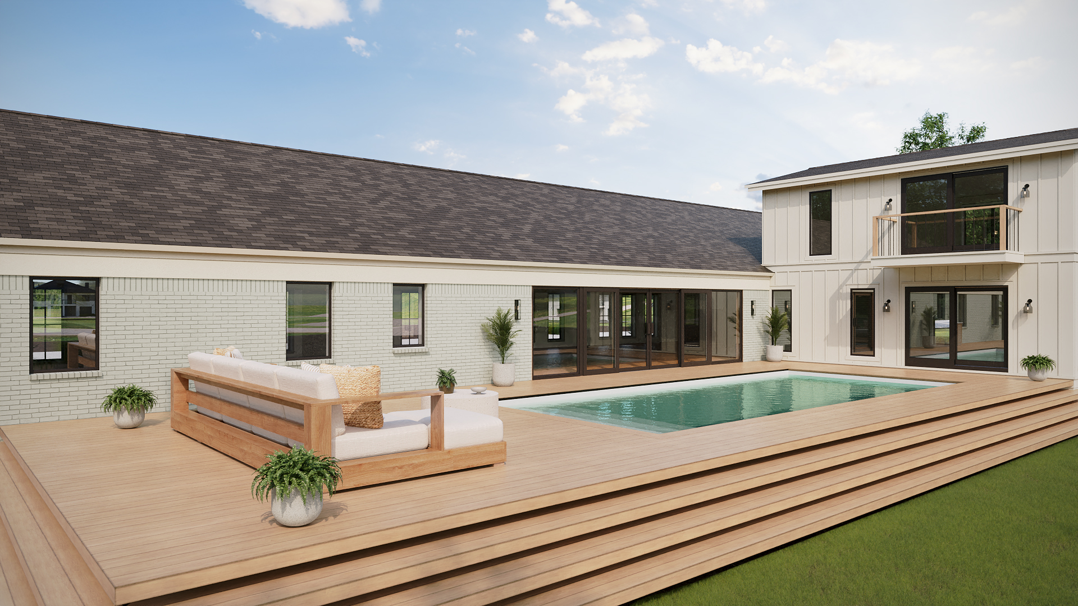
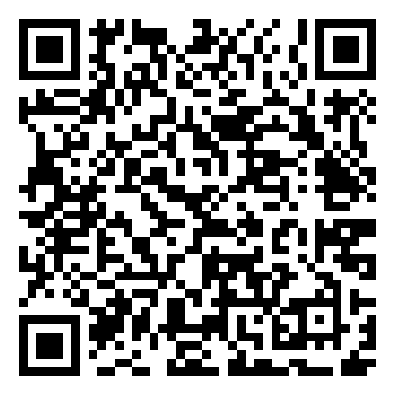
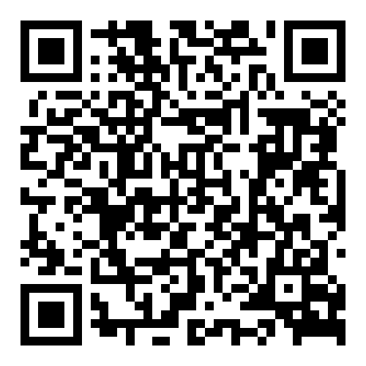


Exquisite Golf Course Living 1183 Farm Quarter Rd, Mt. Pleasant – A Rare Opportunity
1183 Farm Quarter Road
Snee Farm
Mount Pleasant, SC 29464
MLS# 24028796 | $2,900,000
Property Website
Video Tour
Sellers are offering 2% toward Buyer Agent Compensation
Discover unparalleled golf course living at 1183 Farm Quarter Road, Mount Pleasant. This custom-built, 6-bedroom, 5-bathroom home blends timeless elegance with modern design on a beautifully landscaped 0.6-acre lot. Enjoy breathtaking golf course views, a light-filled open floor plan, and luxurious finishes, including a gourmet kitchen with a 10' marbled island, high-end appliances, and vaulted ceilings with white oak planks. Spa-inspired bathrooms and versatile flex spaces add to the appeal, while stunning natural details like limestone, marble, and terrazzo elevate every room. Set for completion in December 2024, this is your chance to own a masterpiece in the sought-after Snee Farm community. Schedule your private showing today!
Property Video
Ellen O'Neil
Broker/Owner, ABR, e-PRO, CNE
Charleston Realtor of Distinction
843-300-8530
www.EllenONeilProperties.com

