Slide 1
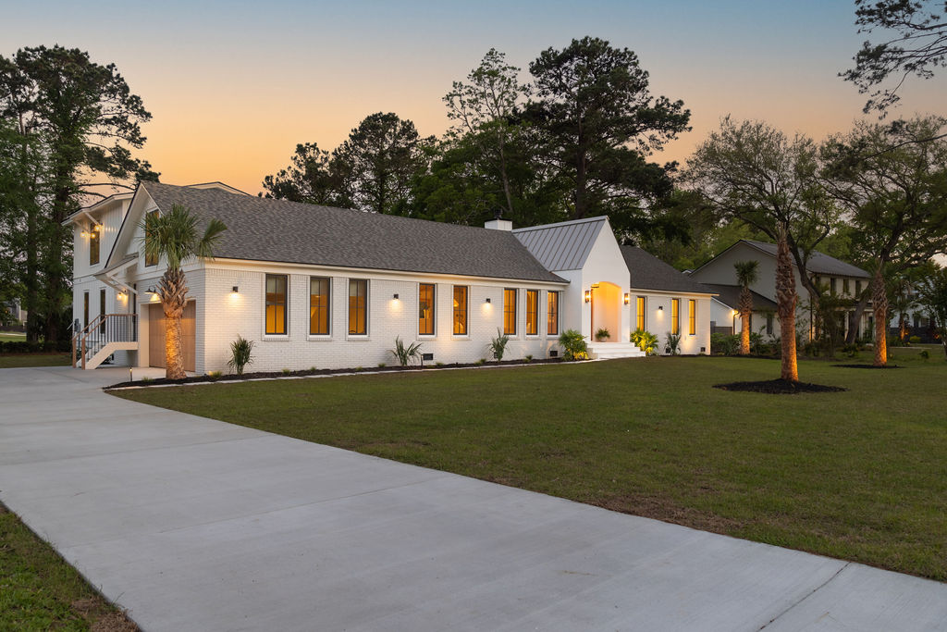


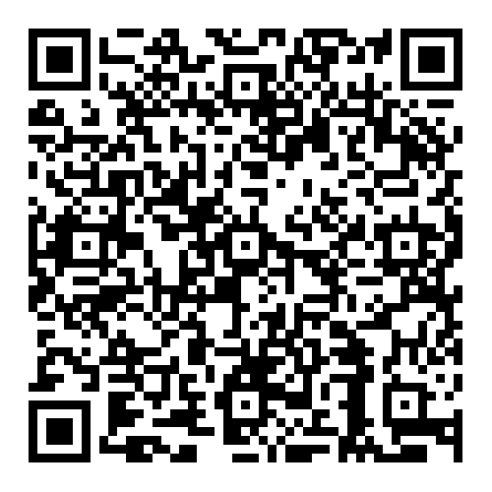

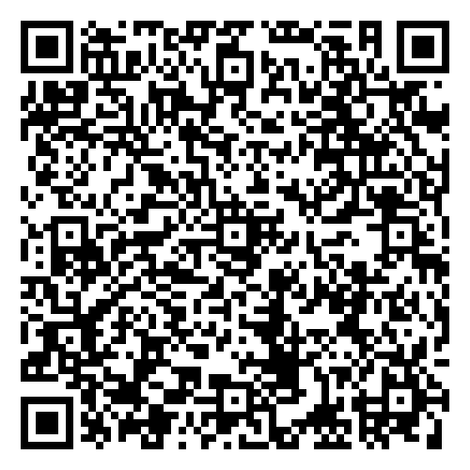


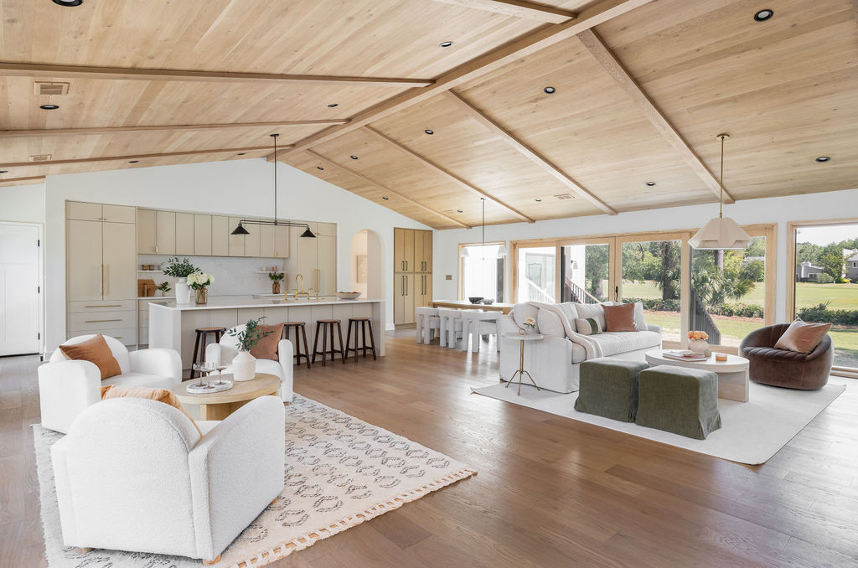
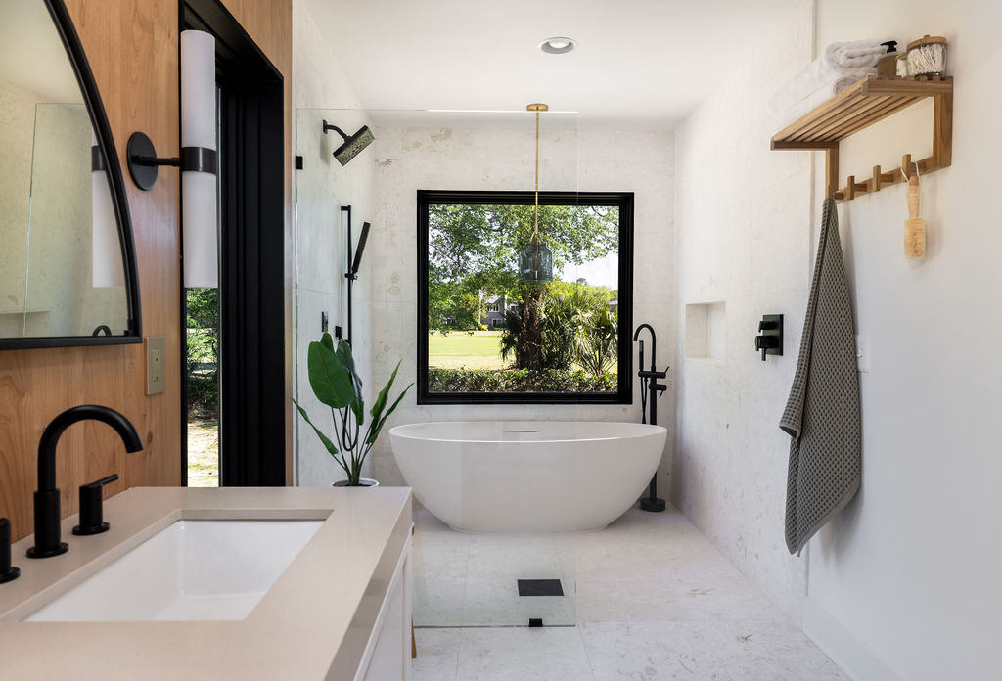
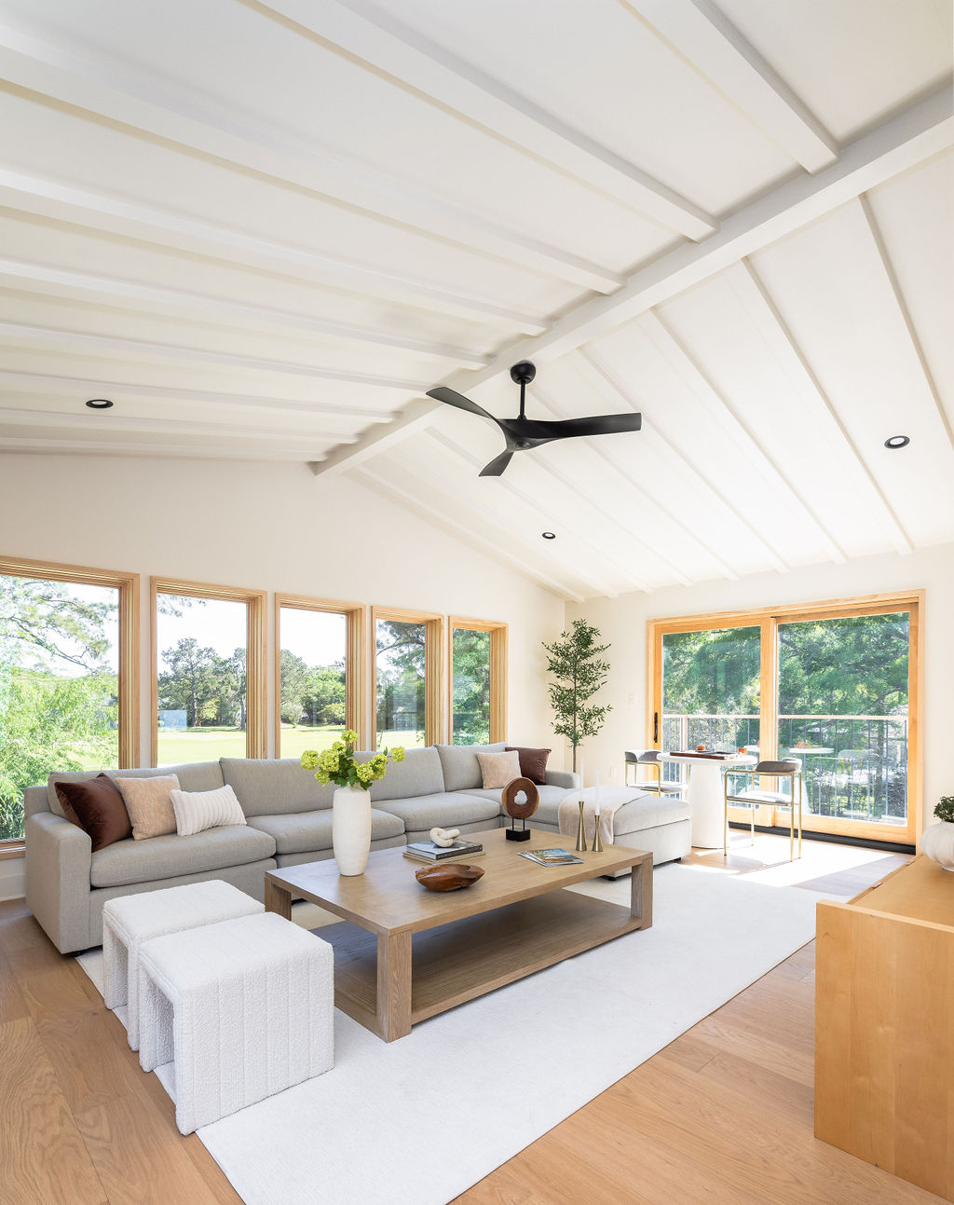
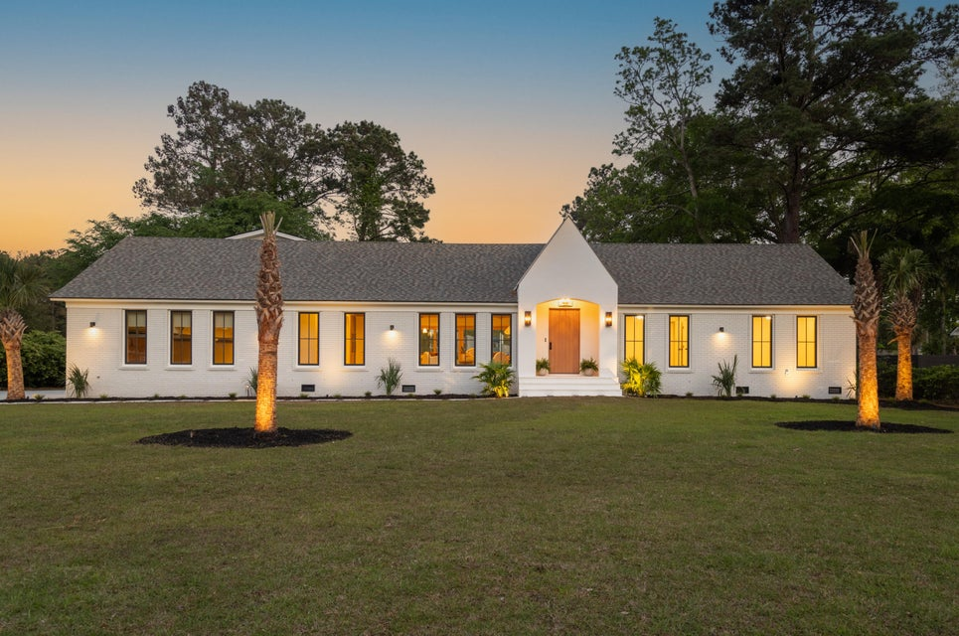



Broker Open House Thursday May 8, 2025 ■ 12-3 PM
Video Tour
Virtual Tour
1183 Farm Quarter Road
Snee Farm | Mount Pleasant, SC 29464 | MLS# 25010704 | $2,850,000
Please join me for wine and charcuterie at my incredible new listing on the golf course at Snee Farm. This is truly a one-of-a-kind home! If you are working with a buyer who has been searching for a luxury home with fine finishes throughout, you do not want to miss this opportunity. We have a 6-bedroom 5 bath home where a down to the studs renovation meets new construction. The Great Room offers tremendous versatility in its design and with so many bedrooms, this plan can easily accommodate the various needs of any owner. Snee Farm residents enjoy proximity to the beaches at Isle of Palms and Sullivans Island, shopping, the airport, excellent schools, and of course Historic Downtown Charleston. This is a home designed for the truly discerning buyer. I would love to share it with you Thursday afternoon. Video Tour
Ellen O'Neil
Broker/Owner, ABR, e-PRO, CNE
Charleston Realtor of Distinction
843-300-8530
www.EllenONeilProperties.com

