Slide 1
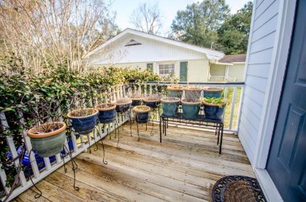
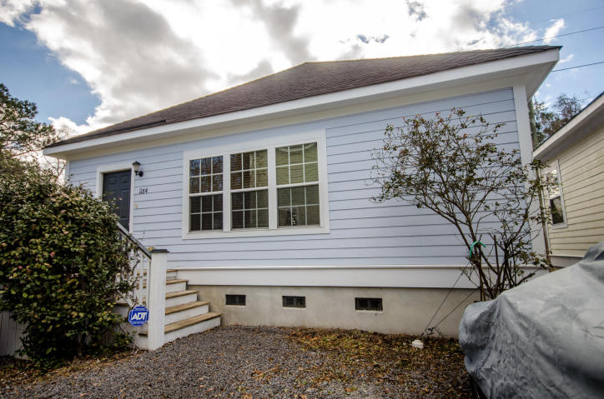
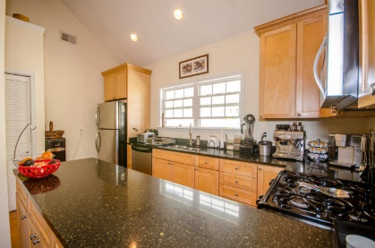
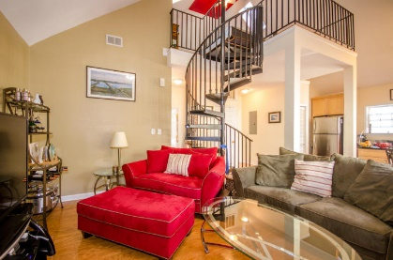
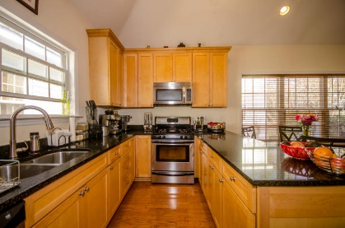
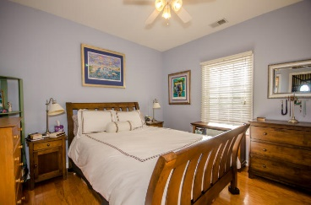
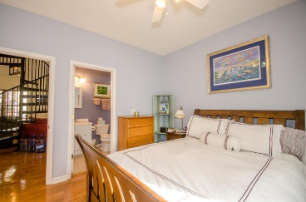
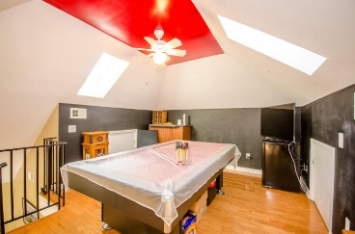
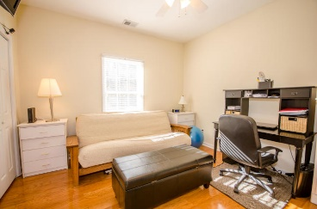
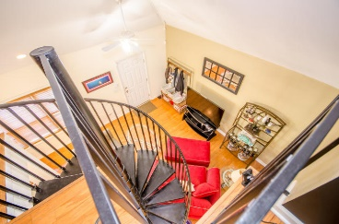


Price Adjusted!
$50 Gas Card Drawing
1184 Dills Bluff Road
Cocked Hat Point ~ Charleston, SC 29412
MLS# 17003878 ~ $240,000
Beautifully appointed home with an inviting deck and no yardwork!
Walk up to the front deck where your container garden is getting ready to bloom. Through the front door into the bright, sunny great room with a spiral staircase to the loft, a seating area for socializing or watching TV; an eating area with a great cook's kitchen with lots of quartz counter space, upgraded cabinets. The bedrooms, each with its own bath, are separated for a great roommate plan.
Head up the spiral staircase to a loft big enough for a pool table. Attic storage. Three parking places come with this home. Stainless stove, fridge, dishwasher, microwave are included, ceiling fans, new hvac in 2014 (zoned).
Susan Woodworth Kraber
Mobile - (843) 779-9655
susankraber1@gmail.com
ERA Wilder Realty, 125-F Wappoo Creek Dr, Charleston, SC 29412

