Slide 1

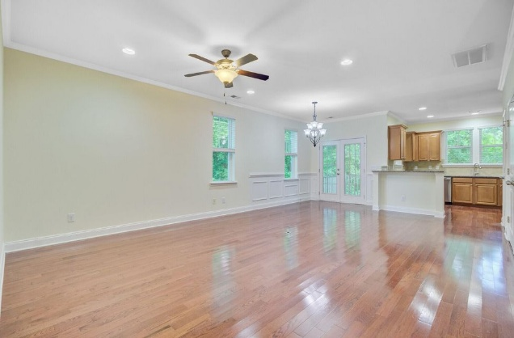
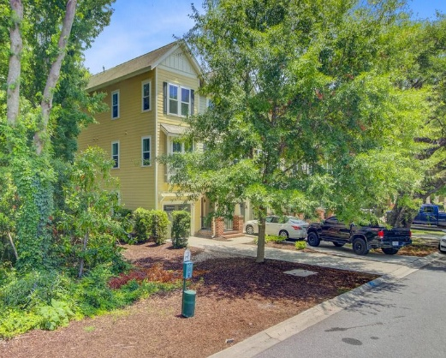
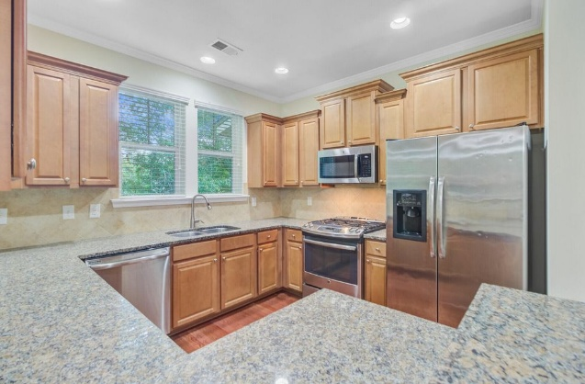
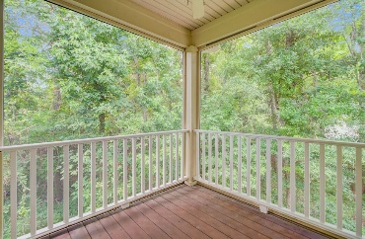
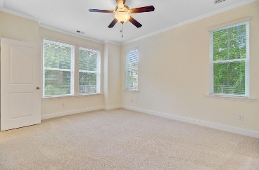
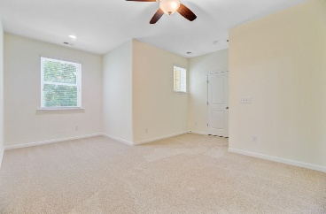
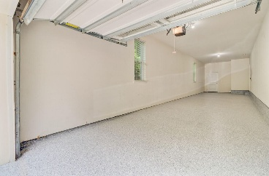
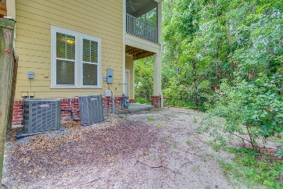
Mt Pleasant 4BR/3BA Townhome Priced to Move
Liz Lyman
603-391-6116 liz.lyman@exprealty.com
www.exprealty.com
1184 Dingle Road
Royal Palms | Mount Pleasant, SC 29466 | MLS# 25017541 | $555,000
Beautiful End-Unit Townhome in Sought-After Mt. Pleasant with Low HOA Tucked away just off Highway 17 in the heart of Mt. Pleasant, this spacious end-unit townhome offers the ideal blend of privacy, convenience, and comfort—just 10 minutes from the beach and 15 minutes to downtown Charleston. With a bright, open floor plan and tons of natural light, the main living area flows seamlessly from the kitchen to the dining and living spaces.
Just off the kitchen, enjoy a peaceful screened-in porch that's perfect for morning coffee or winding down in the evening. Backing up to a wooded buffer, this unit offers exceptional privacy—no direct views from neighbors into the living or bedroom spaces, and the porch is completely tucked away from view. The main floor boasts a generously sized primary suite with a walk-in closet and a well-appointed bath featuring a soaking tub and separate shower. Upstairs, two additional bedrooms share a Jack-and-Jill bath, along with two more large walk-in closets. On the ground level, a versatile bonus room works perfectly as a home office, media room, or guest suite.
Recent updates include fresh interior paint, new carpet in bedrooms, hallways, and stairs. Professionally resurfaced epoxy flaked garage floor, and newly installed gutters. The oversized garage easily fits two cars (or even three, depending on vehicle size) with additional space for storage or a golf cart.
Appliances will convey...including a brand-new fridge, washer and dryer. You'll also find a tankless water heater for energy efficiency and on-demand hot water and an active termite bond in place for added peace of mind. Located in Royal Palms, this home is truly move-in ready and offers both privacy and value in one of Mt. Pleasant's most convenient locations.
Additional guest parking nearby and boat/RV storage at no additional cost.
eXp Realty Charleston · 711 Fairview St · Fountain Inn, SC 29644

