Slide 1


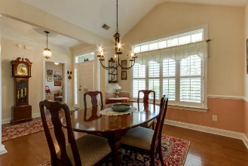
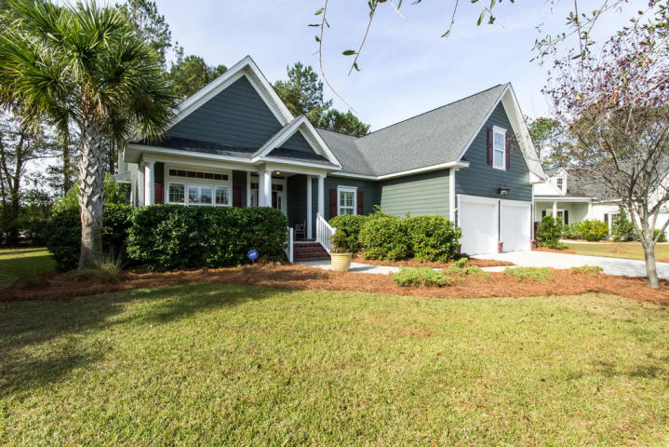
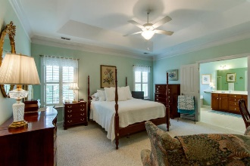
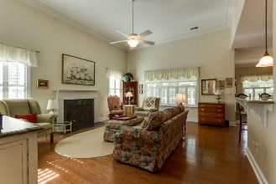
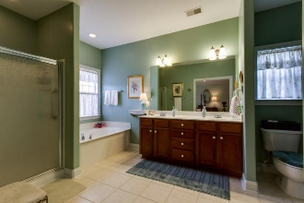
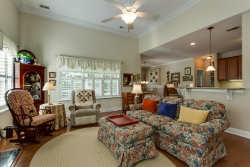
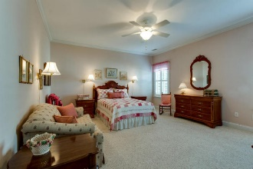
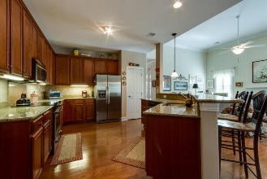
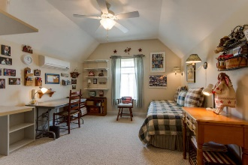
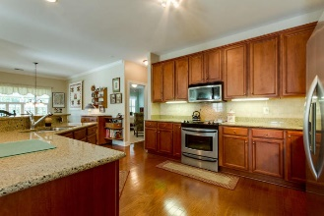
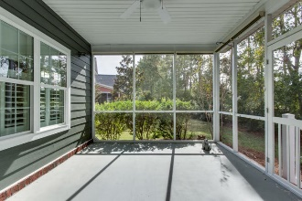
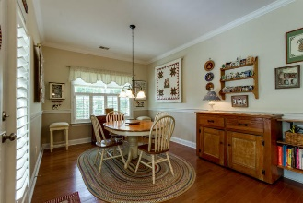
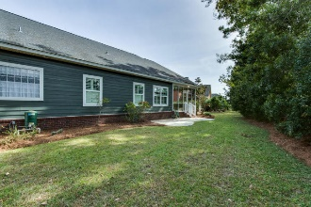
Thursday, December 15th from 11:30-1:30
River Reach Pointe
Broker Open House
$50.00 gift card give-away
1185 Rivers Reach Drive
MLS# 16027525 ~ $459,900
This wonderful cottage is in immaculate condition. Custom details throughout. Dual Masters with another room that could be office, or bedroom. Finished room over the garage with separate bath and individual HVAC unit. Hardwoods in all living areas. 10 Ft ceilings. Custom crown mold throughout this home. Formal Dining room. Large Family room with fireplace. Kitchen with stainless appliances and granite counters. Plantation shutters throughout home. Very nice eat in area with direct access to the screened porch. Yard backs up to a wooded area. Large Garage. House has been recently painted, power washed.
Lynn Barber
(843) 991-4186
lynn.barber@goldenbearrealty.com
Golden Bear Realty | 654 Coleman Blvd, Suite 100 | Mt Pleasant , SC 29464
| Office (855) 352-9088 | Fax (561) 721-3311

