Slide 1
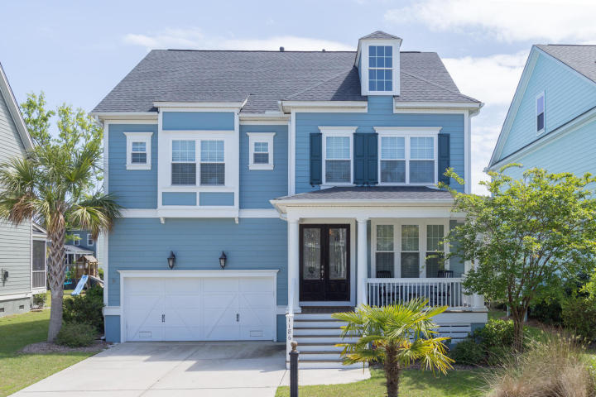
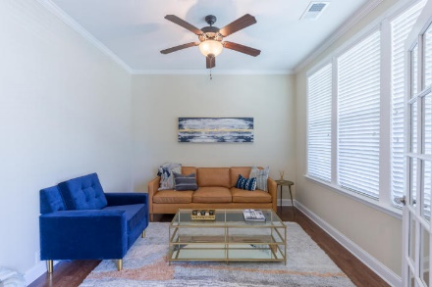
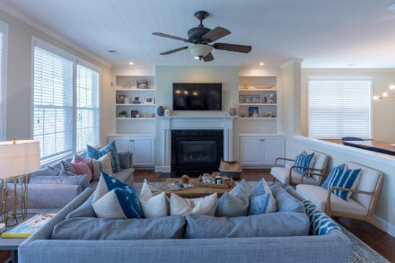
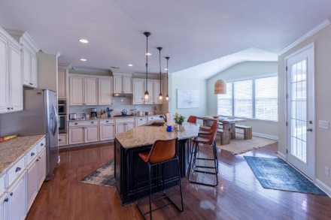
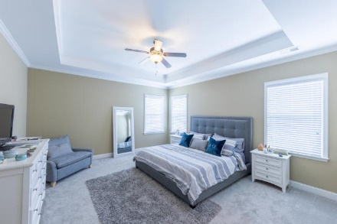
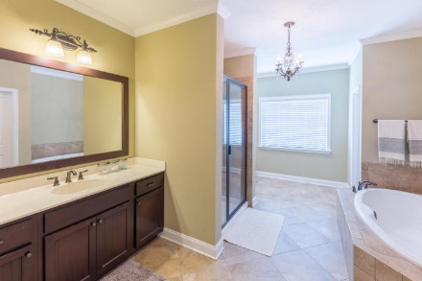
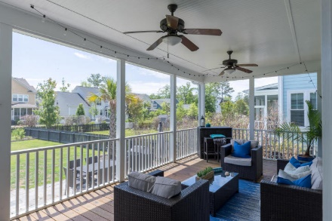
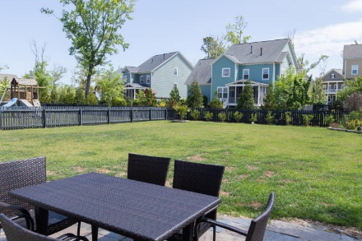


1186 Ayers Plantation Way Mount Pleasant, SC 29466 MLS# 18011286 ~ $569,000
Beautifully Maintained & Upgraded Dunes West Home
Beautifully maintained home with tons of upgrades throughout. This spacious, open concept floorplan provides both a formal dining room as well as eat in breakfast area. The kitchen is upgraded with granite counter tops, gas range, stainless steel appliances and new subway tile backsplash.
Just off this main living space there is a large screened in porch that leads to a premium, larger fenced yard and fabulous stone patio. The second floor features a spacious open loft with endless possibilities, a master suite with walk in closet, jacuzzi tub, tile shower surround, 2 additional bedrooms and bathrooms.
Mary Beth Bennett
(843) 367-1774
marybeth.bennett@agentownedrealty.com
www.chsarealiving.com
AgentOwned Preferred Group | 824 Johnnie Dodds Blvd | Mt Pleasant, SC 29464

