Slide 1
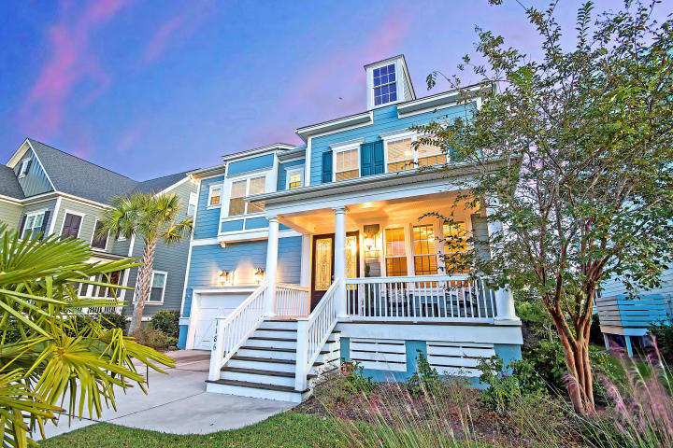
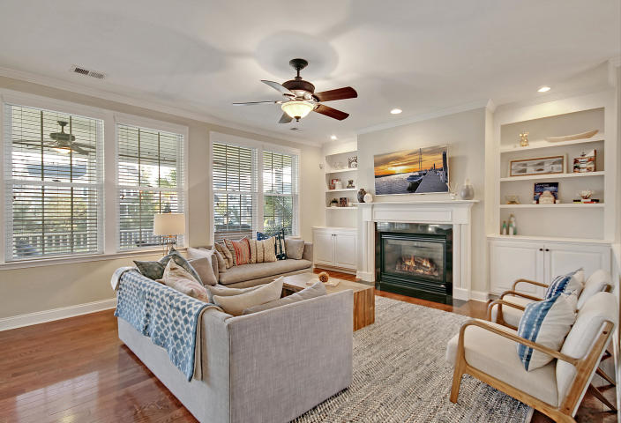
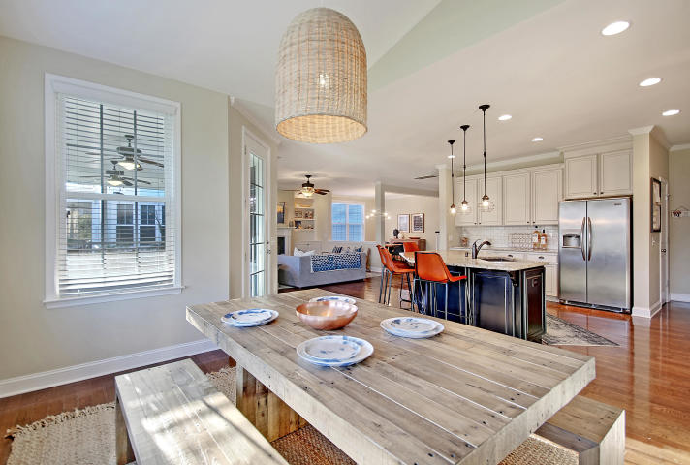
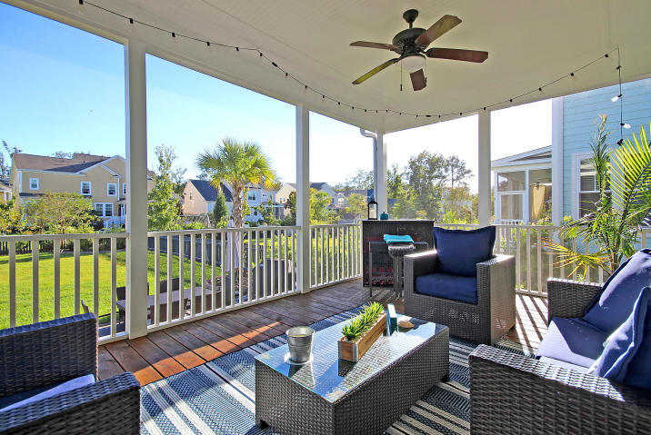
Price Reduced in Dunes West!
New A/C Units With Nest Controllers PLUS a 10 Year Warranty
Perfect for Entertaining
1186 Ayers Plantation Way
Dunes West ~ Mount Pleasant, SC 29466 ~ MLS# 18029028 ~ $539,900
You'll feel like you're stepping into a design magazine, when you walk in the door to this gorgeous Dunes West home! You will fall in love the open concept floor plan & the many custom features that the home offers such as the beautiful fireplace surrounded with built-ins.
Nate Gainey nate@mattoneillteam.com 843-513-2038

