Slide 1
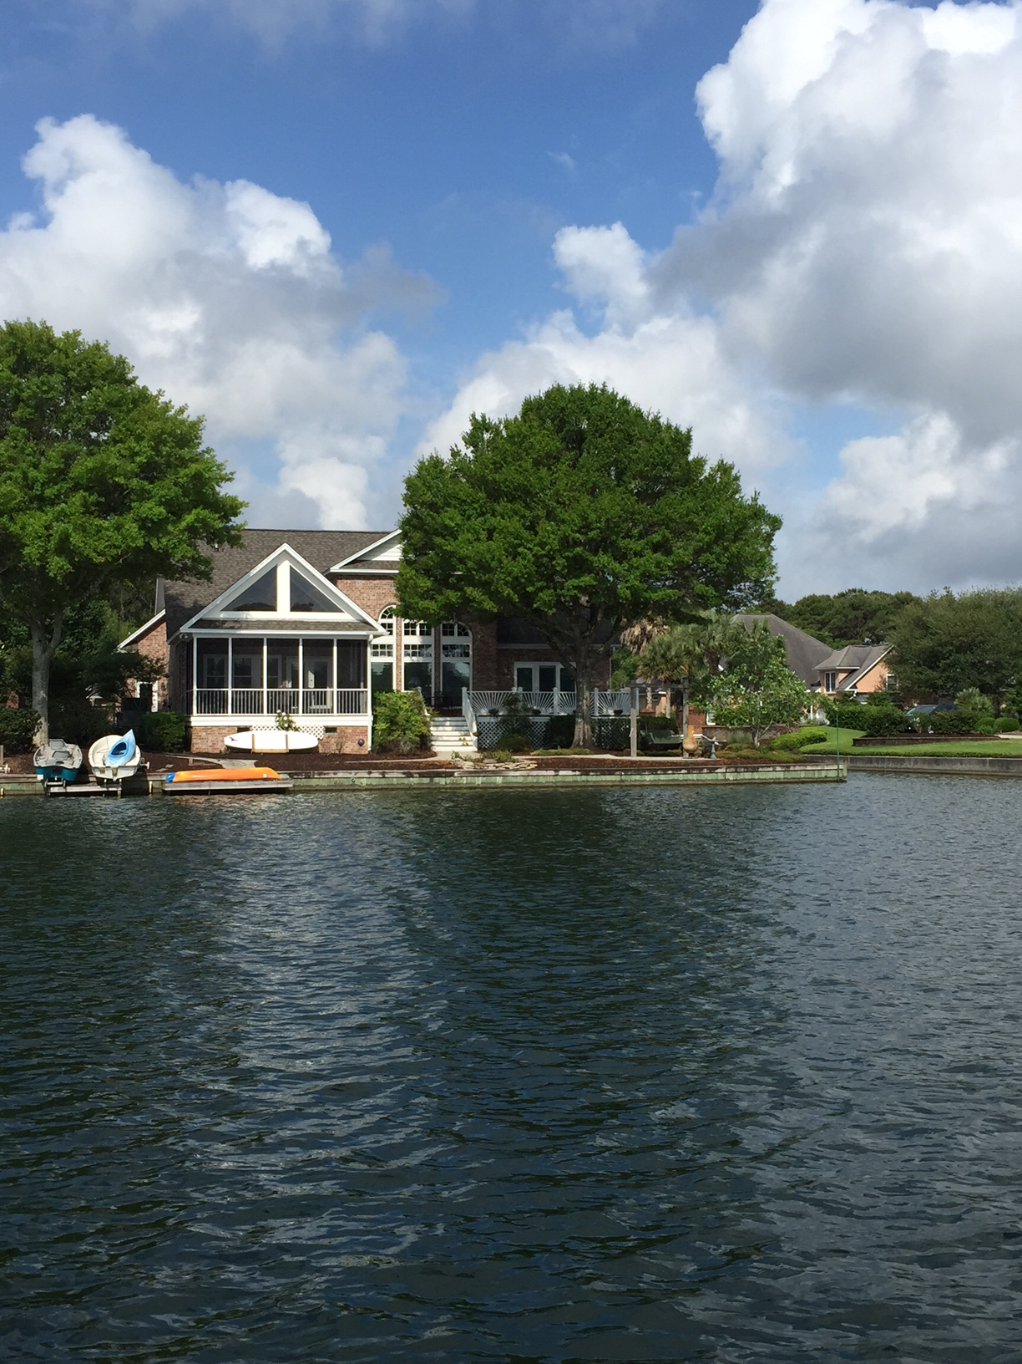


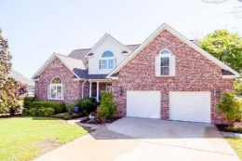


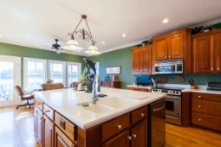



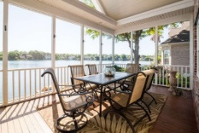
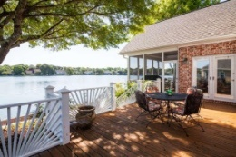
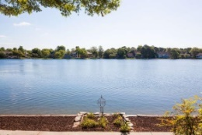
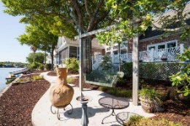


Waterfront Inner Mt. Pleasant X-flood Zone
1186 Waterfront Dr
Mt Pleasant MLS# 15013340
$907,000
Large homes on the BIG LAKE don't come on the market very often so DO NOT MISS THIS OPPORTUNITY!
Premium Lake AND Canal-front Lot; Ground-Floor Master; Brick Construction; Lake-Drawn Landscaping Irrigation; X-Flood Zone. Elegant touches abound such as the massive two-story windows in the living room, the coffered ceilings in the Master bedroom, the large island in the kitchen, and the spacious screened-porch and deck overlooking the lake. There are also heaps of not-so-obvious upgrades such as the high-end hurricane shutters; over-sized garage; handicap ramp and extra wide doorways on the main floor; dehumidified crawl space; new roof covering in 2014; new HVAC in 2011/2012; and so much more! Come grab this OUTSTANDING LOCATION today and personalize it to your liking!
The Boulevard Company, LLC
Mark Macpherson
mark@beachbreak-properties.com
843.367.5640 Mobile

