Slide 1
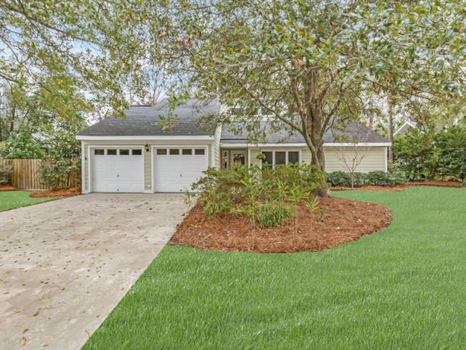
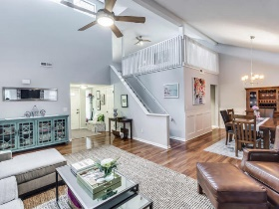
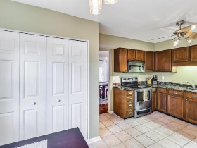
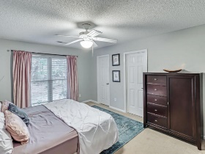
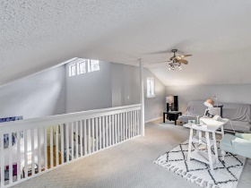
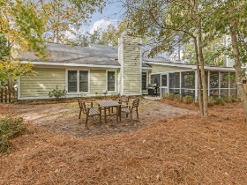


Just Reduced in Snee Farm
1187 Ambling Way
Mount Pleasant | MLS# 17000350 | $425,000
Move in ready! Welcome home to this lovely updated 1.5 story home in highly sought after Snee Farm. Meticulously maintained and loaded with nice features including 3 bedrooms, 2 baths, a bonus finished loft area and desirable open floor plan with vaulted ceilings. Highlights include hardwood floors, updated paint, wainscoting, granite in the kitchen along with stainless steel appliances, wood burning fireplace, huge screened porch and oversized private backyard with enough space and gate access to store a modest sized boat! Newer windows, roof (2008) HVAC (2010) and cement plank siding provide peace of mind for owners. All within a few short minutes to Mount Pleasant Towne Centre, Isle of Palms beach, and I-526. Membership is available to enjoy Snee Farm Country Club pool, tennis and golf.
Crissy Rowell
Mobile - (843) 377-5177
crissy.rowell@carolinaone.com
www.crissyrowell.com
Carolina One Real Estate | 195 W Coleman Blvd | Mt Pleasant, SC 29464

