Slide 1
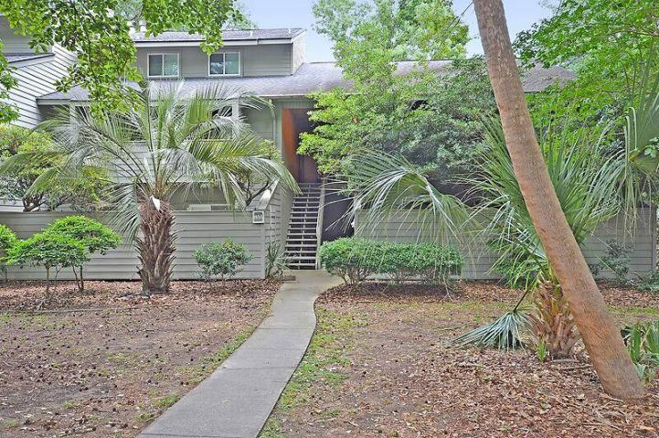
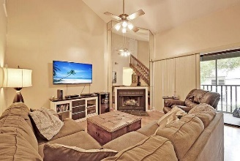
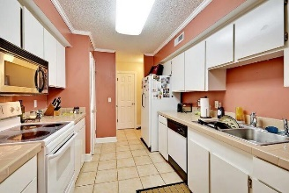
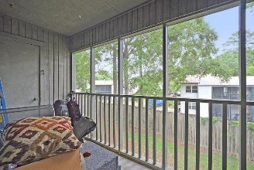
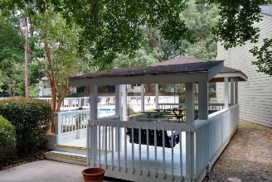
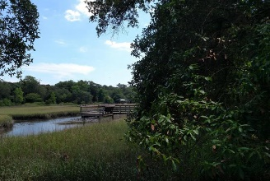
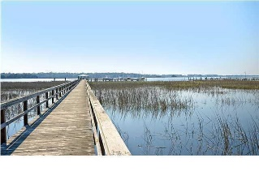

1188 Village Creek Lane 3 Village Creek | Mount Pleasant MLS# 16014007 | $224,900
Loaded with Updates
Rare 3 Bedrooms Close to Ravenel Bridge Under $225K
Spacious 3 bedroom 3 full bath condo is MINUTES from downtown Charleston, MP Waterfront Park, beaches, I-526, airport, and hospitals-LOCATION! This is one of only a handful of units that have dual masters one up and one down. The condo features vaulted ceilings, fireplace, screened porch, and eat-in kitchen. Majority of unit has tile or hardwood flooring. Village Creek has wonderful amenities at an affordable price: community pool, tennis court, crabbing dock on Shem Creek, and green space. Currently there are tenants in the property that can vacate with notice for a new owner or If you want to move in later they would also stay longer with a new lease. You will not find another unit that offers Central Mount Pleasant location, dual masters, and the amenities of this condo! COME SEE TODAY
Stan Huff
843-670-2835 stan.huff@agentowned.com
Jill Marcacci
843-297-5590 jill@agentowned.com
www.agentownedrealty.com
AgentOwned Realty Co. Preferred Group, Inc. | 824 Johnnie Dodds Blvd | Mt Pleasant, SC 29464

