Slide 1
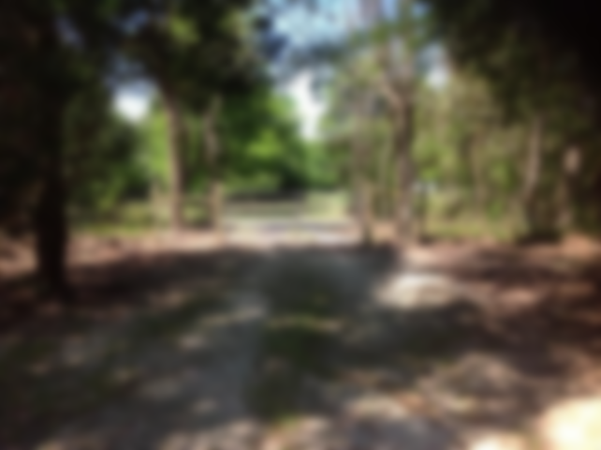
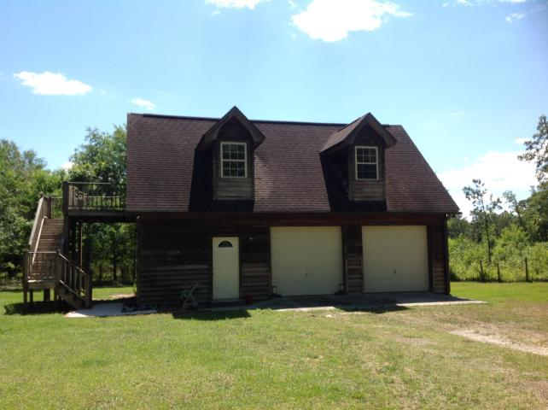
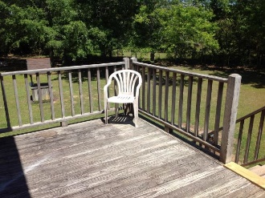
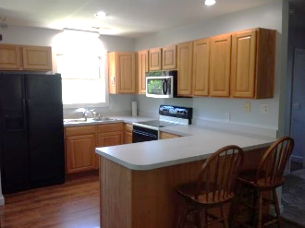
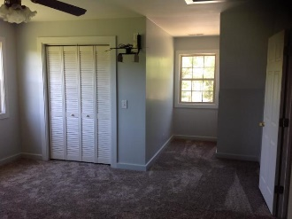
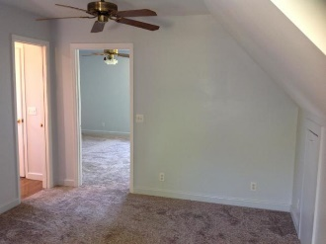
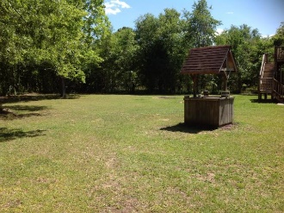
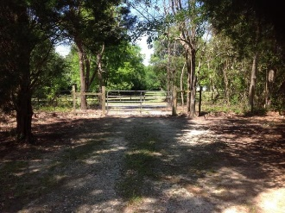

SERENE SETTING AND MOVE IN READY!!!
1189 Gardensgate Road
Eutawville, SC 29048 | MLS# 20011744 | $124,900
1 Bed | 1 Bath | 864 Square Feet | 2½ Acres
THIS RUSTIC HOME IS ONE BEDROOM AND ONE BATH ON 2.5 ACRES WITH A TWO CAR GARAGE. THE HOME IS COMPLETELY FENCED ON 1 ACRE HOMESITE BEHIND A PRIVACY GATE. THERE IS AN ADDITIONAL 1.5 ACRES. THERE IS ALSO NEW CARPET AND THE LIVING SPACE HAS ALL NEW PAINT. KITCHEN HAS HICKORY CABINETS AND OPEN FLOOR PLAN TO LIVING ROOM. NEW HVAC UNIT AS WELL. WITH COUNTY APPROVAL MAY BE ABLE TO ADD ON OR ADD ANOTHER STRUCTURE. THIS PROPERTY IN A SERENE SETTING AND MOVE IN READY!!!BUYER AND BUYERS AGENT PLEASE VERIFY ALL INFORMATION OF IMPORTANCE.
AgentOwned Premiere Group
141 A N. Main Street
Summerville, SC 29483
Carla C Davis
Mobile - (843) 437-4873
gaweber@tds.net

