Slide 1
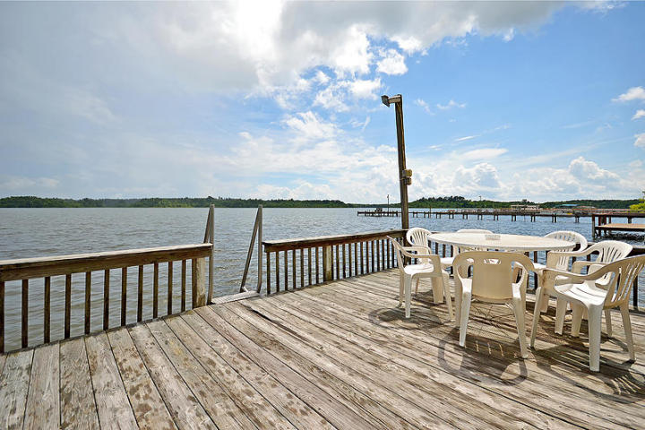
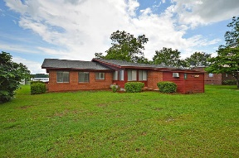
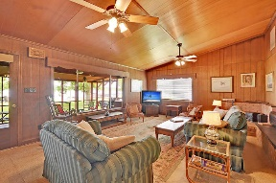
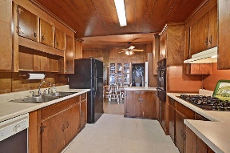
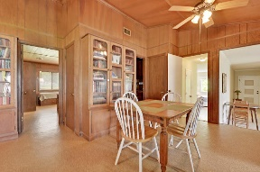
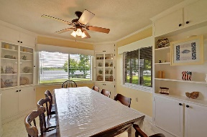
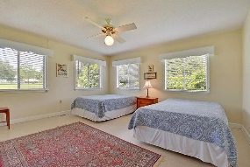
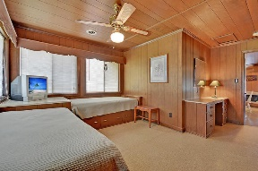
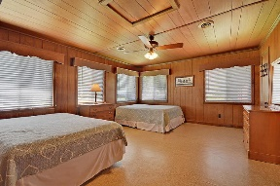
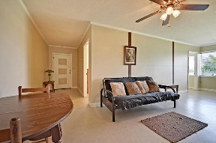
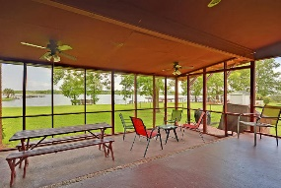
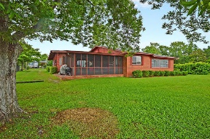
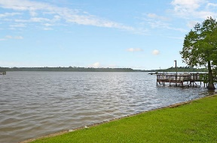


Lake Marion Lakefront - Sleeps 16!!!
1189 Holland Rd
Summerton, SC 29148
MLS# 18015704
$365,000
5 Bedrooms | 3½ Baths | 3,044 sf
Location, location, location!! Come live the good life on Lake Marion! And when you can't be there, rent it out! This lakefront beauty has a great rental history and has been in the same family since it was built! Located on Potato Creek across from the Santee National Wildlife Refuge, the stunning views and breeze off the water is sure to bring peace to your life! This large, quiet creek is perfect for water skiing, paddle boarding, and kayaking with its calm waters. Just around the wildlife refuge, a short boat ride away is the main lake. Like to fish? This is the place for you! A fisherman's paradise! The public boat ramp is right down the road and the dock out back has plenty of room to park at least two boats. The house is much larger than it appears!
This home offers 5 bedrooms, 3 full baths, one half bath and can sleep 16 people!!! This home is being sold fully furnished, so no need to buy a thing! Just add your personal touch! The screened in porch is very large and has great views of the lake. It also overlooks the huge backyard that is just waiting for a corn hole tournament, volleyball net or maybe a horseshoe pit! Inside the home, you'll find wood paneled walls throughout which gives this home a true lake house feel! The living room is a great size, but if you need even more space, there is a whole other living room on the other side of the home. The kitchen has ample storage, a gas cooktop, wall oven, a large eat in kitchen and off the kitchen there is a laundry room with more storage and an extra refrigerator! Through the kitchen, overlooking the lake, is a large dining room complete with built in corner china cabinets! The bedrooms in this home are very large. The first bedroom has two full size beds with access to a jack and jill bath. This bathroom connects to bedroom number two that offers twin beds with built in storage underneath and a desk area. The entire left side of the home can be separated by closing a door to offer people who stay on that side of the home privacy, three more additional bedrooms, (one with two full beds, one with two twin sized beds, and one with a full size) two full baths, an exterior door for their own access to the lake and a living room with a futon bed!! This is a chance to live on one of the prettiest locations on Lake Marion, have a rental property that rents for at least $1100 a week, and be a short 20-30 minute drive away from tons of restaurants and I-95! This home is a must see!!
Larry & Kathy Mazalatis
Larry Cell 843-693-0529
Kathy Cell 843-693-0159
Office 843-871-9133
AGENTOWNED PREMIERE GROUP | 1800 TROLLEY RD | SUMMERVILLE, SC 29485

