Slide 1


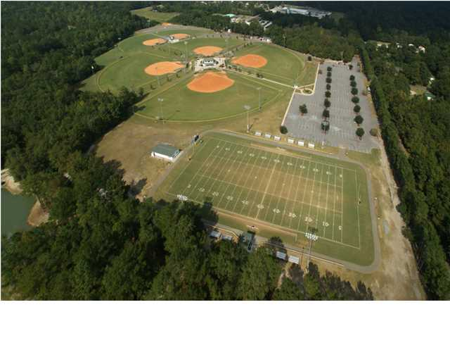
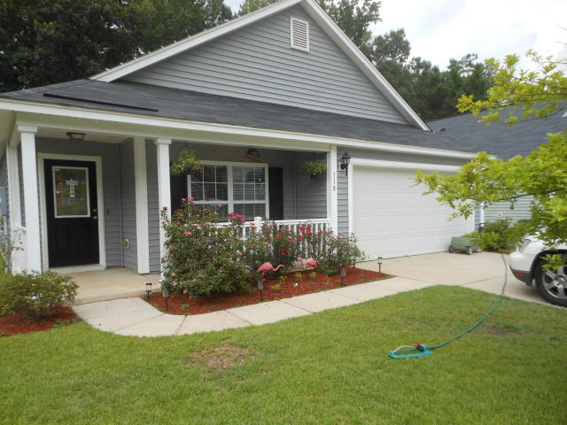
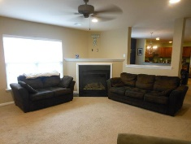
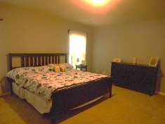
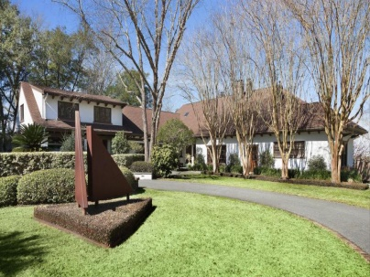
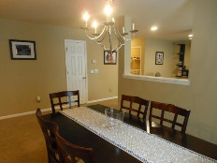
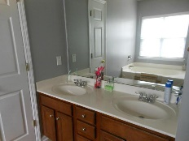
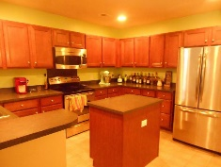
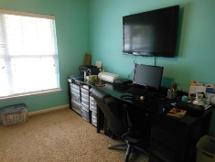
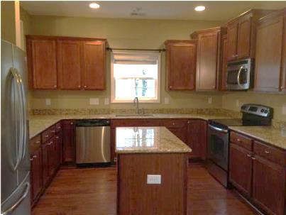
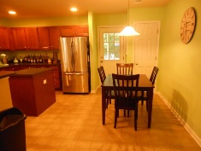
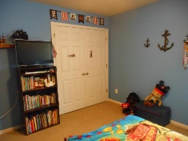
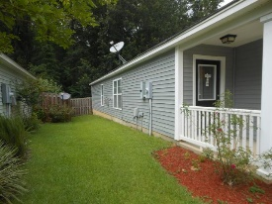
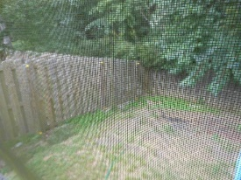
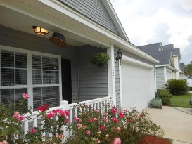

Jane Locke, Realtor
M (843) 819-3508
lockejaneb@aol.com
www.century21properties.com
Huge Price Reduction
118 Avalon Rd | Brookwood | Summerville | MLS# 15016683 | $173,700
Welcome to this quiet neighborhood and this spacious designed home. This is a one owner, well maintained home built with all the upgrades including maple cabinets with easy glide drawers and adjustable shelving in kitchen and bath, floor coverings, and lighting fixtures. Kitchen is a chef's dream kitchen with a center island, nice wide countertops, all stainless steel appliances. Home is freshly painted, ceiling fans in all bedrooms and family room. All utility outlet covers are in brushed nickel as are all faucets in kitchen and baths. There is a nice wooden privacy fence in back yard for your private backyard grilling. The Master Bedroom is huge with double sinks in master bath, built in shelving and cabinets in master closet. This home is move-in ready and waiting for you.
Century 21 Properties Plus | 3301 Salterbeck St Suite 100 | Mt. Pleasant, SC 29466

