Slide 1
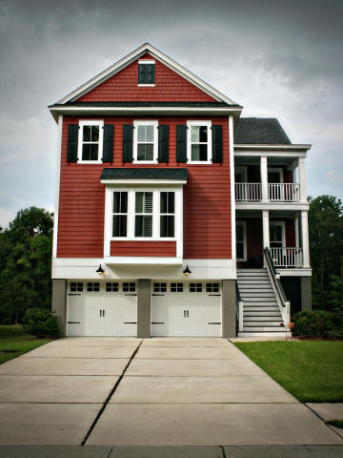
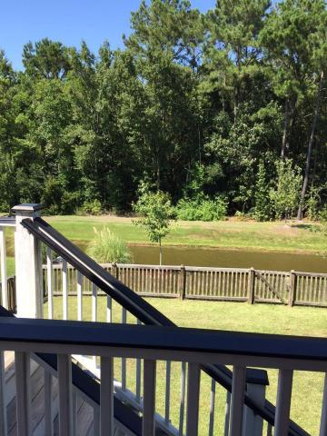
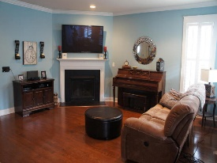
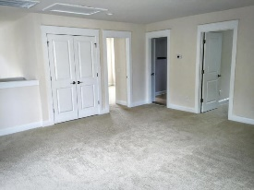
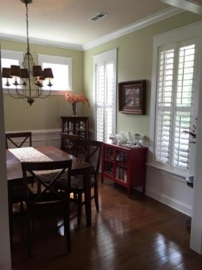
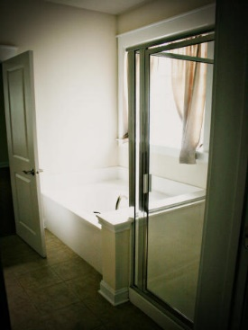
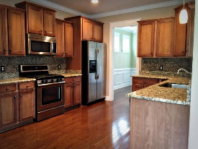
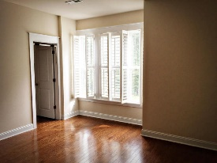
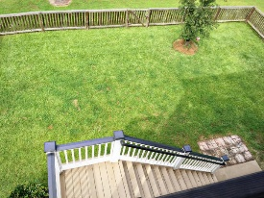
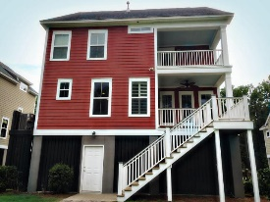

118 Clouter Creek Dr
Shellring at St Thomas Island
Daniel Island, SC 29492
MLS# 15022311
$469,900
Southern Charmer
Immaculate Charleston Style Home In SHELLRING. Shellring is a small, quiet, well laid out neighborhood adjacent to Daniel Island. This Charming home is on a short cul de sac. Owners suite on 1st, w/gas stove , granite in kitchen, hardwoods and tile flooring, 4 porches, gas FP, loft, gameroom, upgraded kitchen cabinets and Plantation Shutters.
If you love to boat, you will love the short drive to the full service marina with rack storage. drive under 2 car garage with room to store additional cars or a boat. Side Trail next to pool connects to Daniel Island School, Bishop England, Shopping, Restaurants, Fishing Pier, Park, and walking/jogging trails Buyer's closing costs are covered if you use our preferred lender.
Gerri Sandford
(843) 817-8762
gsandford29455@gmail.com

