Slide 1
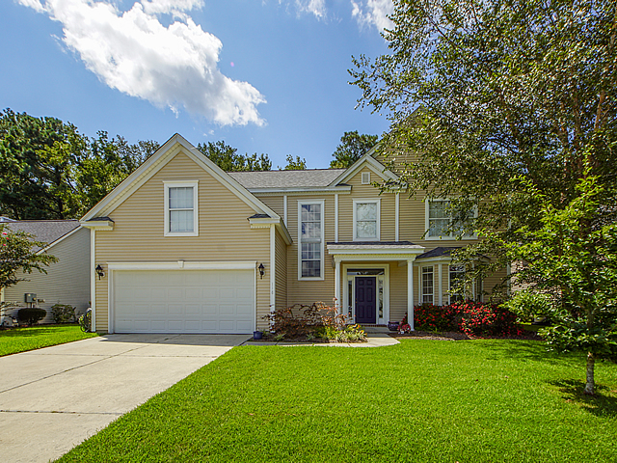
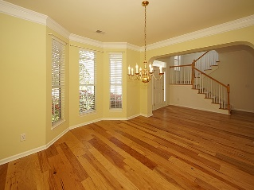
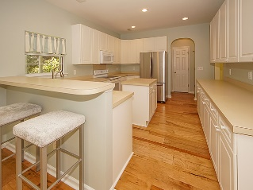
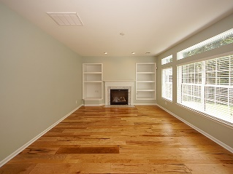
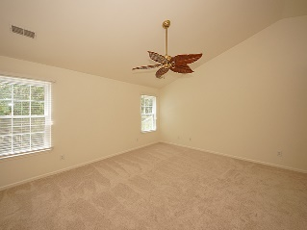
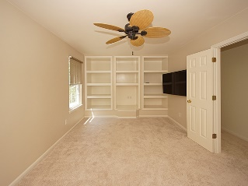
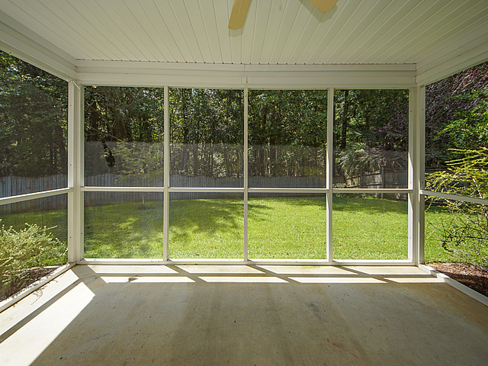
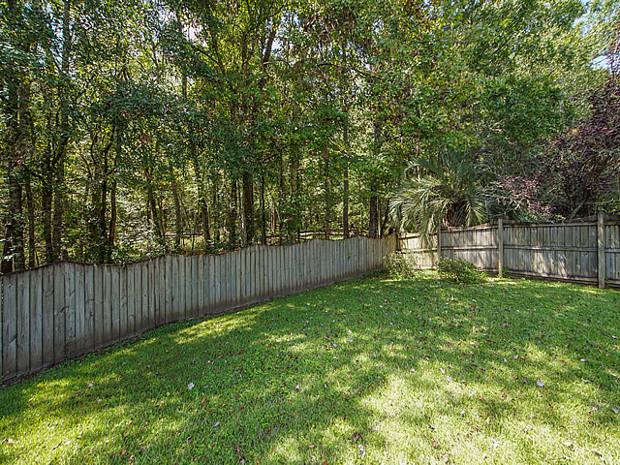

118 Corral Circle
Legend Oaks Plantation
Summerville, SC 29485
MLS# 20022760 ~ $319,900
4 Bedrooms | 2½ Baths | 2,472sf
New Price! Quick Close!
Quick close and ready to move in. Recently updated bright and light 4-bedroom 2.5 bath home in desirable Legend Oaks Plantation golf course community. Home features 4 bedrooms with one that can be used as an upstairs office or den. Beautiful new random plank hardwood floors throughout the lower level and new carpeting throughout the second floor. First floor features an entrance hall with hickory random plank hardwoods that opens to a formal dining room with crown molding. The large kitchen with breakfast bar (custom bar stools convey) and island with plenty of white cabinets and is open to a breakfast dining area with French doors leading to the screened porch. There is a brand-new dishwasher and built in microwave and the refrigerator, washer and dryer convey with the home. There is a brand-new dishwasher and built in microwave and the refrigerator, washer and dryer convey with the home.A bright family room with gas fireplace surrounded by built in bookcase, a half bath and laundry room complete the first floor. The stairs to the second floor have brand new carpeting and lead to French doors that open to the 4th bedroom or office / den. It is presently being used as a den and features one wall of built in bookcases. There is a wall mounted 55-inch smart TV that conveys with the home in this room. Down the hall is the large master bedroom which is big enough for a sitting area and has a vaulted ceiling and a private bathroom. The master bath with new tile floor has two separate vanities with sinks, a soak tub and a shower stall and toilet. A large walk in closet is connected to the bath. The remainder of the second floor consist of two other good size bedrooms and another full bath with tub. This home sits on a quiet street and the yard backs up to a beautiful wet land forest. Nothing behind except beautiful woods . Legend Oaks Plantation is a desirable community and is home to the championship 18-hole Scott Poole golf course, which was named 2010 Golf Course of the Year by the South Carolina Golf Course Owners Association. Wildlife inhabitants, 300-year-old majestic Live Oak trees, towering pines, and various ponds are just a few highlights adorning this wonderful area, which was once a rice plantation. Amenities include a junior Olympic pool, four tennis courts, and a clubhouse, with a variety of membership options available. It is situated in the Dorchester 2 school district and Beach Hill elementary is across the street from the development entrance. This exceptionally well-maintained home is available for a quick settlement and move in.
The owner of this property is a real estate broker.
Bill Milo
843-412-0052
williampetermilo@gmail.com
www.bnre.info
Brand Name Real Estate
4 Carriage Lane Suite 106
Charleston, SC 29407

