Slide 1
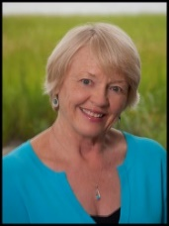
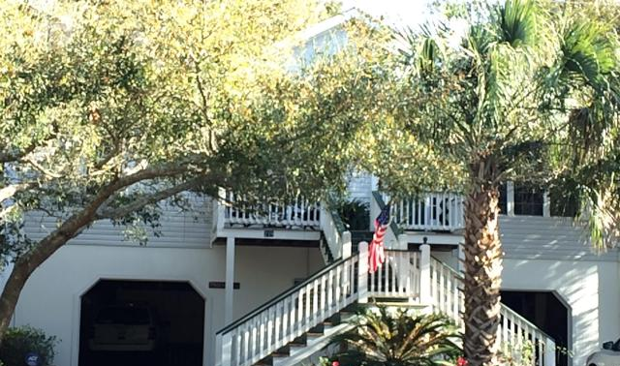
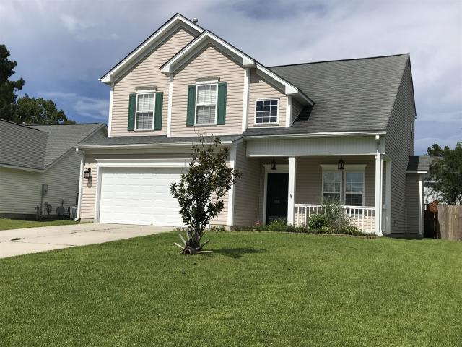
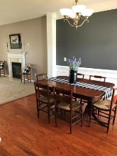
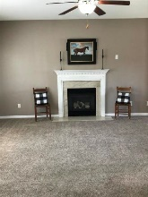
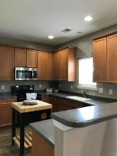
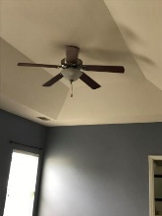
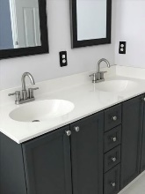
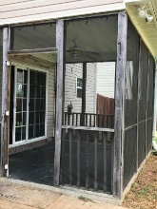
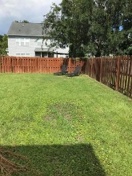
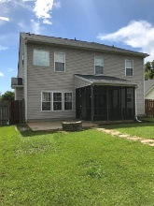

Jane Locke, Realtor
M (843) 819-3508
lockejaneb@aol.com
www.century21properties.com
Welcome To Your Immaculately Maintained Plum Creek Home!
118 Corrientes Court | Summerville, SC 29483 | MLS# 20020646 | $256,000
DRAFT
This home has lovely wood floors, ceiling fans in every room. Gourmet kitchen has Corian counter tops, maple cabinets, stainless steel appliances, brushed nickel fixtures, even has two pantries. Has a gas fireplace, plantation blinds. Home even has metal hurricane shutters for all windows, Generous sized bedrooms. MBR has try ceiling and extra-large walk-in closet. On a cul-de-sac. Screened porch overlooking pool after long day's work. Walking distance to schools. Minutes to downtown and I-26.
Century 21 Properties Plus | 1090 Park West Blvd, Suite 3 | Mount Pleasant, SC 29466

