Slide 1
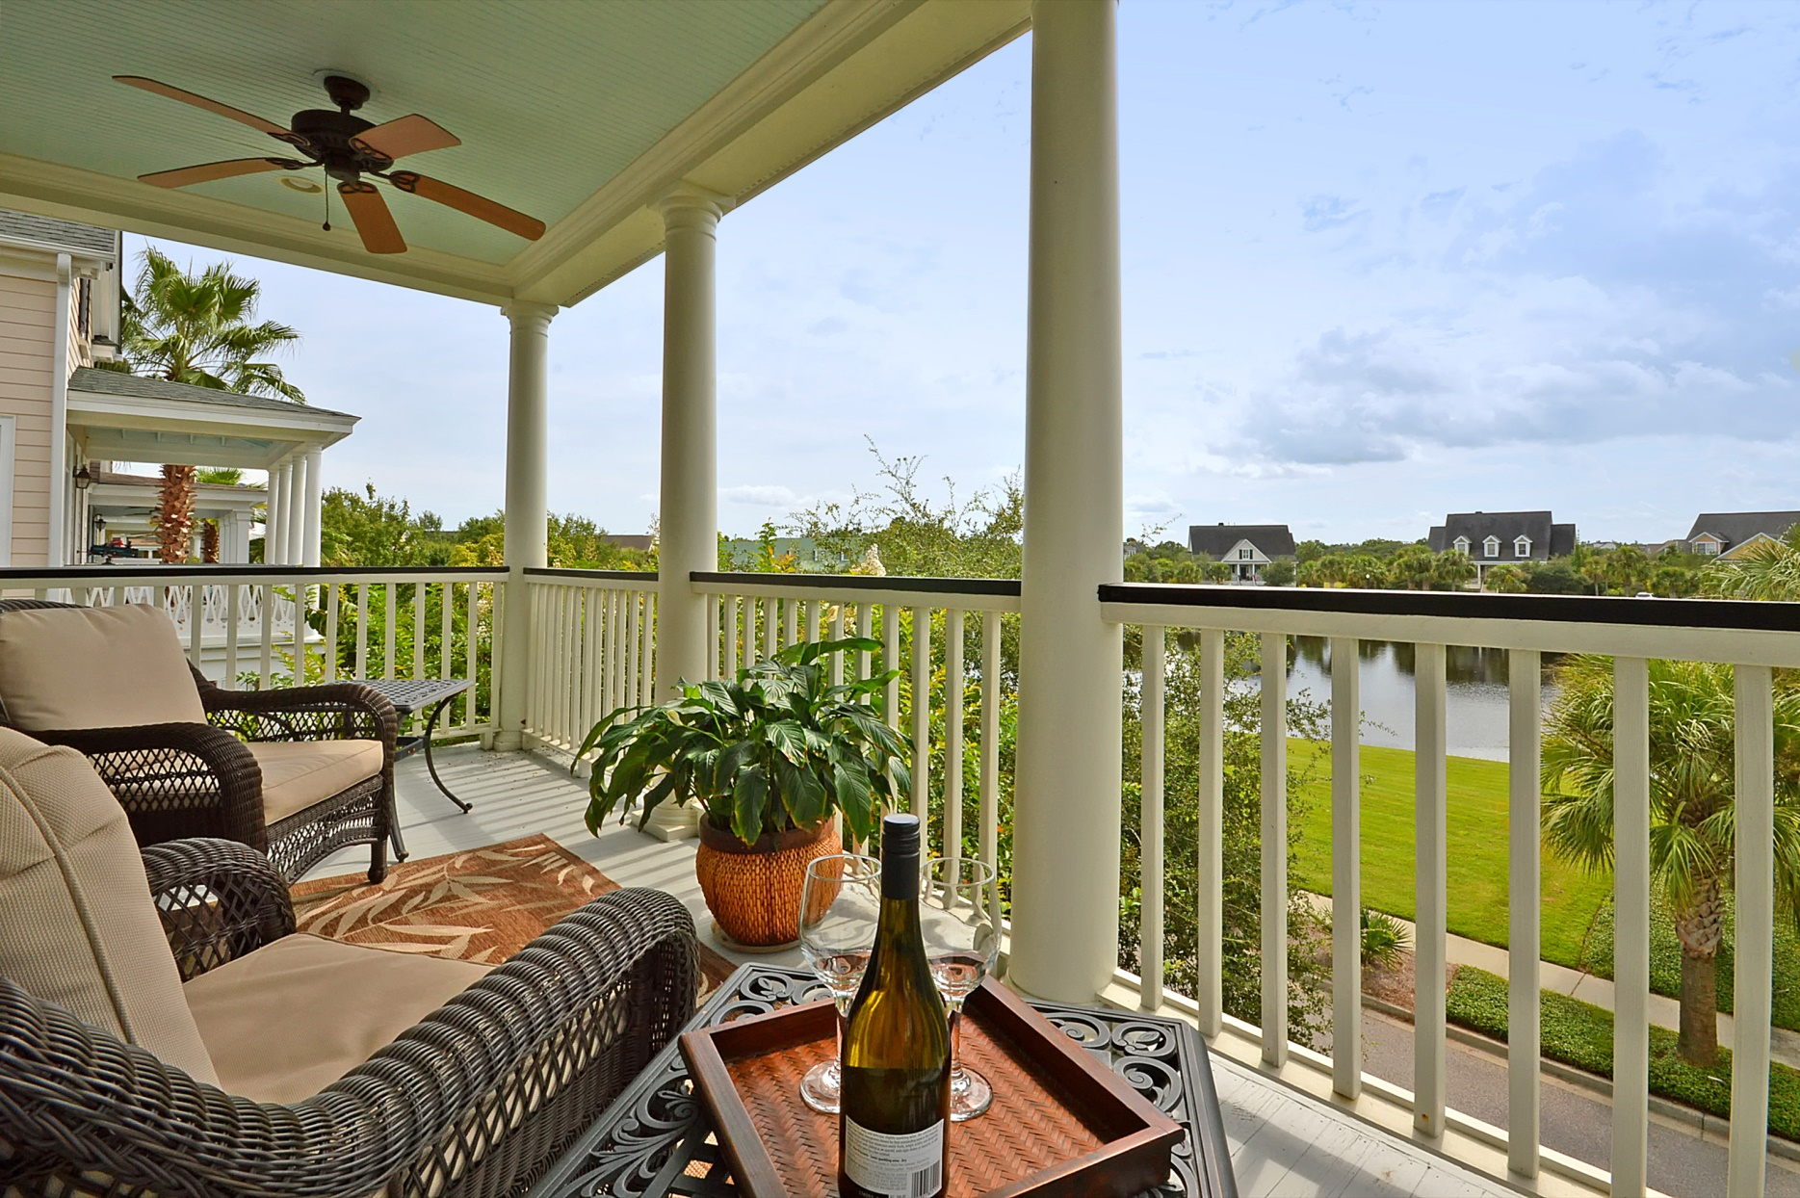
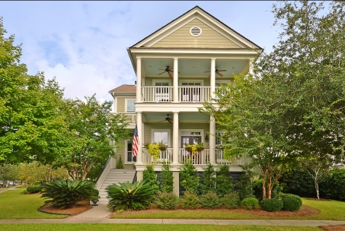
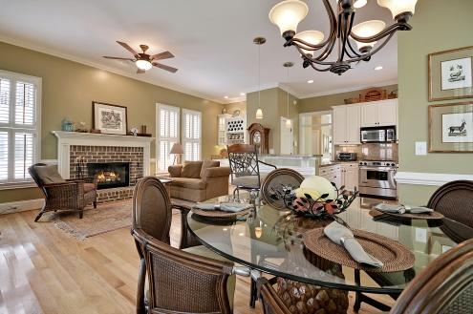
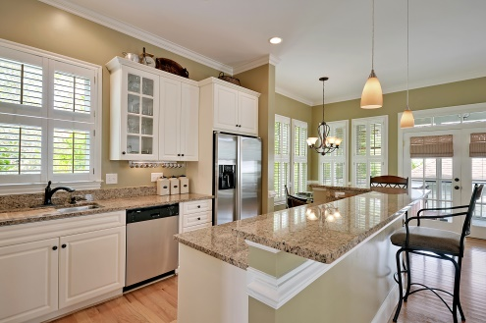
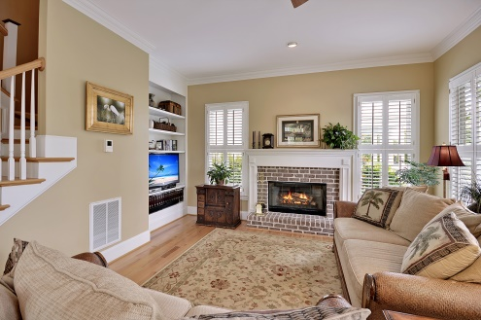
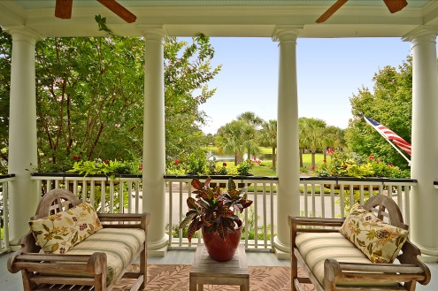
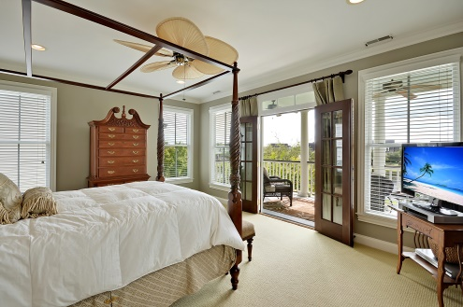
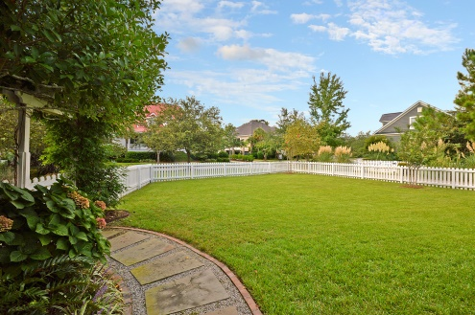
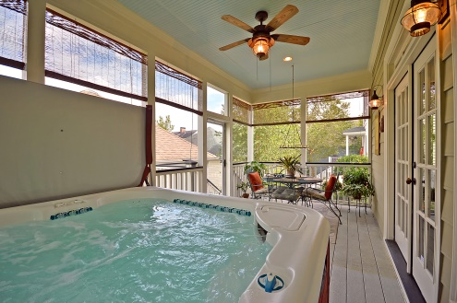
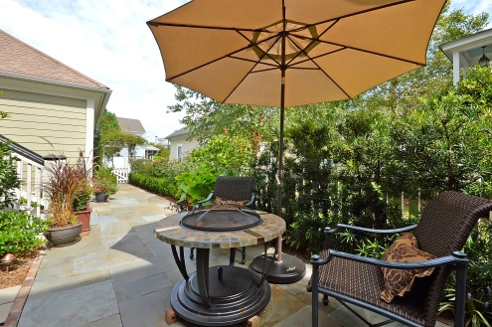

Daniel Island Luxury
Parkshore Marshfront
118 Currier St ~ Charleston ~ MLS# 1424757 ~ $629,000
This unbelievable Charleston Single style home on Daniel Island offers three bedrooms, three baths and a two car garage while sitting on a prime lot in Codners Ferry Park. With two covered piazza and a screened-in porch, there's plenty of options to experience the outdoors. You can watch the dog run in the fenced-in backyard and have a drink on the bluestone porch around the fire pit or enjoy peaceful views of the water from the second story piazza. A lush lawn and well manicured landscaping leads up to the beautiful entry. Step inside to find gleaming hardwood floors, high ceilings, crown molding, plantation shutters and 2,339 square feet of living area. The open concept floor plan reveals an inviting living room with a fireplace, built-ins and a patio. The formal dining room has plenty of room for entertaining on holidays and features wainscoting and chair rail molding. The eat-in kitchen is simply stunning with granite counters, undermount lighting, a breakfast bar, built-in wine cooler, stainless steel appliances, a Jenn-Air range (dual convection electric oven with gas cooktop burners), and recessed lighting. This culinary delight opens to the family room with another fireplace and brick surround. French doors here lead to the screened-in rear porch where you can unwind and enjoy a relaxing soak in the hot tub. Upstairs the owner's retreat boasts custom his and her walk-in closets, en-suite bath with dual vanities, walk-in shower, a jetted tub and access to the most relaxing spot in the home...the second story piazza with views of the water. This is a view that you'll never grow tired of waking up to. Other highlights and upgrades to this home include: a new tankless hotwater heater, new HVAC system (gas with electric supplemental), a security system, fiberglass doors to the garage, a separate irrigation meter, upgraded fans and added attic insulation. As a part of Codners Ferry Park you'll have full access to the community pool, playground and boat ramp. This home shows like a model and is waiting for you!
Call or email for details: (843) 654-7777 or Ben@MattOneillTeam.com

