Slide 1

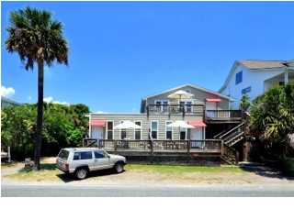
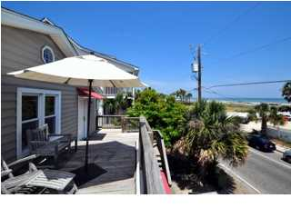
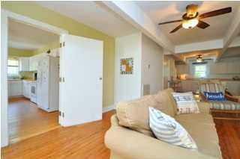
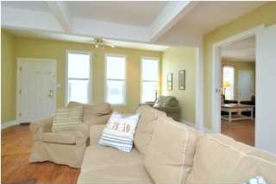
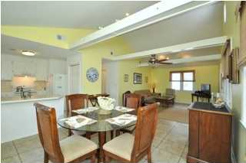
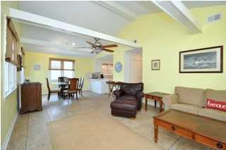
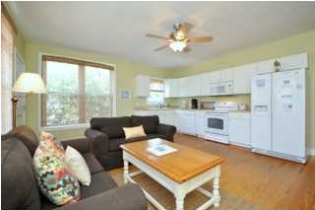
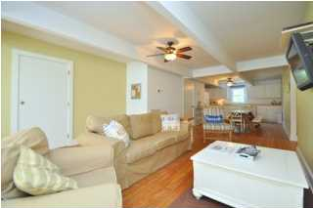
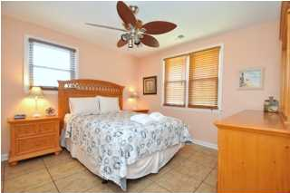
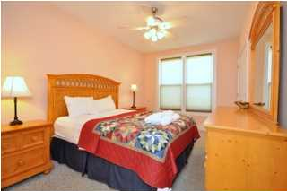
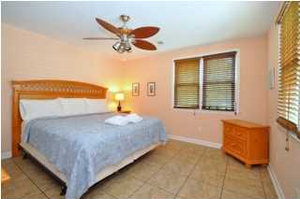
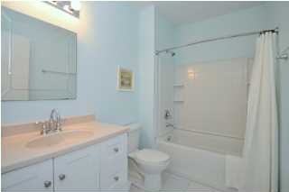
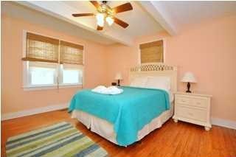
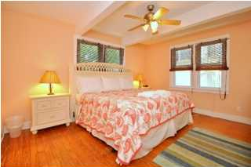
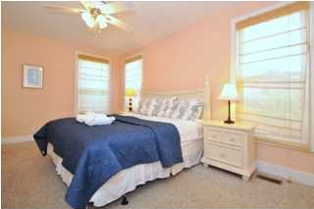
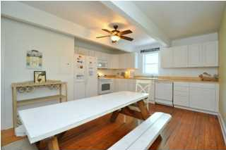
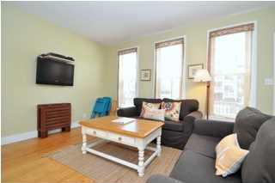
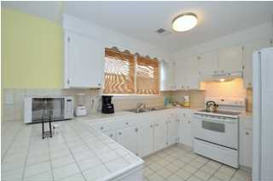

Multi-Family Folly Beach Rental For Sale
118 E. Artic Ave
Folly Beach - MLS# 1409064 - $899,900
Three apartments - ***Zoned C-2 Commercial/Resort Mixed Use***. One 2-bedroom apartment and Two 1-bedroom apartments. Some off-street parking. Rented through "My Ocean Rental" "la Casa Atlantica" daily/weekly rental program. This property is close to the center street shopping and restaurants and direct beach access across the street. **Unit C: This is the largest of three units that is alone on the top level with 2 Bedrooms, 2-Full Baths. (Sleeps 4) private deck upstairs. Private Outdoor Shower that is shared with the other two units on the first floor that has both Hot and Cold water. There is also access to a rare back yard from this unit only. Washer and Dryer. Bedroom 1: KING. TV Bedroom 2: QUEEN. Living: Flat Screen TV** ** Unit B: Is a 2-Bedroom, 1-Full Bath unit. Sleeps 5. Fully equipped kitchen - with a deck out front, washer and dryer. Bedroom 1: KING. Flat Screen TV Bedroom 2: QUEEN. Living: Pull-out Love Seat. Flat Screen TV This unit can be combined with unit A next door to make one 4 Bed, 2-Bath unit.** **Unit A: Is a 2-Bed, 1-Full Bath unit. (Sleeps 4). Fully equipped kitchen, with deck out front. Bedroom 1: KING. Flat Screen TV, Bedroom 2: QUEEN. Living: Flat Screen TV/DVD.** ALL FURNITURE, FIXTURES AND APPLIANCES CONVEY
Steve Radekopf
843-514-0761 cell
Steve@Radekopf.com
Andrew Tackitt
843-437-8726 cell
Andrew@Radekopf.com
1205 Two Island Court, Suite 201 | Mt Pleasant, SC 29466 | Phone: (843) 579.2217 | Fax: (843) 971-0281

