Slide 1
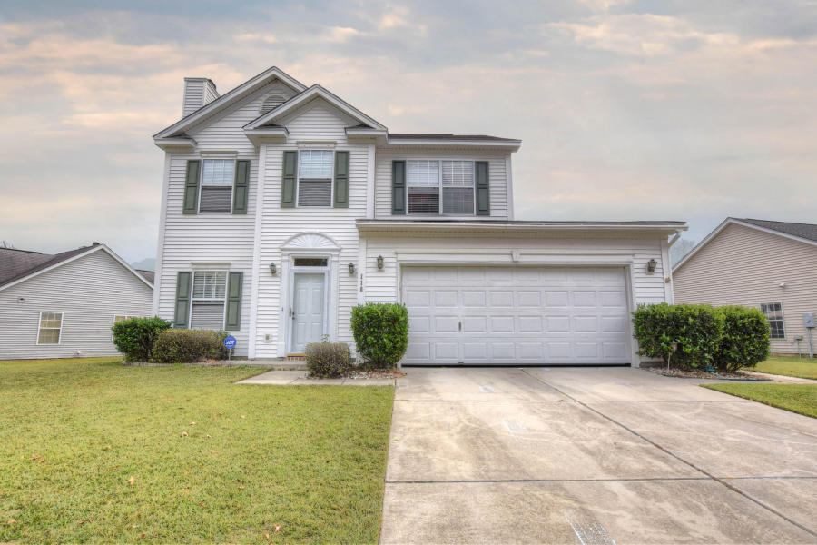
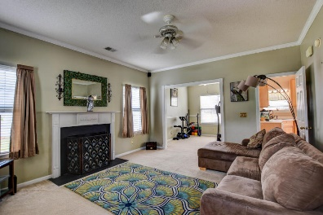
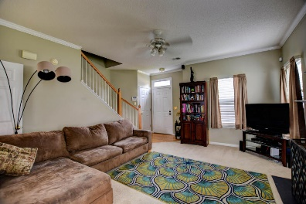
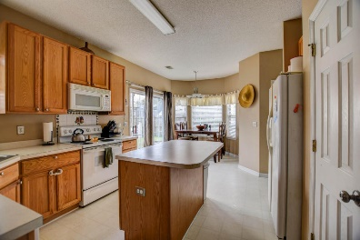
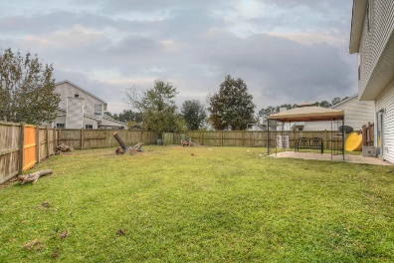


Wonderful Home …Easy Living
118 Hearthstone Circle
Crowfield Plantation · Goose Creek MLS# 16028962 · $196,000
3 Bedrooms · 2.5 baths · 1,586 sqft
Desirable Crowfield Plantation, established neighborhood, amenities, walking and jogging trails and convenient location to shopping, bases and schools, for under $200K! 3 bed, 2.5 bath home with wood burning fireplace. Living room, separate dining and eat-in kitchen with bay window. Large fenced in back yard. Seller offering a $1500 redecorating allowance to buyer at closing. Come see this delightful home and make it your own before it's gone. Tree stumps in the backyard are scheduled for removal.
Rochelle Rennert
(843) 847-9694
rynoroch@gmail.com
www.RochelleSellsCharleston.com
AgentOwned Premiere Group
100 Crowfield Blvd
Goose Creek, SC 29445 Real Estate ● Mortgage Insurance ● Business Brokerage

